Slide 1
OUTDOOR WIRELESS PROJECT
University of Colorado Colorado Springs

Slide 2
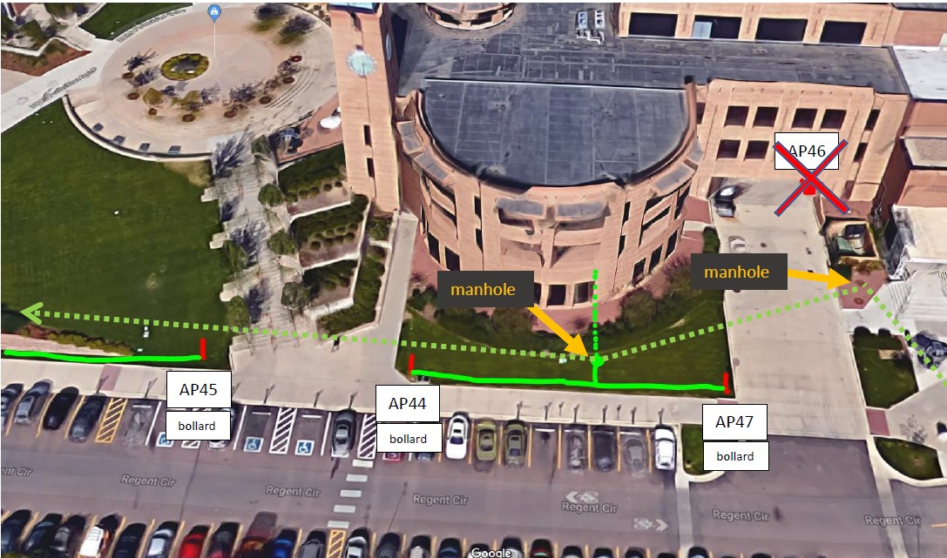
Goals of the Project
Increase wireless coverage outdoors
along the main pedestrian spine and
highly trafficked areas.
Outdoor AP count prior to
this project: 23
  Mostly on new and recent
  construction, and most of
  these were not near main
  campus where high traffic
  is located

Slide 3
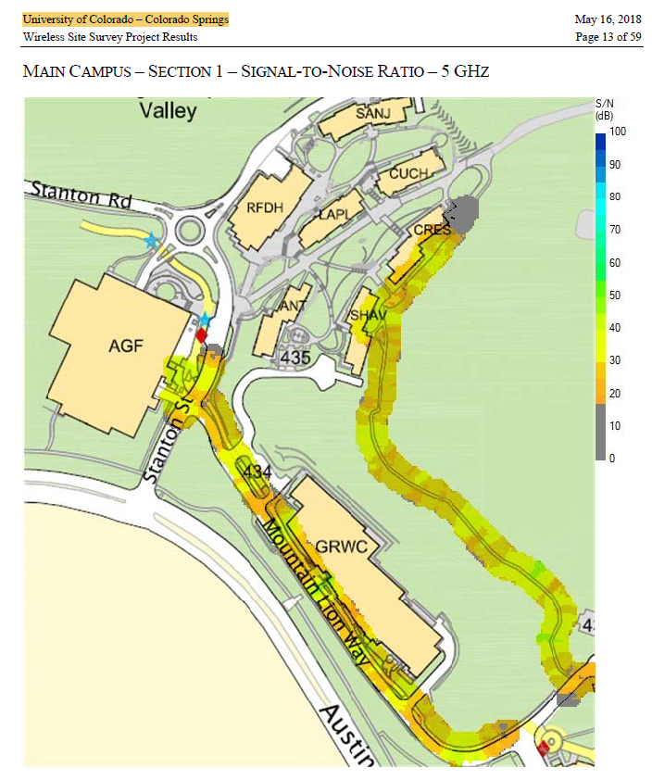
Initial Planning
Planning and early talks
began in Fall of 2017
Full site survey in April 2018
  CDW engineers came on site and surveyed all proposed areas
  Simulated with Aruba AP 365, 367 & 324 series
  Worked within following parameters…
    2.4 and 5 ghz bands, No UNII-1 bands
    Max transmit power of 25mW
    Min signal strength of -72
    10% coverage overlap

Slide 4
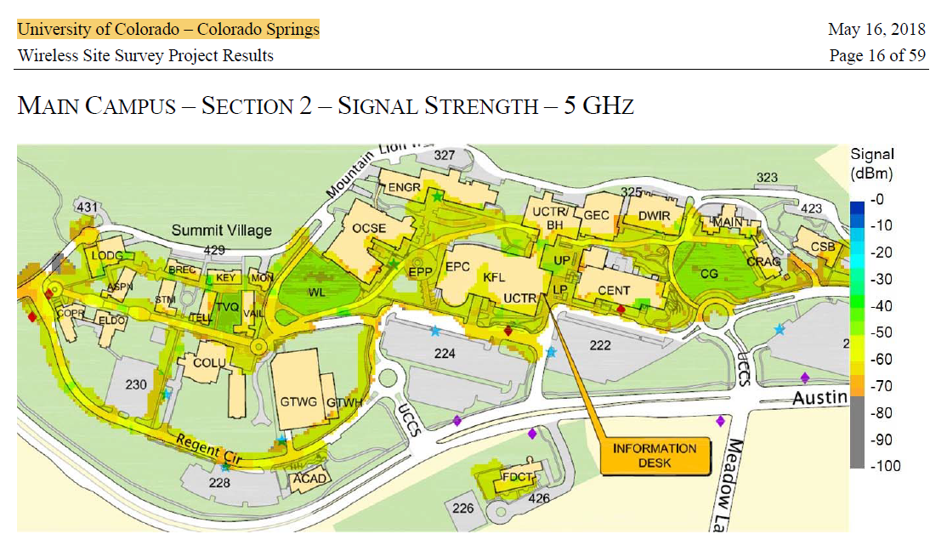
Initial Planning
The original proposal:
  122 new outdoor APs
  This included east, central
  and west campus
So… What did that look like???

Slide 5
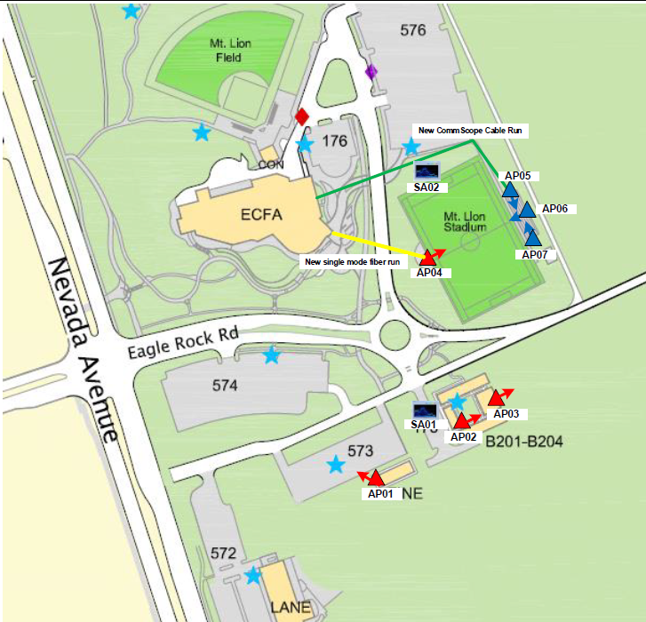
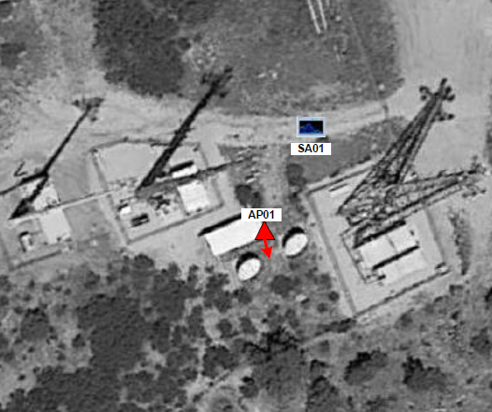
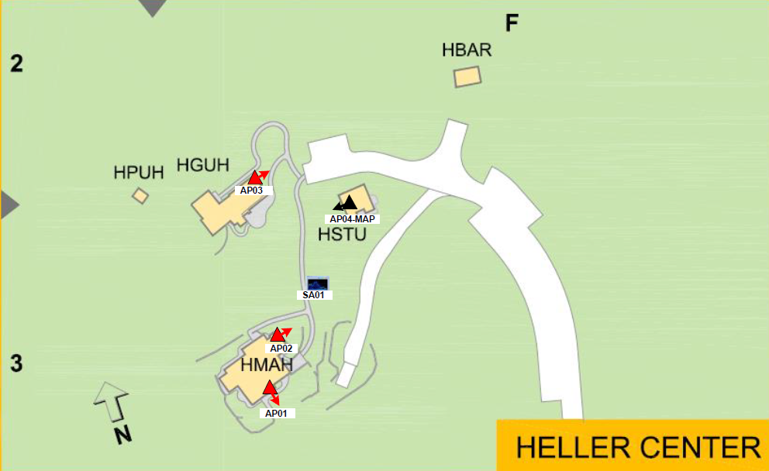
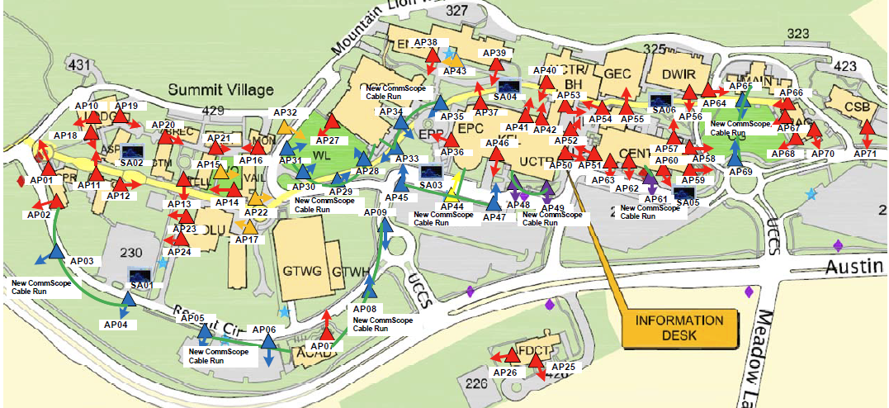
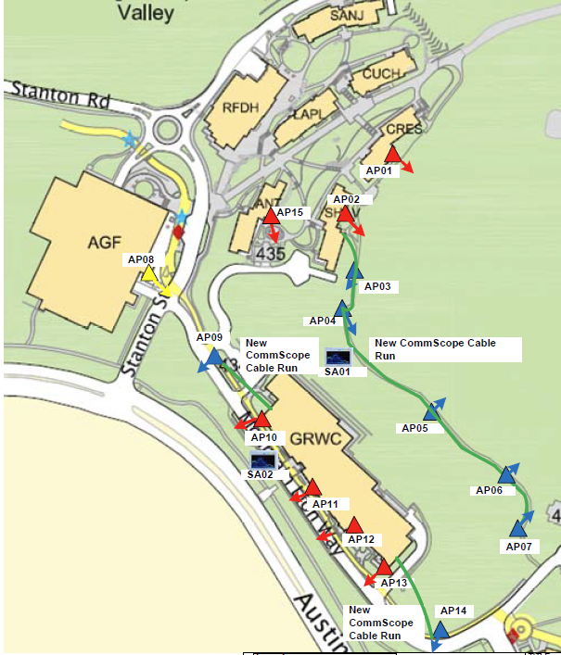
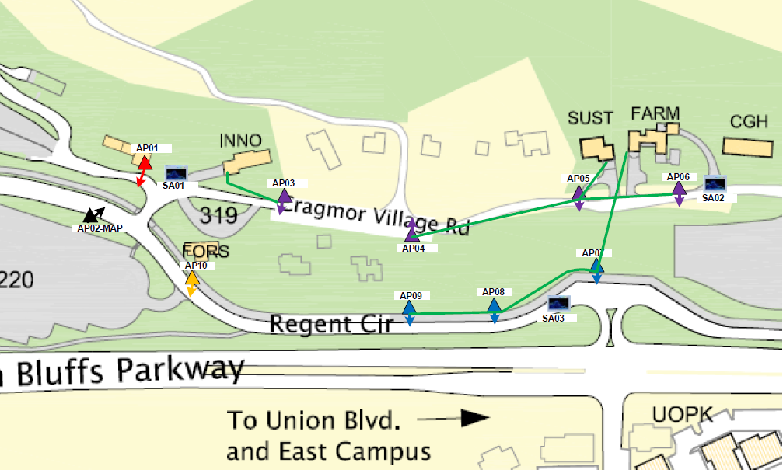
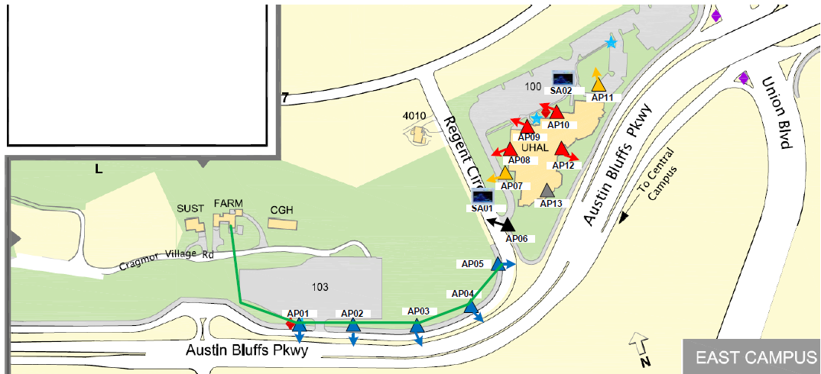
122 new APs meant…
A lot of new APs
A lot of new construction
High cost $$$$$$$$
Higher costs for some APs in areas where they would get minimal use.

Slide 6
THE initial plan
(had a lot going on)
  Campus APs and Mesh APs
  Some APs were remote to the main campus
  CAT6a runs and Powered Fiber runs
  Did we have conduit and innerduct space? (both indoor and outdoor)
  Powered Fiber hardware
  How to run the cabling to various locations?
    Light poles? Bollards? Digging, trenching, boring, etc. A lot of construction!
  Switchport availability for 122 new APs?!

Slide 7
What we knew…
  We liked the idea of all the proposed coverage
  We did not like the price tag for all of the proposed coverage
  We needed to balance cost vs. use

Slide 8
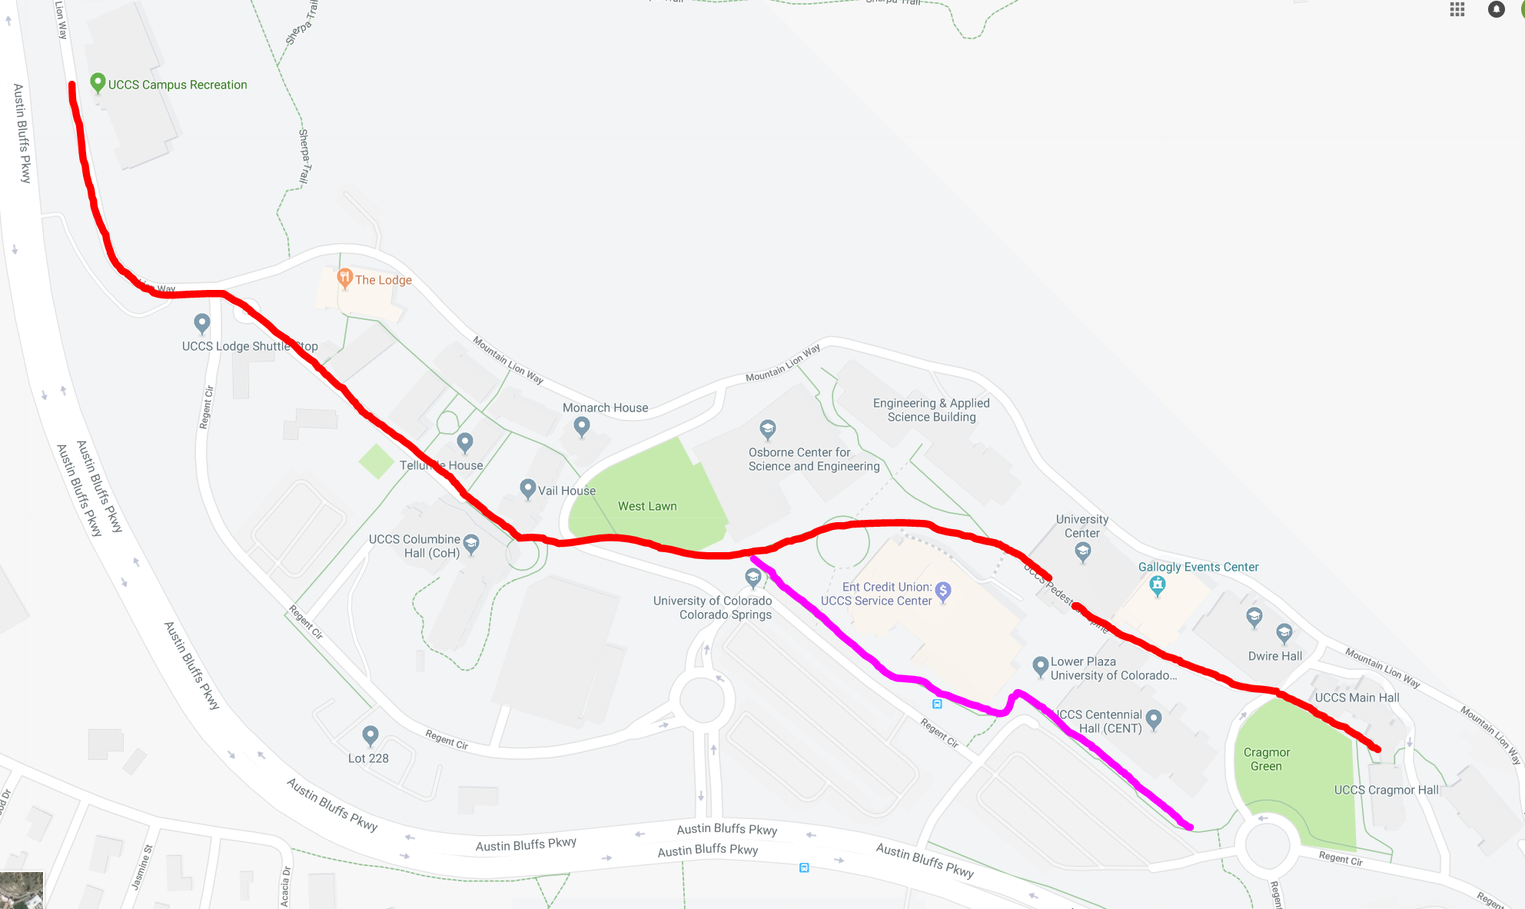
The revised Plan
Phase 1
Break it down into phases
  Phase 1 – Pedestrian Spine
    Cover most highly
    trafficked areas first
    Reduced scope to 40 APs
    (cut out 82 APs)
  Phase 2 and 3
    If funded in the future…
    Expand to more areas
    Fill in the gaps
    Keep up with campus
    expansion

Slide 9
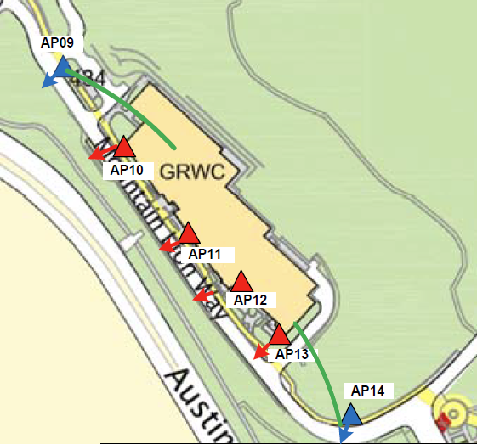
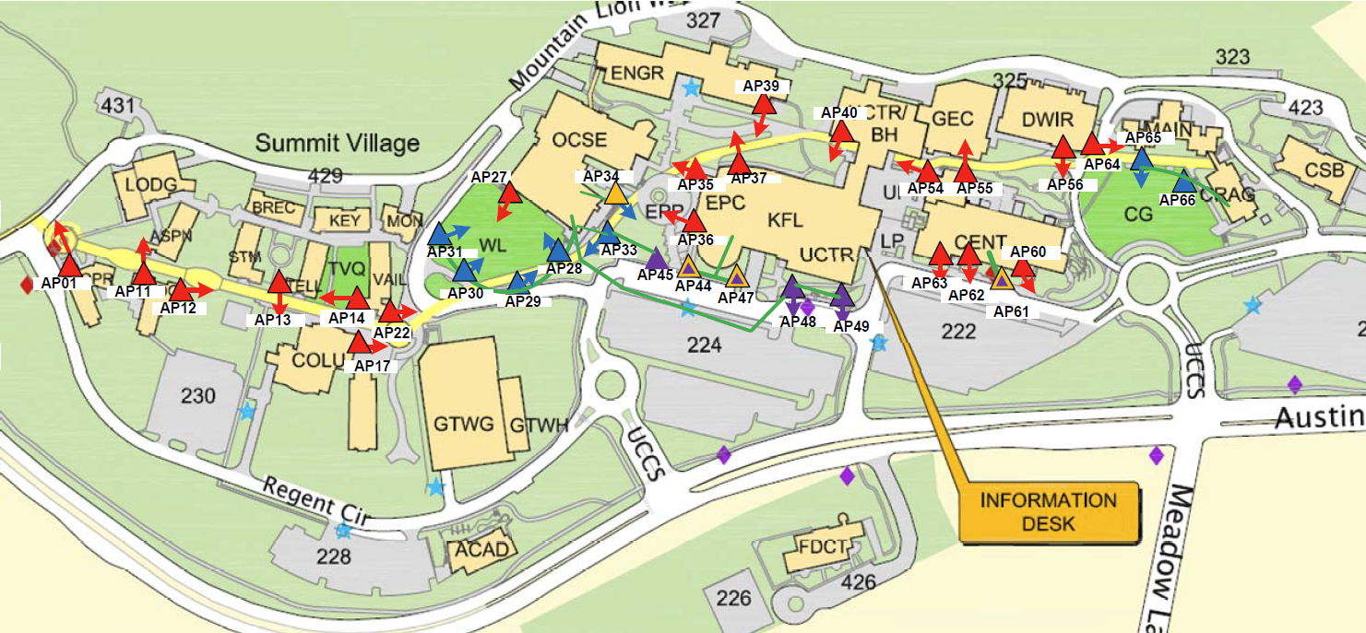
The Revised Plan
40 new outdoor APs
Focus on the pedestrian spine through central campus

Slide 10
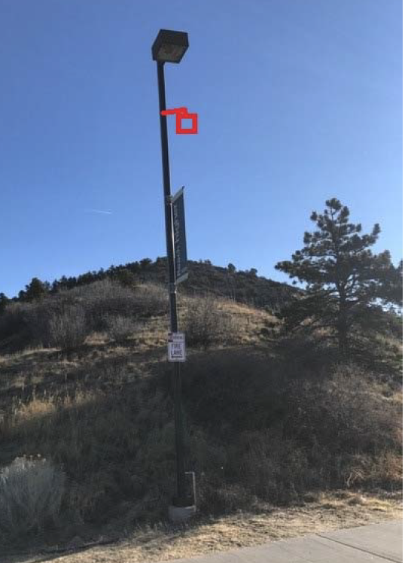
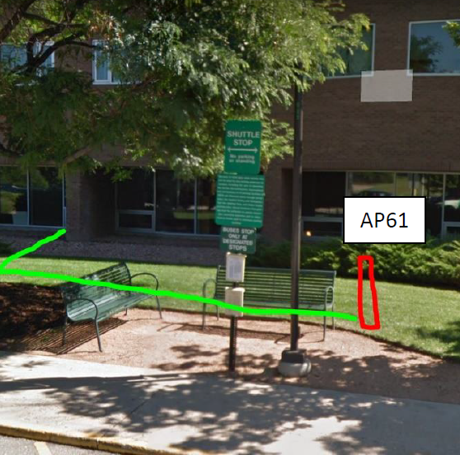
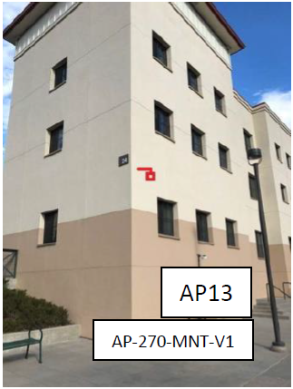
The Implementation
10 Light Pole mounts
6 Bollards
24 Building mounts

Slide 11
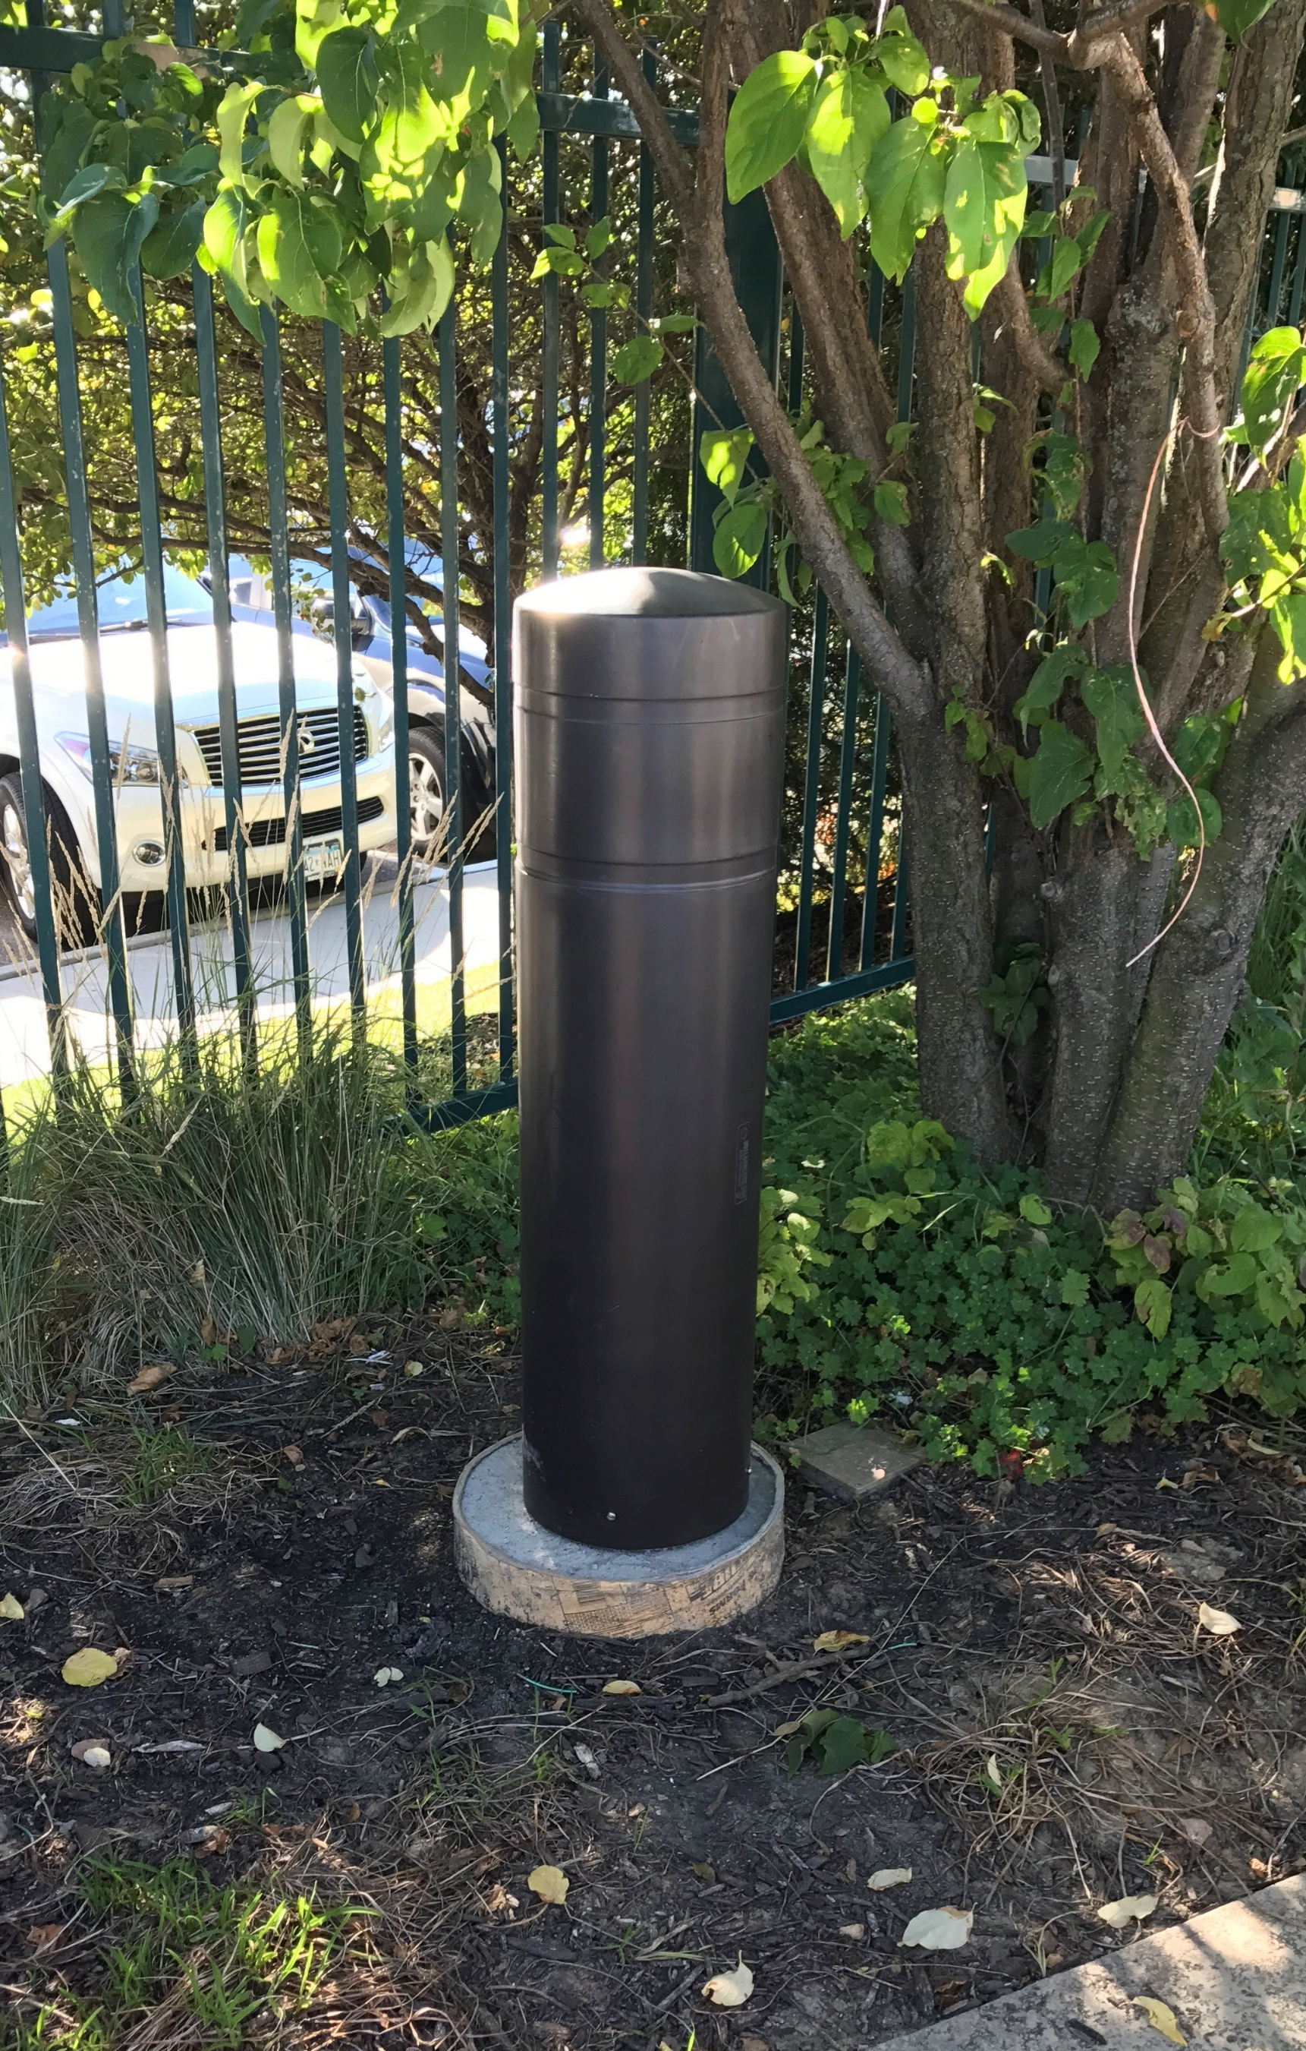
The Hurdles
AccelTex
Bollards
  We wanted to match current bollards on campus
  Many current options are very large
  We found most…
    Too large for our needs
    Aesthetically different from our needs
The right height,
but too wide.

Slide 12
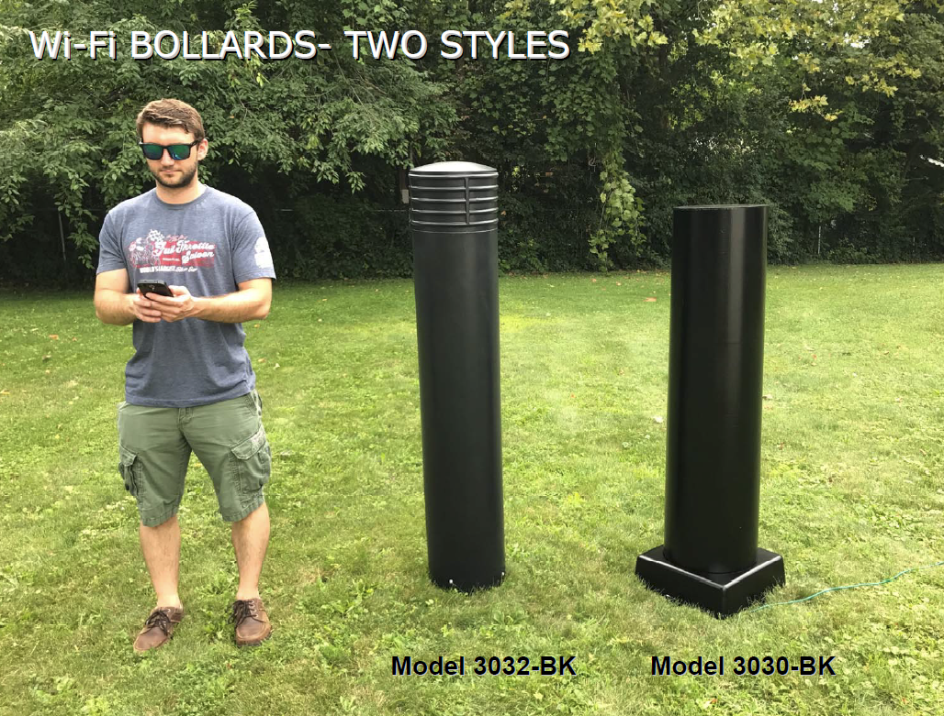
Oberon
Although these can house the AP and antenna…
They are way too big for our taste!

Slide 13
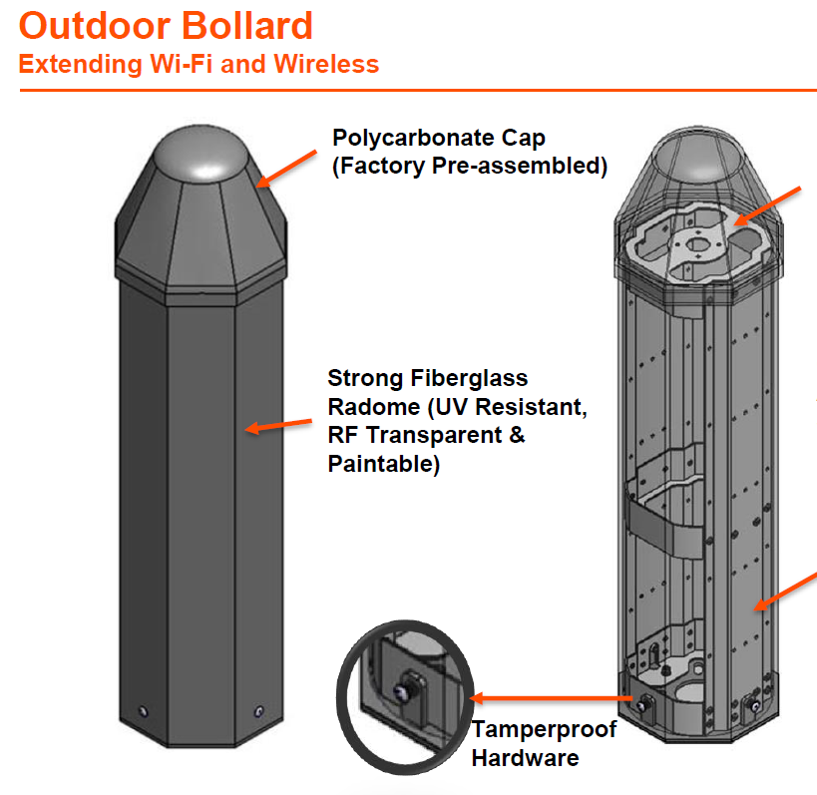
This solution was also very large and aesthetically unpleasing…
We called it
“The Missile.”
Again, this was not going to work for our solution.
Ventev

Slide 14
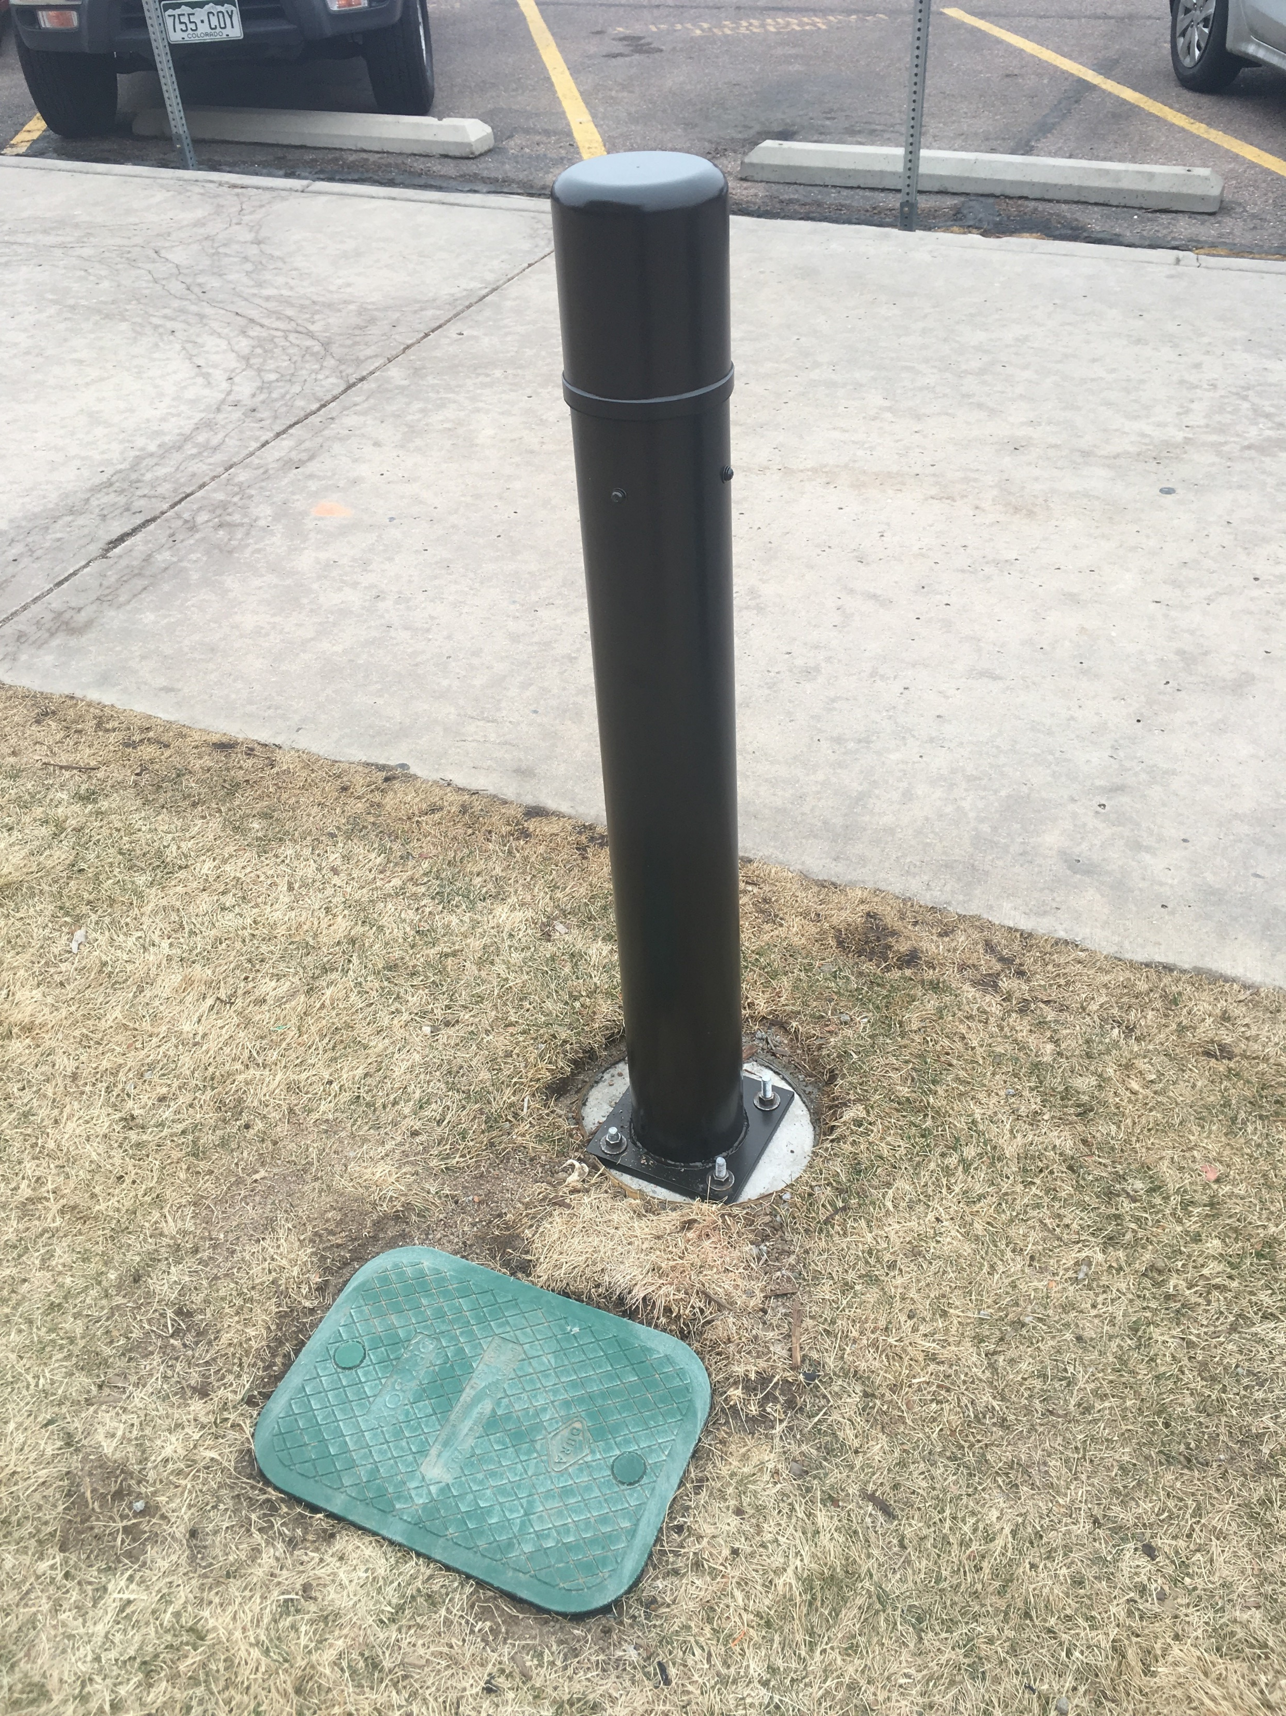
Bollards
Custom solution was needed
  We needed a 6-7” wide pipe
  Which meant AP couldn’t go inside
  Pipe had to accommodate our antenna
  Antenna needed to work with our AP
  AP needed to handle cold weather
  Dry box located adjacent to bollard to enclose….
    AP
    Antenna cables
    Lightening Suppressors
    Grounding rod and grounding wires

Slide 15
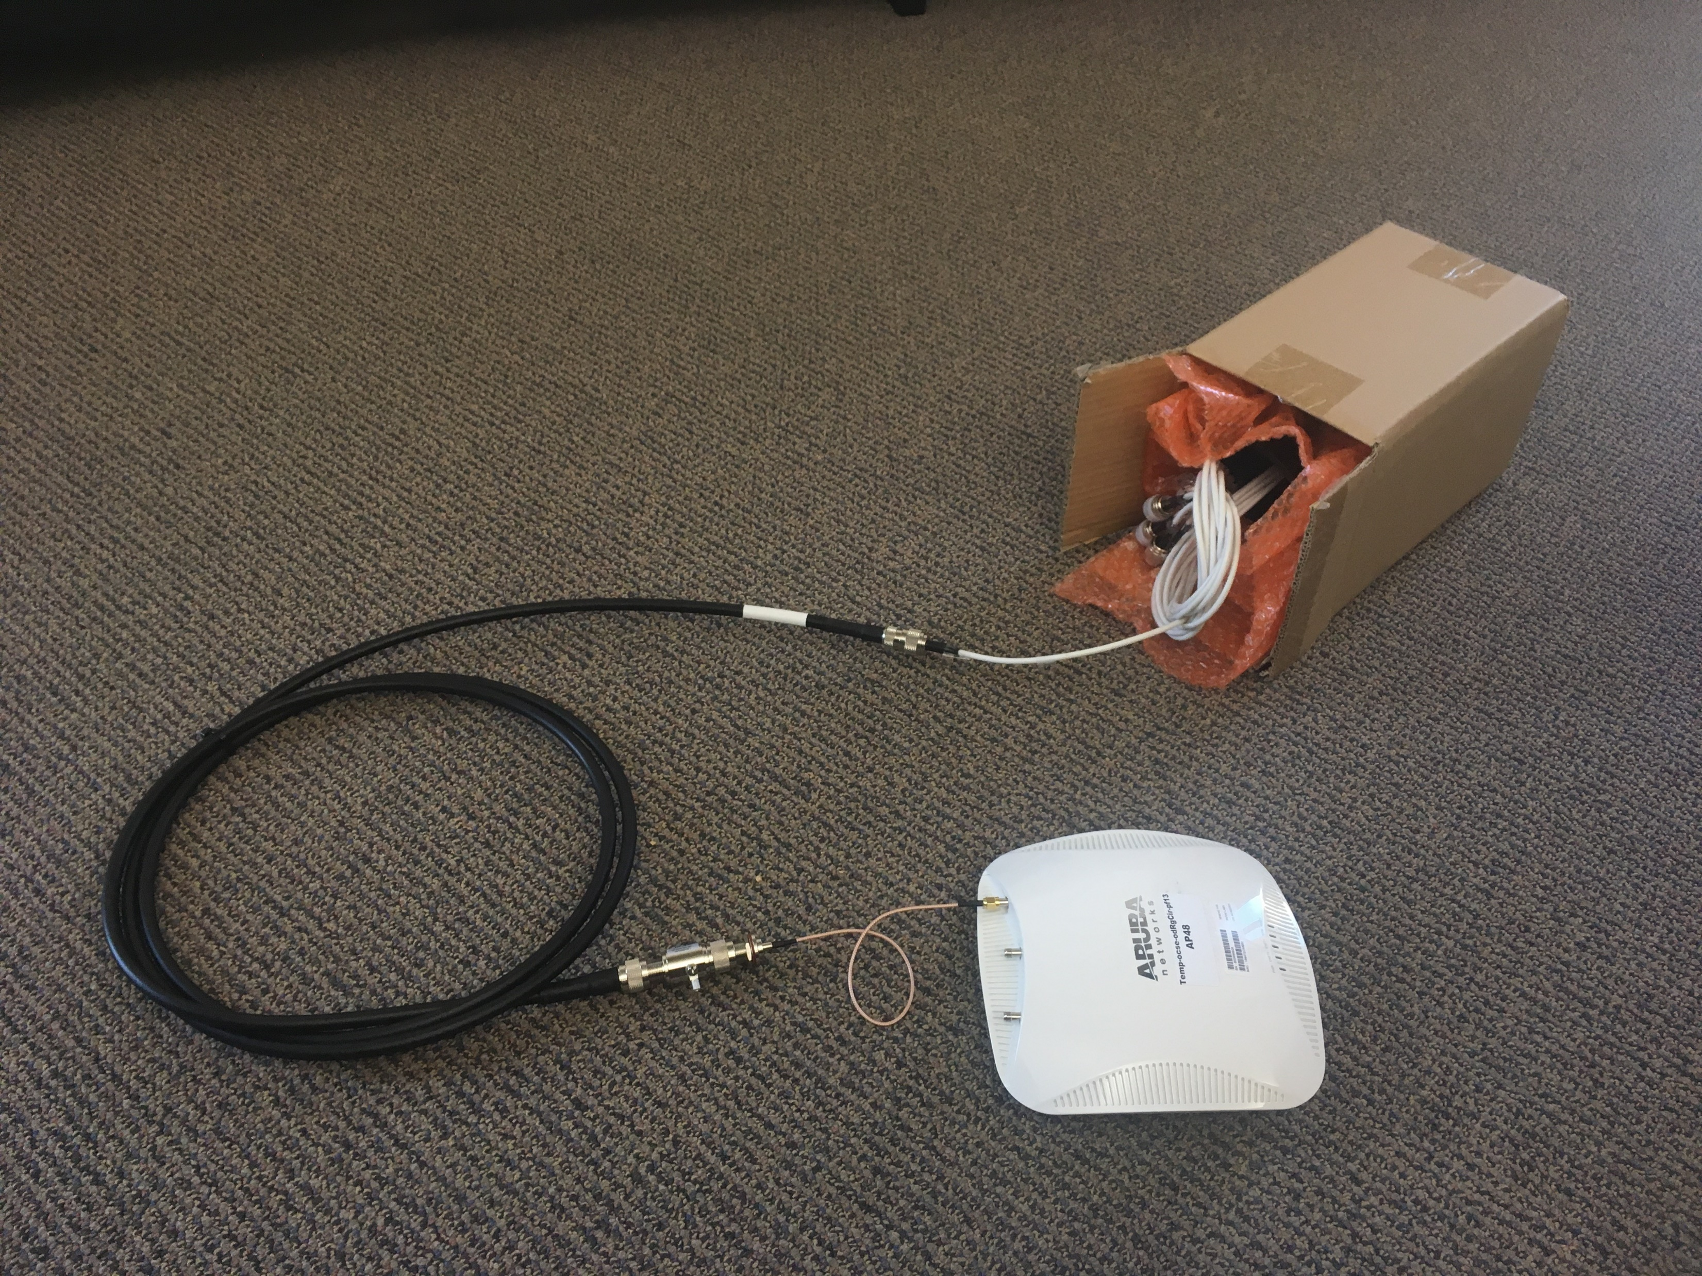
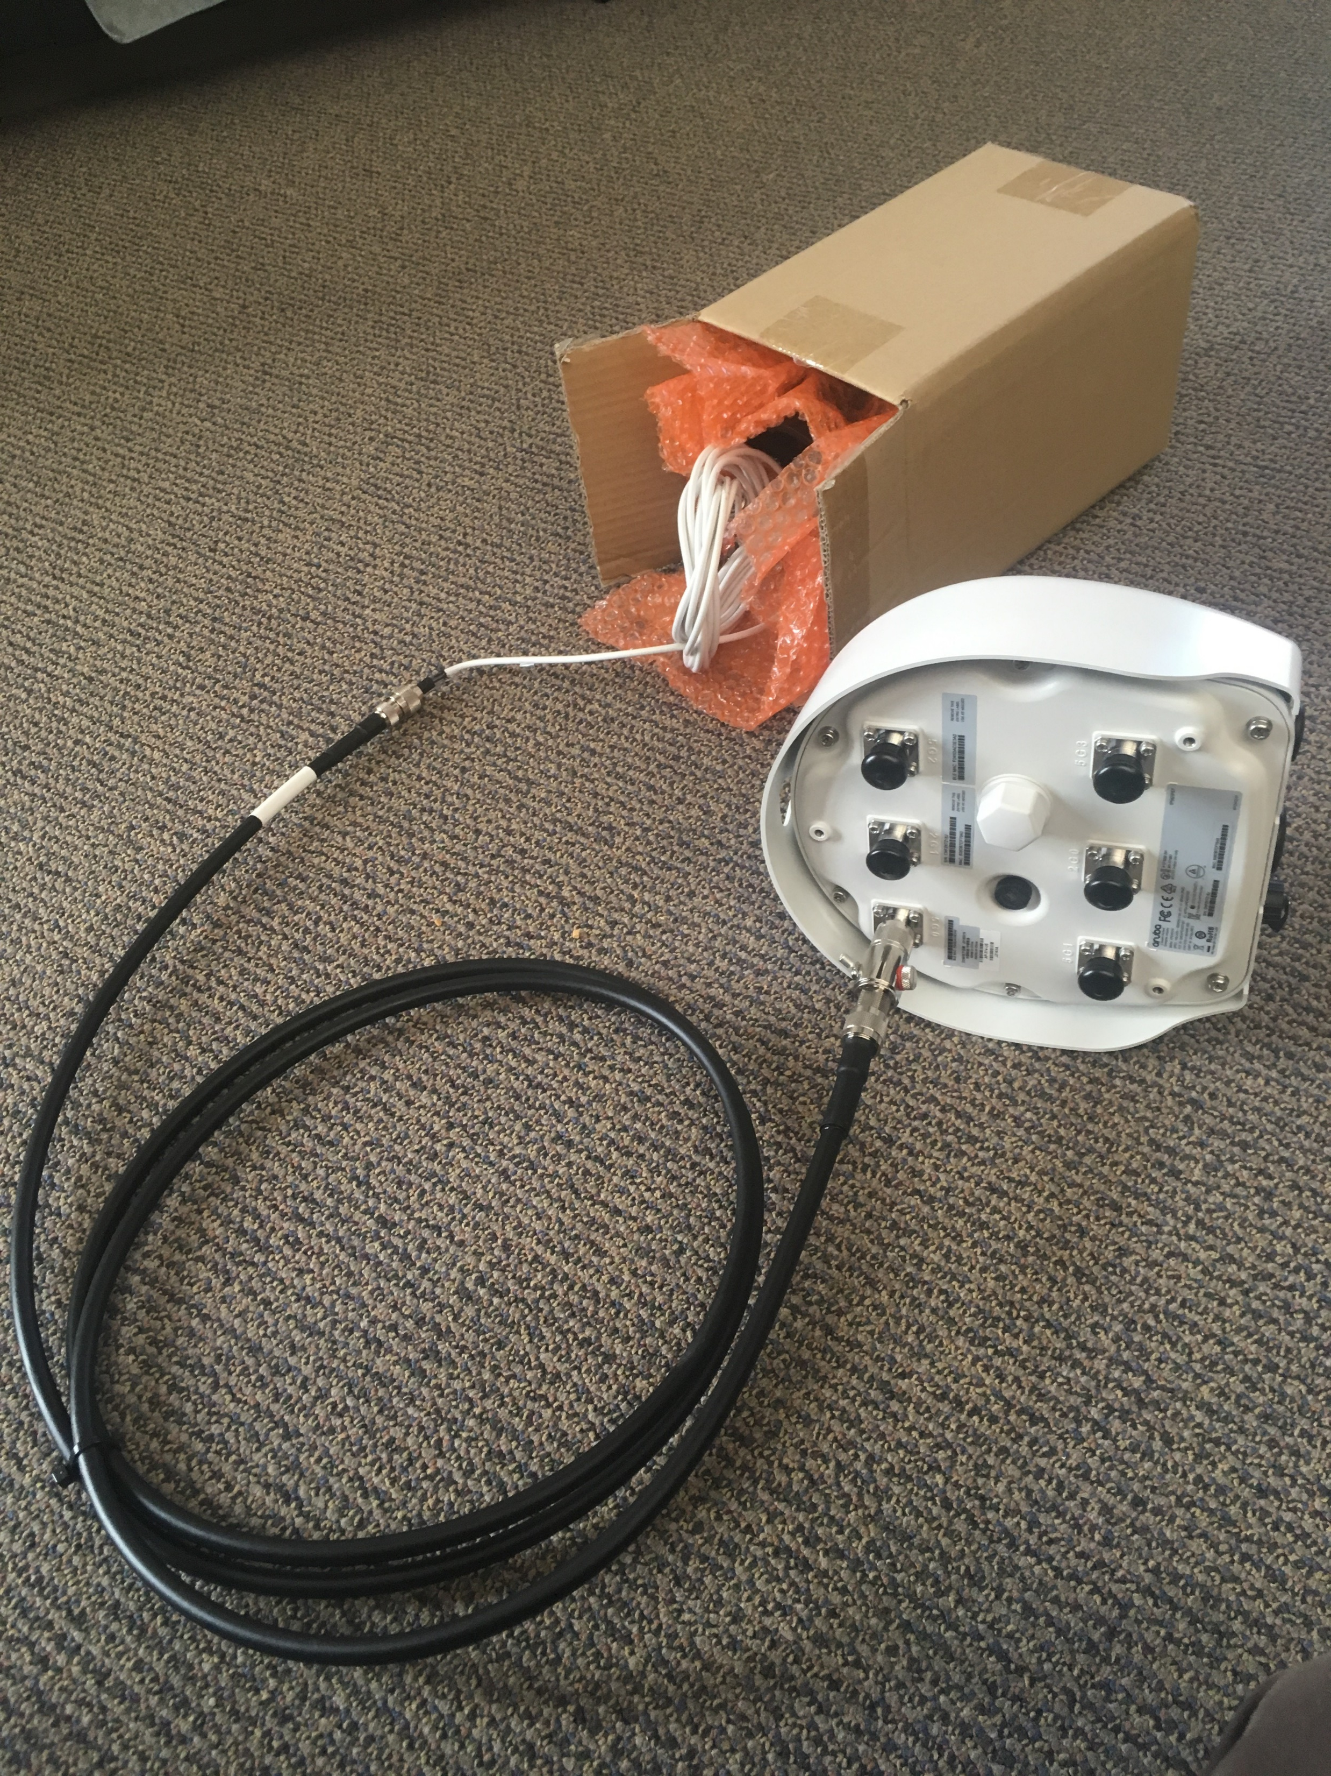
BOLLARDS
Temp setup until we migrate to AOS8
  AP-224
  Not outdoor-rated, but we had spares and hoped the dryboxes would help.
Long term solution once upgraded to AOS8
  AP-374
  Outdoor rated

Slide 16
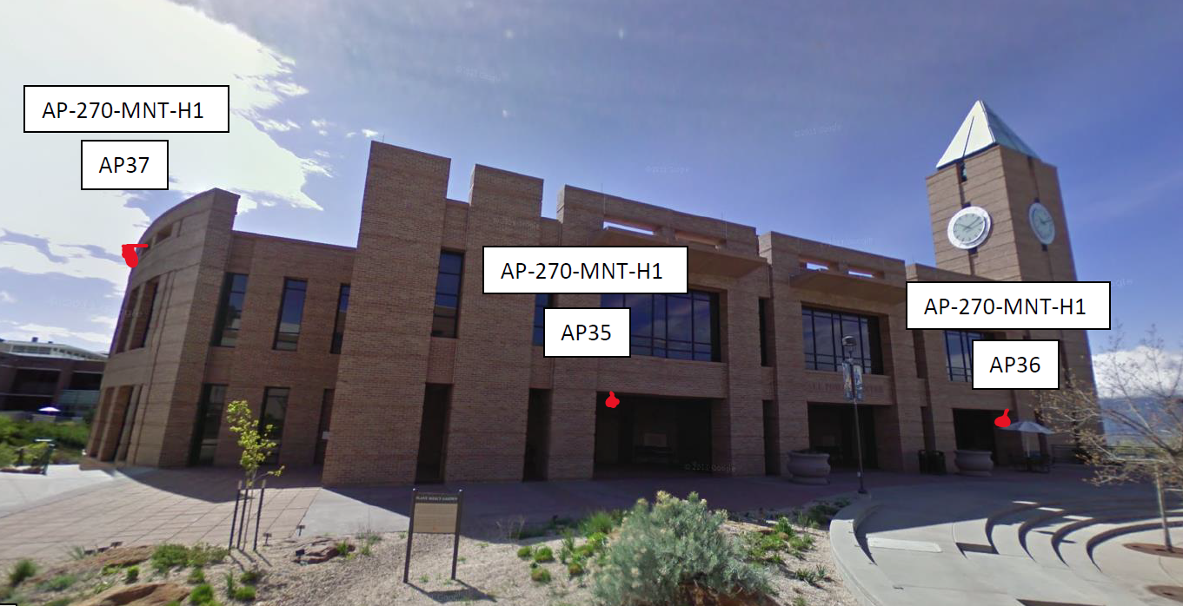
The Hurdles
Buildings
  Had to coordinate access
  from inside
  Where does the penetration
  align?
  Hard lid and hatch access for some areas
  Roof access for others

Slide 17
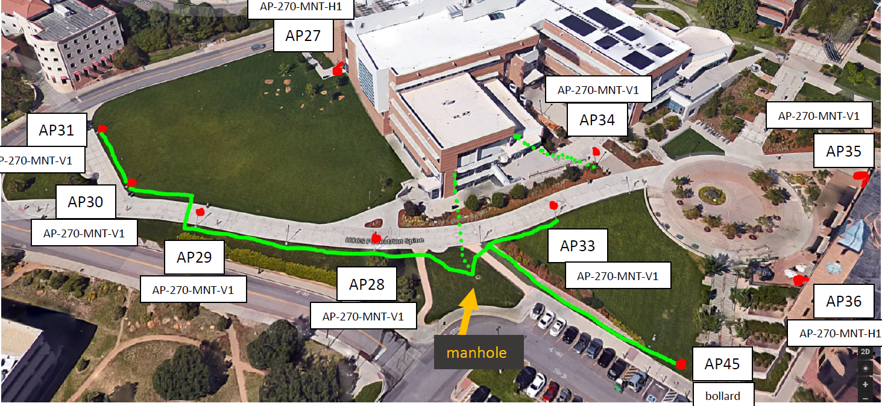
The Hurdles
Poles
  Distance limitations
  Direct CAT6a vs. running powered fiber and POE extenders
  Tapping into the poles

Slide 18
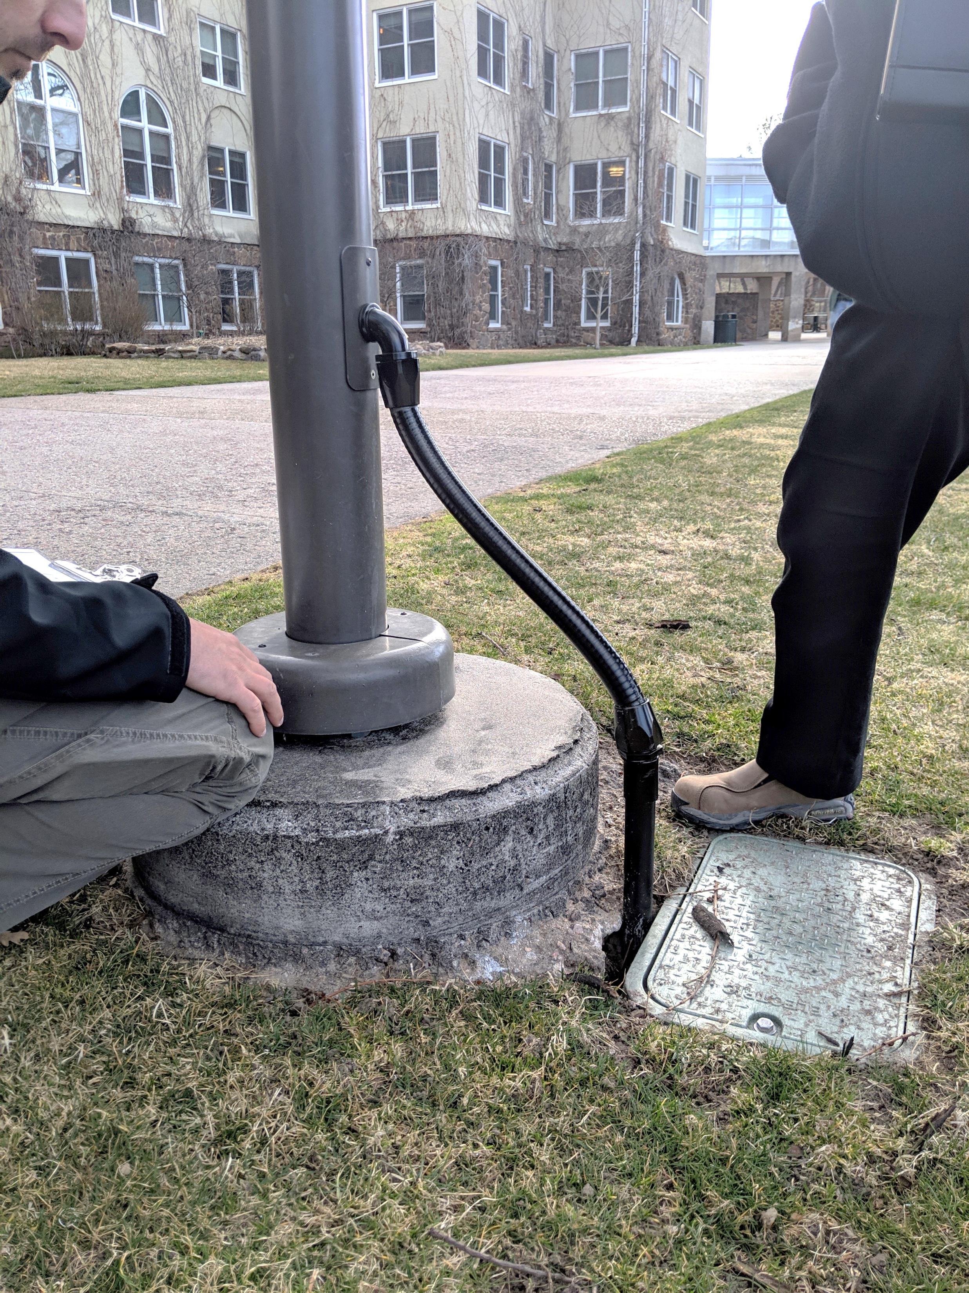
The Hurdles
Poles
  Getting cabling into the existing poles
  Trenching and boring in high traffic areas

Slide 19
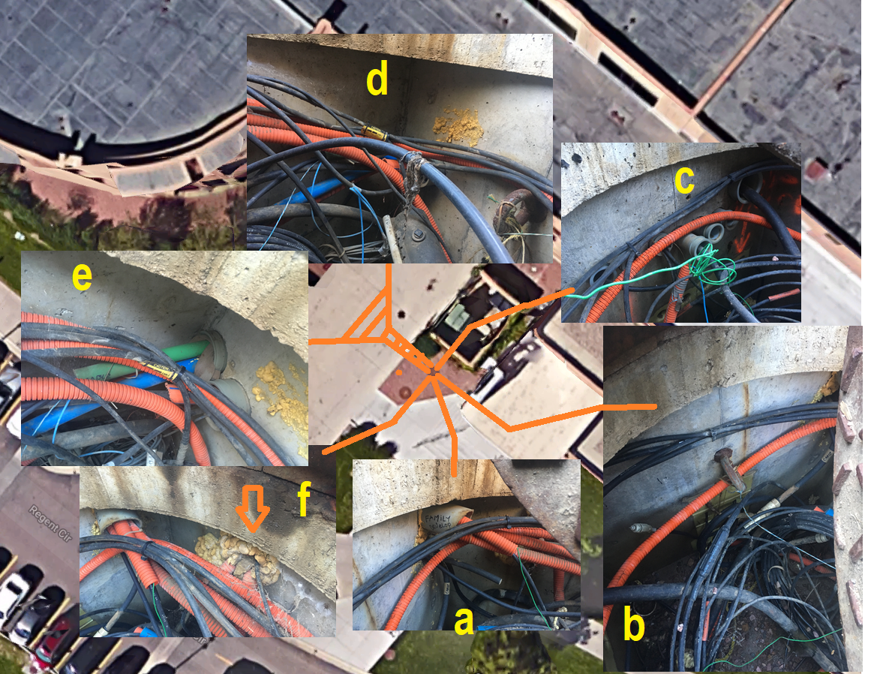
Other hurdles
Lack of documented OSP
Campus Architect’s requests
Procuring & coordinating access
to various locations such as…
  Roofs
  Meeting rooms
  Fac/Staff rooms
  Class rooms
Weather
Dealing with Subcontractors

Slide 20
Where we are to date
Major on-site physical installation work began November 12th 2018
Major on-site physical installation ended March 8th 2019
  Minor clean up then occurred such as restoration, paint touch up, small modifications, etc.
Testing of live APs began mid-February and continued through March.
Officially launched on campus April 15th.

Slide 21
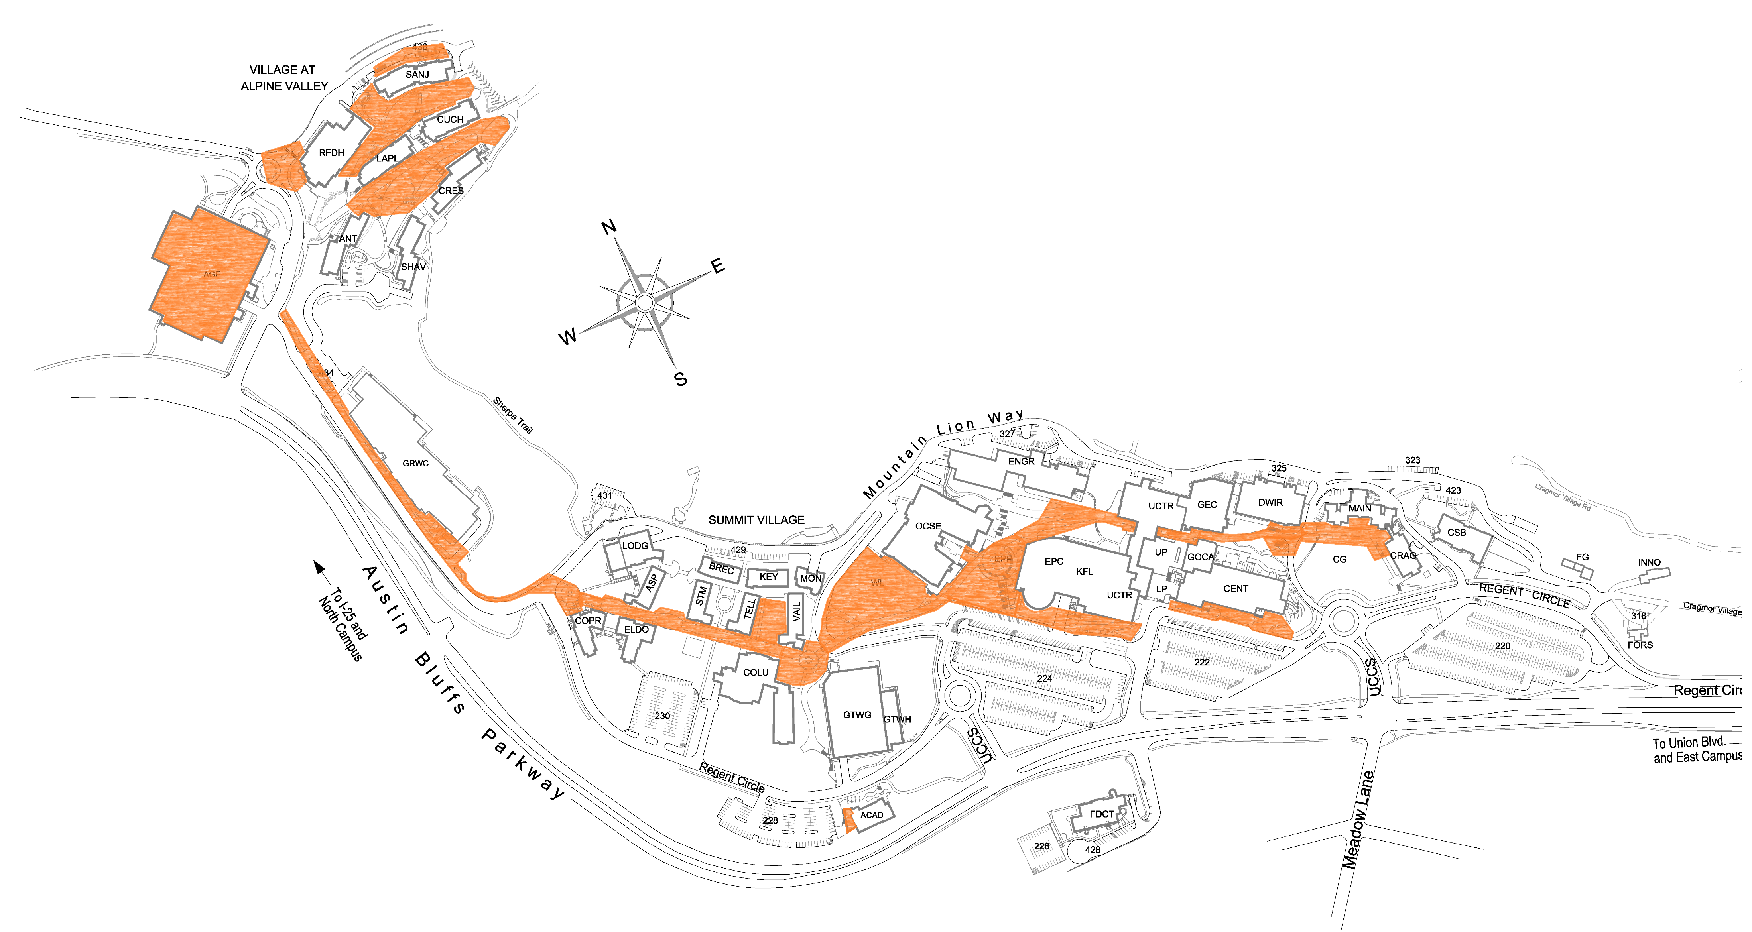
Coverage today

Slide 22
QUICK STATS
Added 40 new outdoor APs
  From 23 to 63 = 270% growth
Coverage area
  Approx. old coverage area = 2.8 acres
  Approx. new coverage area = 7.3 acres
New APs added coverage along over 5000 linear feet of sidewalks and walkways
Unique clients seen on outdoor APs (on an average Monday b/w 6a-6p)
  Before project: 466
  After project: 7,413

Slide 23
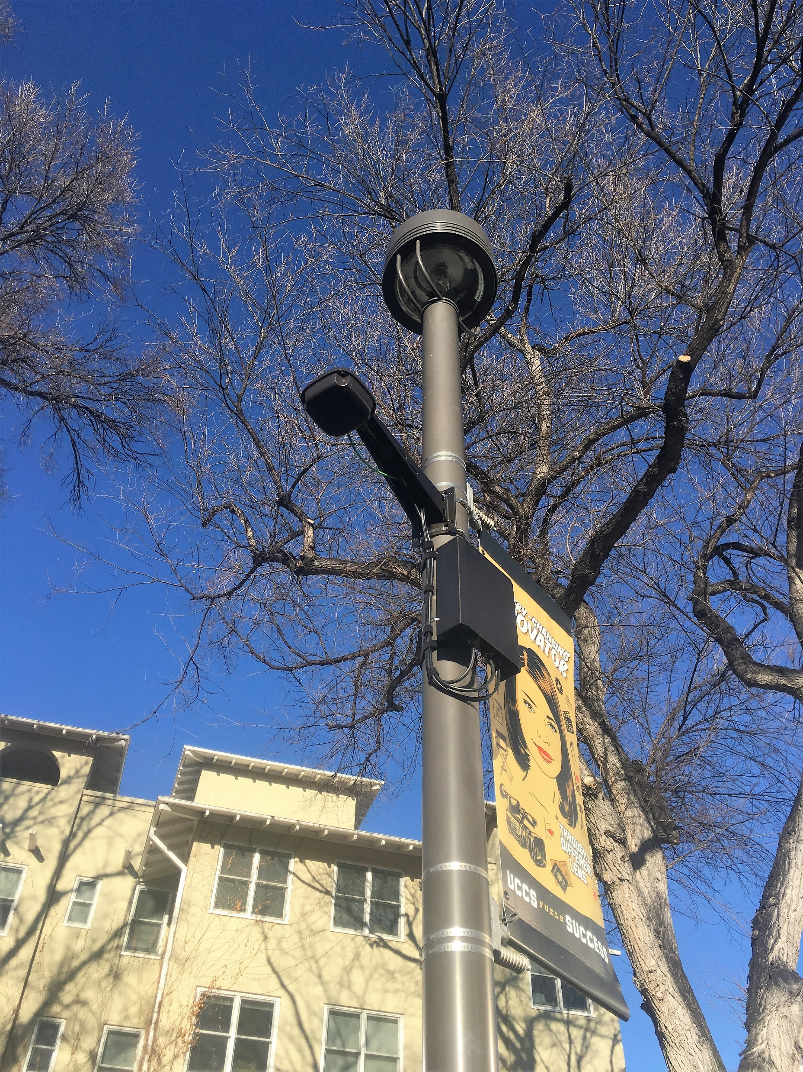
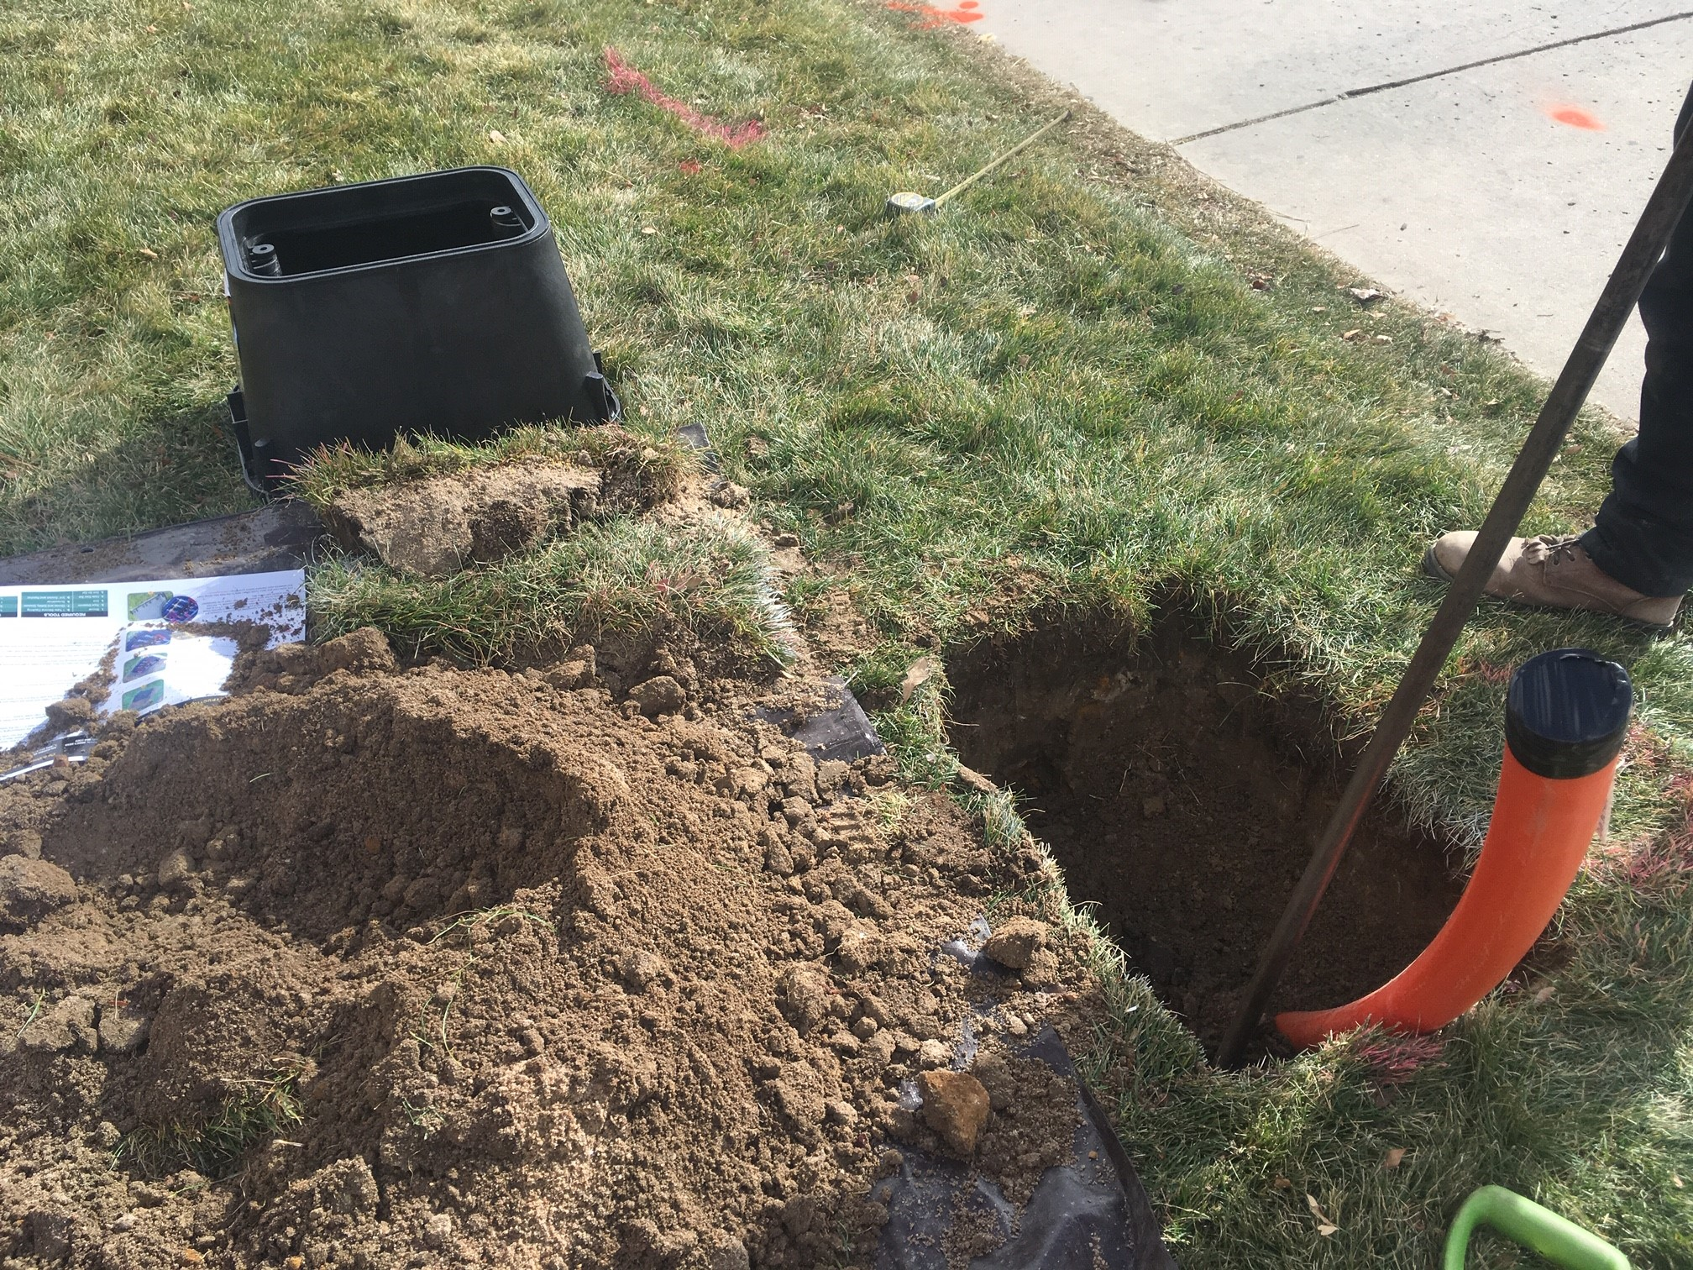
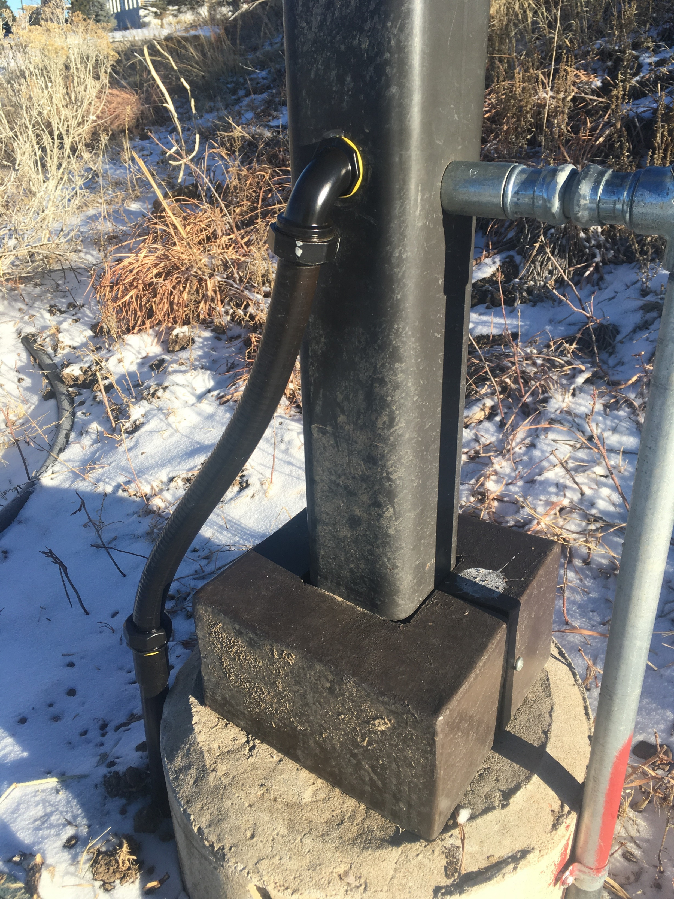

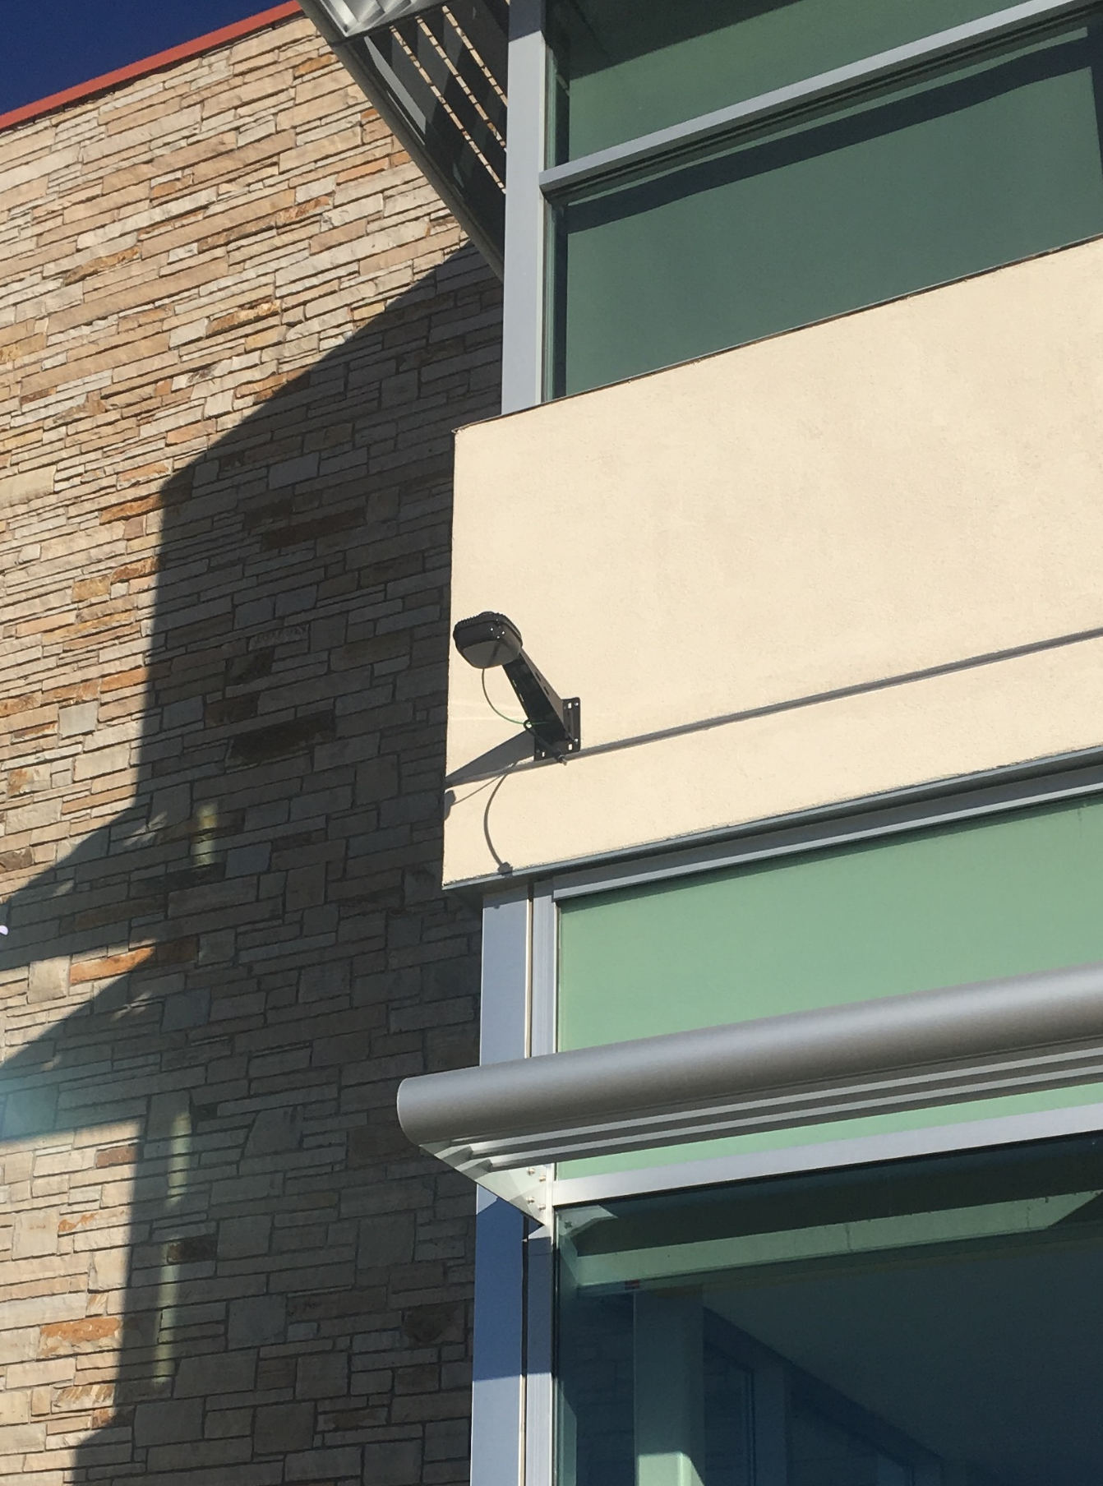
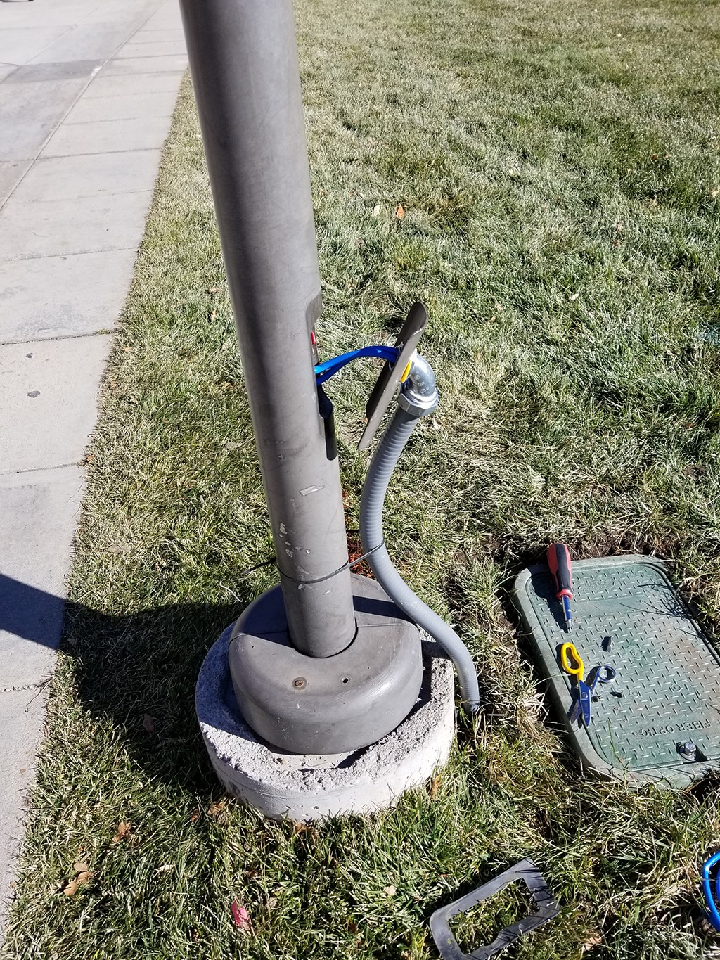
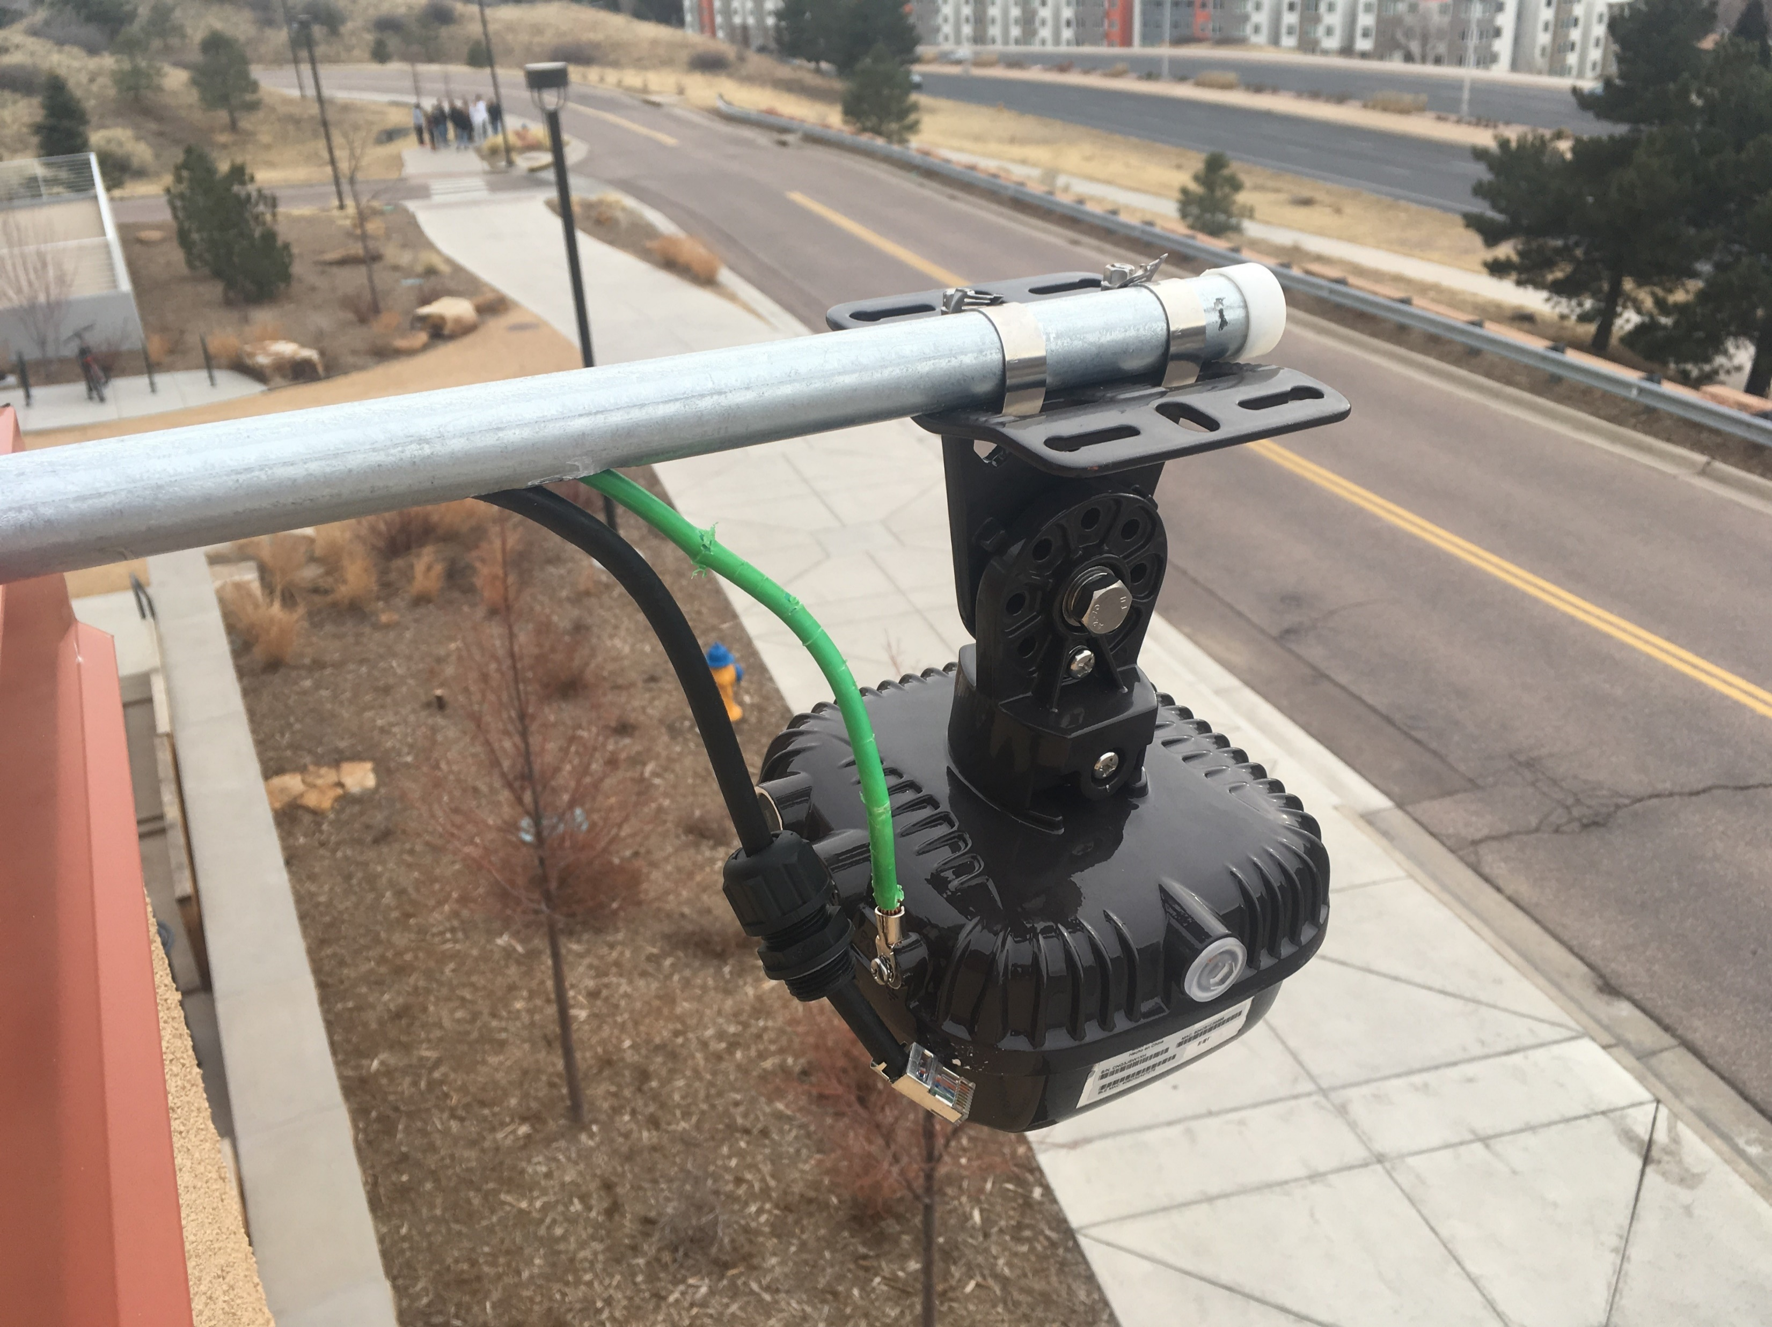
PHOTOS

Slide 24
some LESSONS LEARNED
Find out ALL of the needs of the installers and subcontractors…
  Do they want to store
  equipment on site?
  Do they need 100s of
  gallons of water?
Dryboxes are finicky and sometimes not dry
Paint matching is a pain
Estimated costs significantly lower than actual costs
  Vendor’s initial estimate: ~$120K
  UCCS estimate: ~$200K
  What we budgeted: ~$400K
  Costs after subcontractors
  got involved: ~$800K
Make sure bollard conduits will accommodate thick antenna cables
Time to implement took a lot longer than originally thought
Outside Plant was poorly documented from the start
Involve your campus architects early in the project

