Slide 1

Microsoft Teams:
Teams Phone
Modern Calling for the Modern Workplace

Slide 2
Desktop Application – Calls and Voicemail Overview
Managing Calls in Teams
Call Answering Rules and Delegation
Call Queues and Shared Lines
Mobile Application – Calls Overview

Slide 3

Desktop Application:
Calls and Voicemail Overview

Slide 4
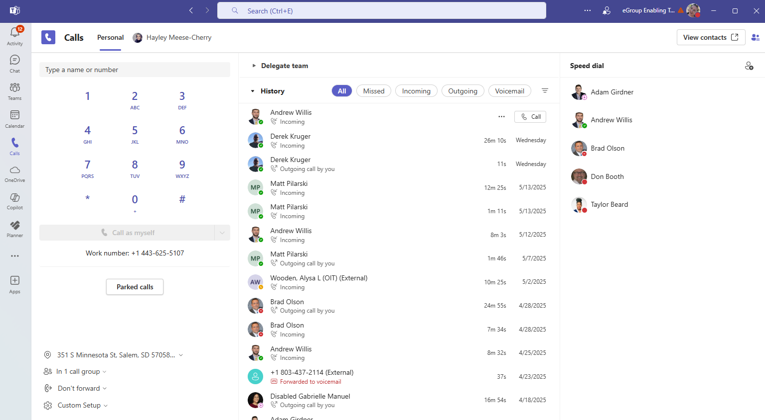
Desktop
The Calls landing page will display a dial pad, call history, delegates, speed dial groups, access to voicemail, quick access to specific settings, and the option to view other contacts.

Slide 5
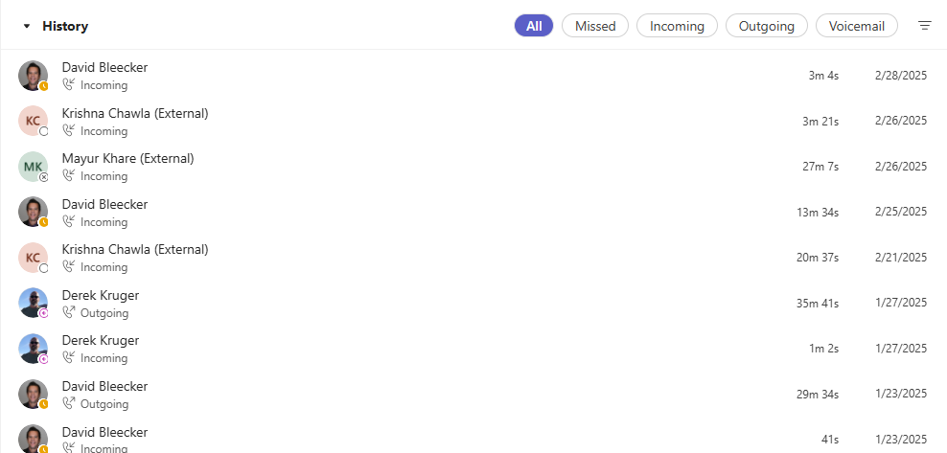
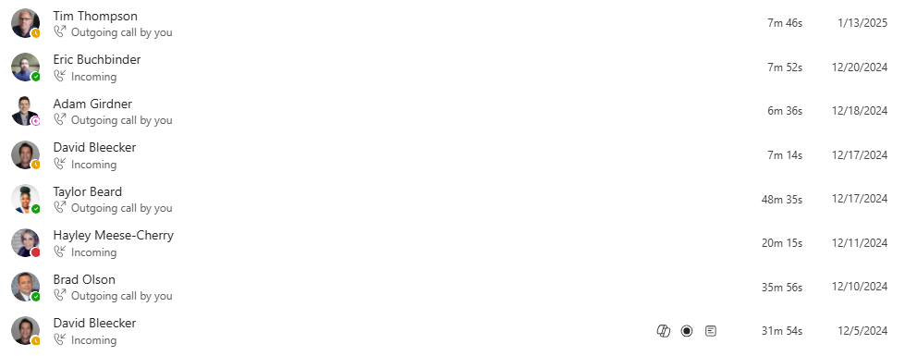
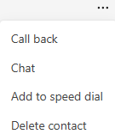
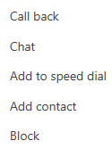
History
Call history will show you all calls received, initiated or missed in the last 30 days, at least.
Hover your mouse over the call entry line to make the Call button and the “…” menu appear.
Clicking the three dots will offer more options, including:
  Call back
  Chat (only available for internal callers)
  Add to/Remove from speed dial
  Add/Delete contact
  Block (only available for external callers)
Internal
External

Slide 6
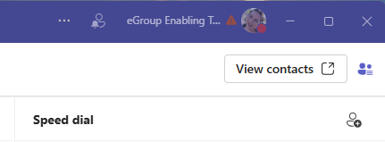
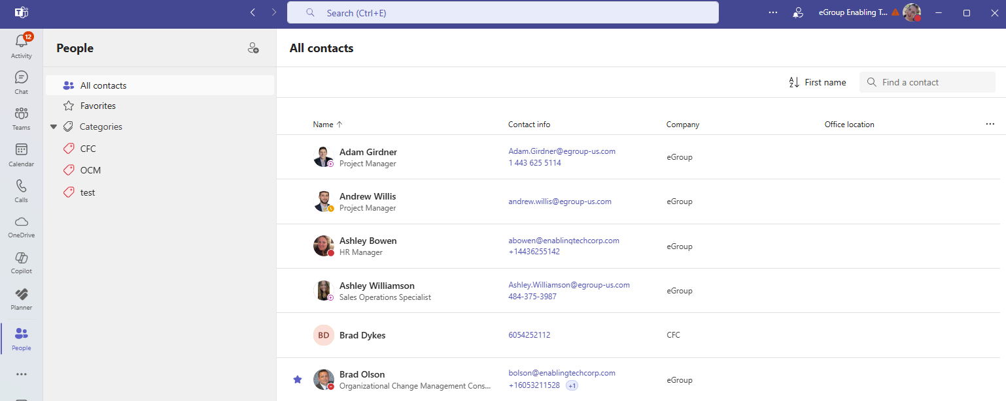
View Contacts
From the Calls menu in Teams, View Contacts displays your Outlook contacts. You may view all contacts, those you have marked as favorite, and contact categories if you have created them.
From here, you may initiate a call, email, or chat, depending on added information and whether they are a part of your organization.
If enabled with external dialing, storing contacts makes it easy to initiate external calls with one click.
New contacts may be created in Outlook or added in Teams by clicking the Add contact button.

Slide 7
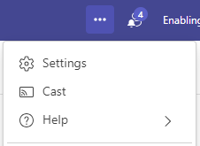
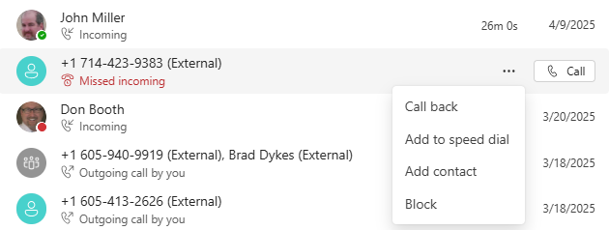
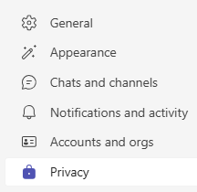
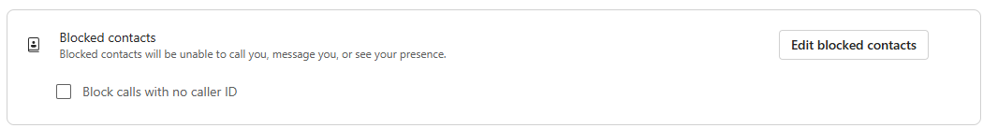
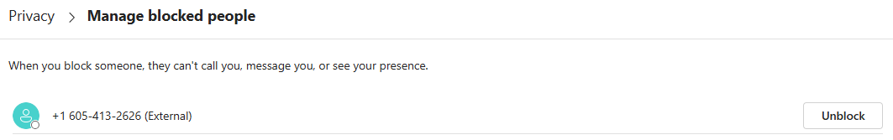

Blocking & Managing Unwanted Calls
Blocking Unwanted Calls:
In your Call History click the ellipsis next to the unwanted call/number and select Block.
The number will have a Blocked notification next to it in the Call History list and will be added to your blocked contacts list in Settings.
Note: You can only block external callers.
Managing Blocked/Unwanted Calls:
Click Settings and more, then Settings.
In the Privacy menu, click Edit Blocked Contacts.
To unblock a call/number, simply click Unblock.

Slide 8
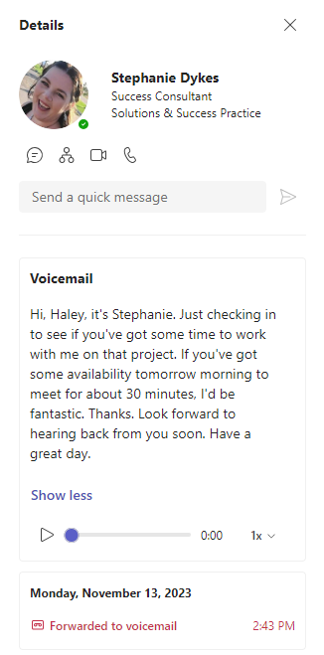
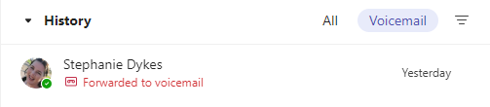
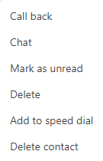

Voicemail
Voicemails are stored and accessible in the Calls app in Teams.
From the History section, select Voicemail to see a list of your message.
Click a message to populate more information in the Details pane, including information about and ways to contact the sender, a transcript, and options to play, speed up, slow down, or pause the playback.
When hovering over the voicemail line under History, from the More options menu, you may also return the call, initiate a chat (if internal caller), manage the message, or add the caller to your contacts.

Slide 9

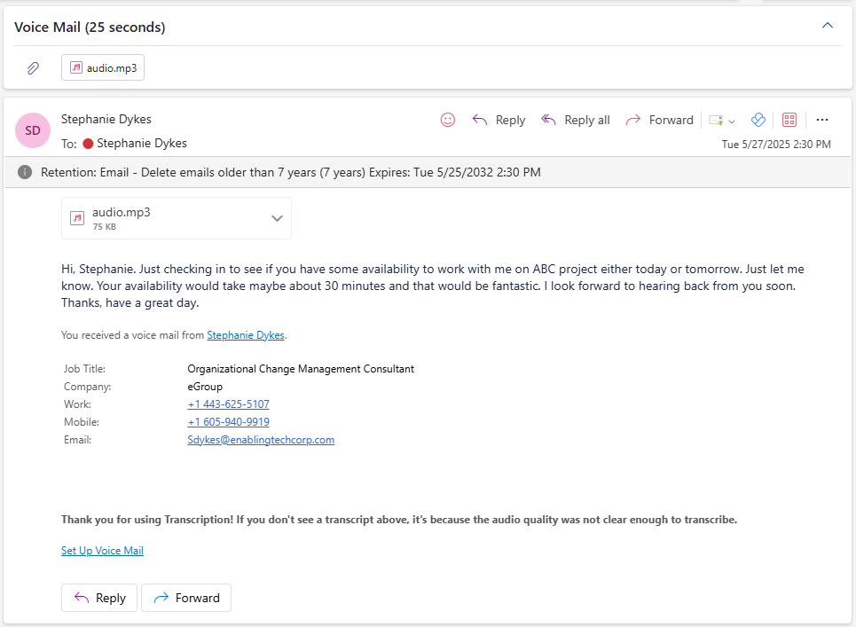
Voicemail in Outlook
A copy of each voicemail will also be sent to Outlook. Open the Outlook message to read or listen to your voicemails.
Voicemail emails include:
Sender information and options to return contact
An attached MP3 audio file of the voicemail. No installations or downloads are necessary to play the file.
A transcript of the voicemail.
NOTE: Deleting the voicemail in one location automatically deletes the corresponding notification and storage.

Slide 10
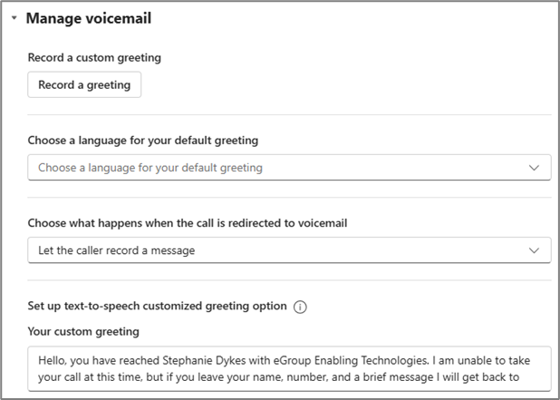
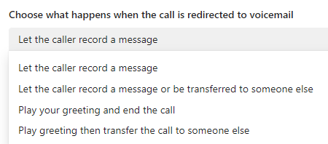
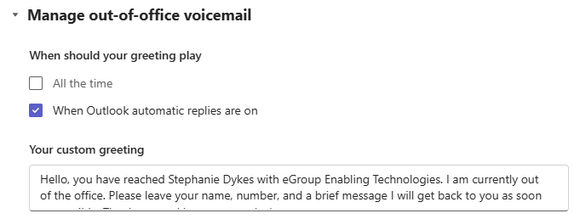
Voicemail Configuration
Configure your voicemail settings in Settings and more → Settings → Calls.
Record a custom greeting: Allows you to record your own voice to play when callers reach your voicemail.
Choose a language for your default greeting: If you do not create any voicemail settings, an automated message will play in the language you select.
Choose what happens when the call is redirected to voicemail: Designate the caller’s experience when reaching your voicemail.
Set up text-to-speech customized greeting option: Indicate what the automated message should read instead of the standard message.
Manage out-of-office email: Indicate what the automated message should read instead of the standard message when you are out of the office as well as when the out-of-office text-to-speech should be read instead of your standard voicemail greeting.

Slide 11
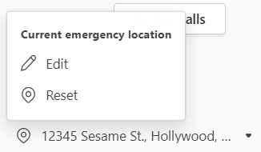
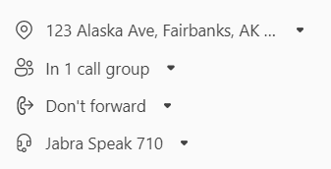
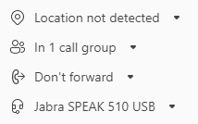
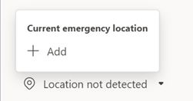
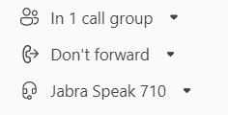
Location Services in Teams
To support secure, remote work Microsoft has a location feature in Teams. Adding or confirming your location in Teams is designed to get the fastest emergency response when you dial 911 while working remotely.
In the bottom-left corner of the Calls menu, you will see the option to indicate your location. This may be prefilled with an address, it may say Location not detected, or it may be missing completely:
Click the drop-down next to the location option (showing an address or “location not detected”) and select edit or add to manually confirm address (do this even if address is correct).
An address
Location not detected
Experience if an address is listed.
No item referring to location at all. If you see nothing, contact your help desk.
Experience if “location not detected” is shown.
Reminder: Calling 911 from within an office on campus automatically provides your location to first responders.

Slide 12
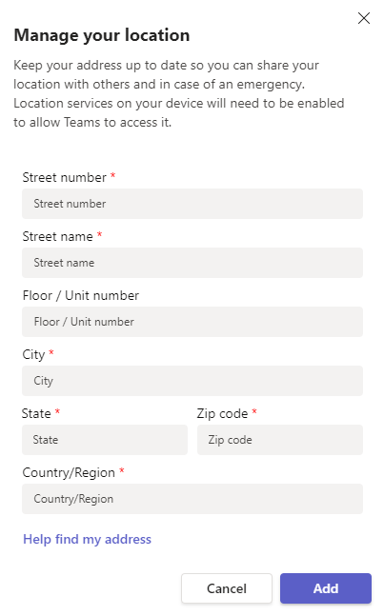
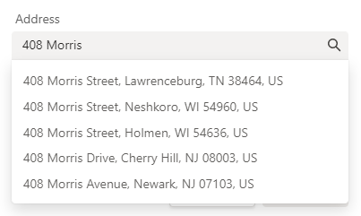
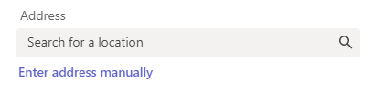
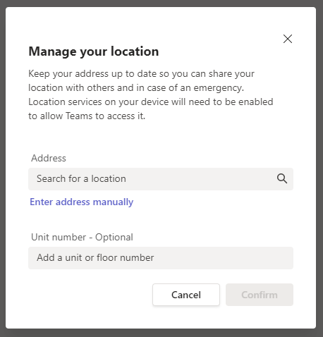
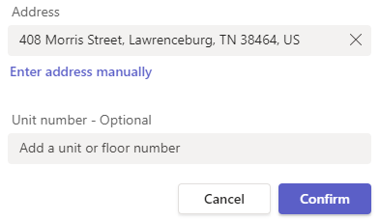
Location Services in Teams
To support secure, remote work Microsoft has a location feature in Teams. Adding or confirming your location in Teams is designed to get the fastest emergency response when you dial 911 while working remotely.
Click the Search for a location search box and begin typing your address. If you see your address populate, simply click it and select Confirm.
If you type out your address, and it does not populate in the list, you will have to click Enter address manually. Once all pertinent information is entered, click Add.
Add a floor and/or unit number if it applies to your address.
Add a floor and/or unit number if it applies to your address.

Slide 13
Managing Calls
in Teams

Slide 14
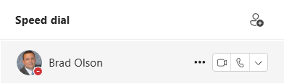

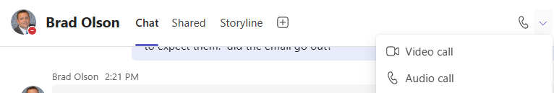
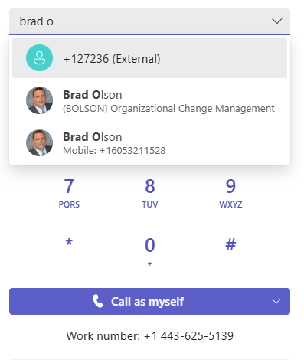
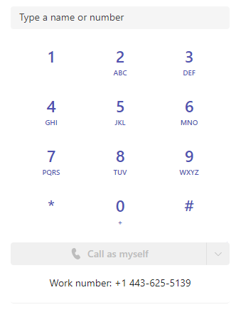
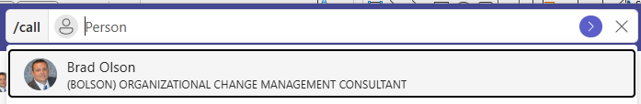
Initiate a Call
Click to dial in speed dial or contacts.
Escalate any chat to a video or audio call.
The dial pad allows you to call by:
  Typing the numbers with a keyboard
  Clicking the numbers with your mouse
  Pasting a copied number from another location
  Searching for internal colleagues by name
Use the /call command from the search field to make a call no matter where you’re working in Teams.

Slide 15
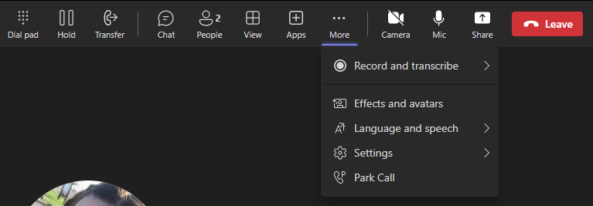
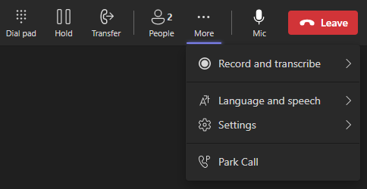
Call Controls
Call controls will appear slightly different if you are making an external call versus an internal call.
Internal Calls (Team to Teams)
External Calls

Slide 16
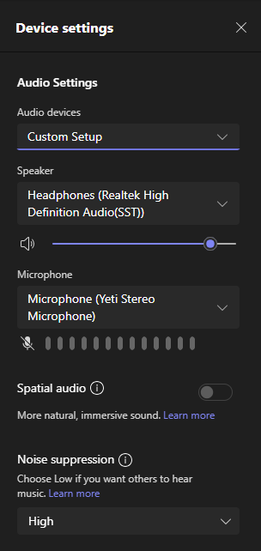
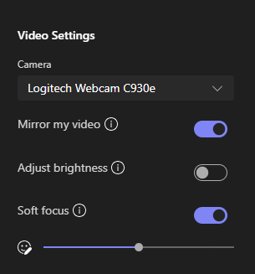
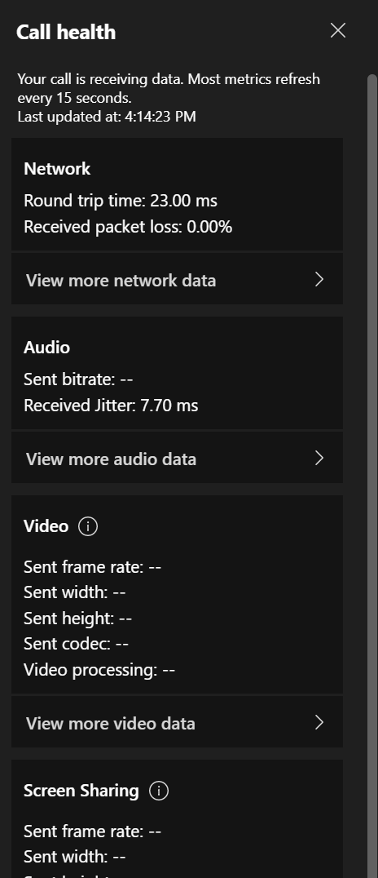
Device Sessions & Call Health
Experiencing poor audio or video quality? Use the More menu to view Device settings and Call Health.
Confirm both audio output and microphone input are adjusted and responding appropriately.
If issues continue and are unable to be resolved during the call, it is recommended to take a screenshot of the data metrics displayed in Call health (located in the three dot more options menu). These data metrics can be shared with IT to help troubleshoot the issue.
  Note: Call health is only available on Teams to Teams calls.
Quickly adjust noise suppression settings from this menu.

Slide 17
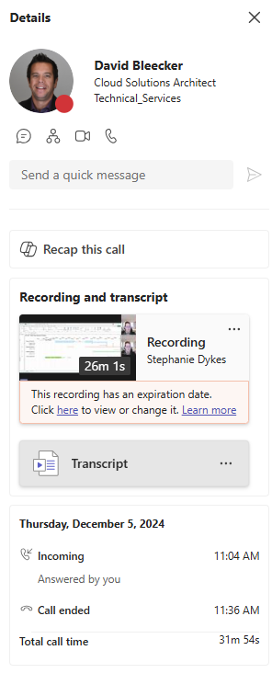
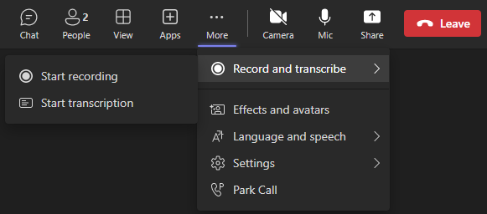
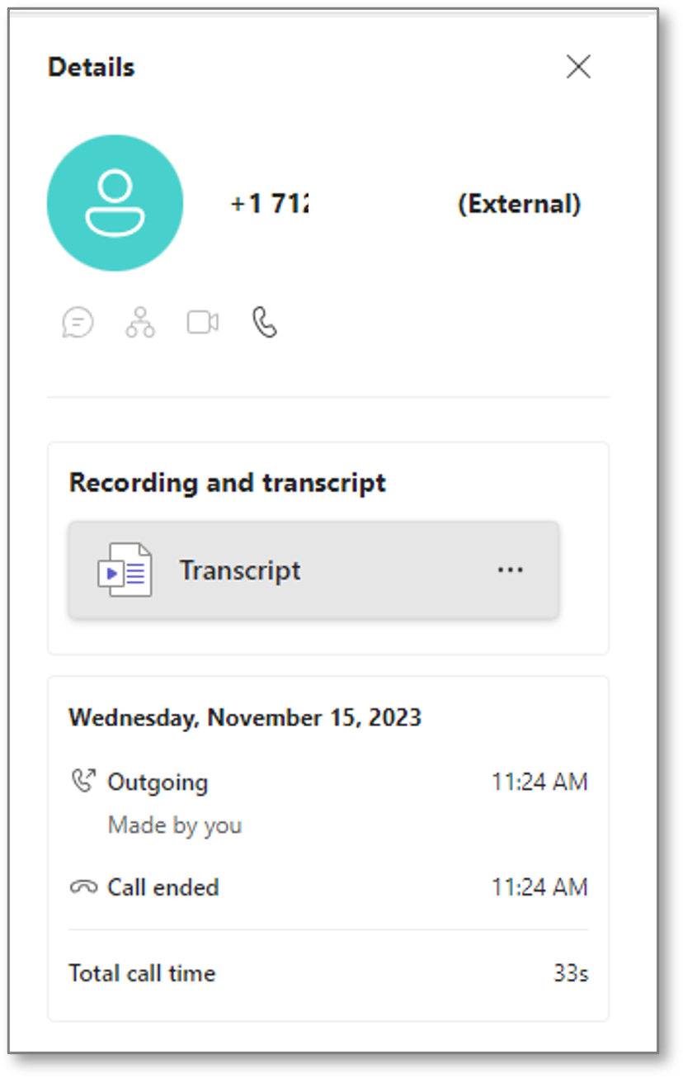
Call Recording
Call recording and transcription is available for both internal and external one-to-one calls.
Select Start recording or Start Transcription. (Depending on the configurations of the organization, transcription may be greyed out as not available.) An automated message will play notifying all parties that the call is being recorded.
Once the call has ended, the recording will be available from History in the Calls app in Teams.
Select a recorded call from History and the details pane will display the call recording.

Slide 18

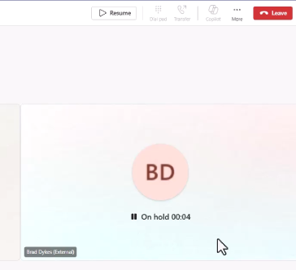
Using Hold
To place a call on hold, click the Hold button from your call window options menu.
While on hold, a hold timer will run below the caller’s image.
To retrieve the call, click the Resume button.
Going back to the caller will also repopulate the usual options menu buttons.

Slide 19
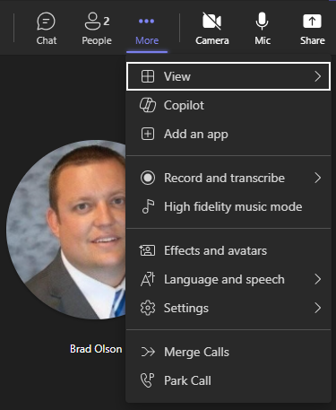
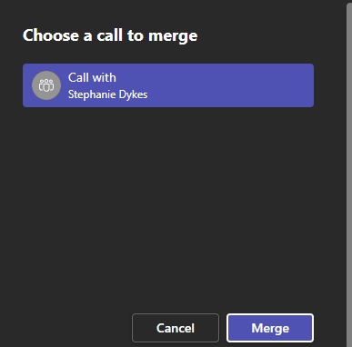
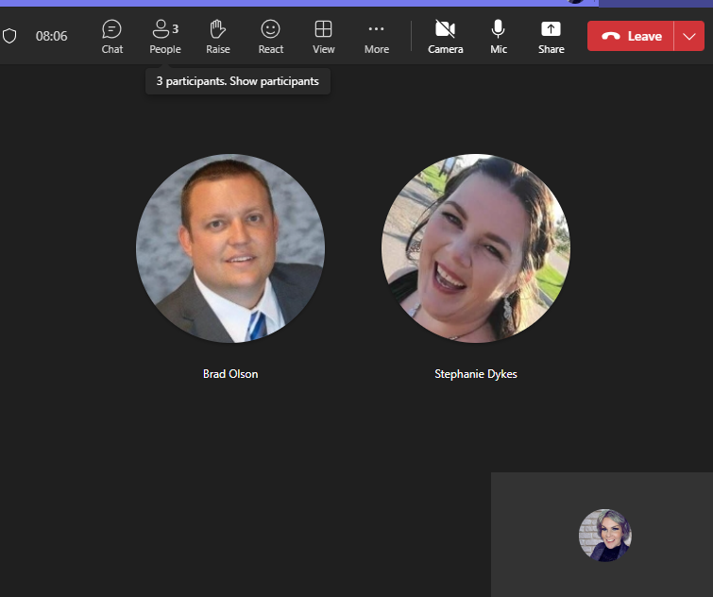
Call Merge
Whether you have received a new call while actively on a call, or if you have made a second outgoing call, the Call merge feature will allow you to merge these two calls into one.
From the active call, access the ellipsis and select Merge Calls.
A new window will appear allowing you to choose which call to merge. Select the other caller and click Merge.
You will now see both calls in one call window. If appropriate, you can Leave the call, leaving the other lines still together on the call.

Slide 20
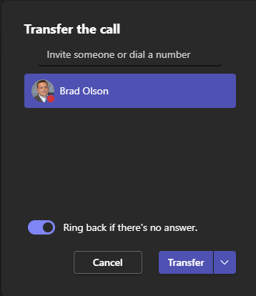
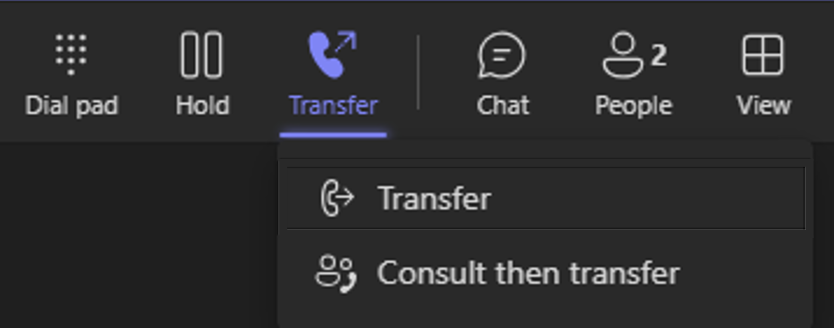
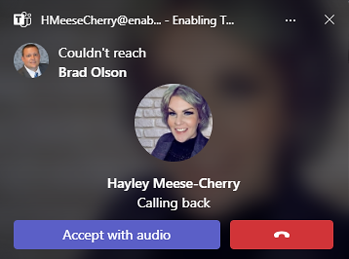
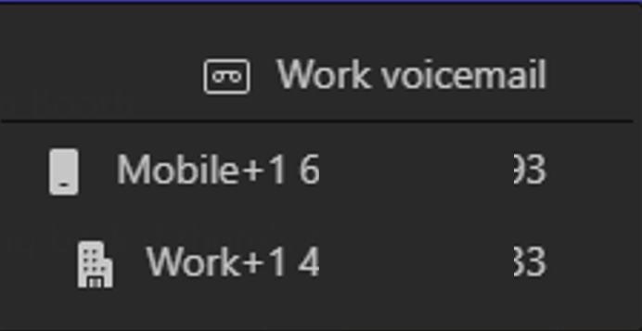
Transfer a Call – Two Experiences
User Experience - Transfer
Type the number or the name of the intended recipient.
If internal, click their name when you see it.
If transferring to an internal user, turning on Ring Back will allow the original caller to automatically ring back to your line if the receiver does not answer. You may then handle the call or transfer directly to the recipient’s voicemail.
Start the process by clicking Transfer in the call window and selecting Transfer.
Transfer = The user sends the caller to the line of another user without any contact with them.
The caller is automatically place on hold upon clicking Transfer.
To transfer the call to their primary line, click the Transfer button.
The drop-down arrow may provide additional contact numbers for internal users.
For external users, there will be no drop-down.
When a call rings back, it will show the recipient could not be reached and appears as if you are calling yourself back.

Slide 21


Transfer a Call – Two Experiences
User Experience – Consult then Transfer
Type the number or the name of the intended recipient.
If internal, click their name when you see it.
Start the process by clicking Transfer in the call window and selecting Consult then transfer.
Consult then transfer = The user has a chat or a call with the receiving user before sending the caller to their line.
The caller is automatically place on hold upon clicking Transfer.
Instead of transferring the call, you will select how you wish to consult with the receiving user.
Click Chat to consult via chat.
Click the drop-down arrow to consult on another phone line.
When consulting via chat, you will see a Transfer button and a drop-down arrow to indicate the receiving user’s preference for the transfer to complete the call.

Slide 22



Transfer a Call – Scenario
Scenario:
Stephanie has called Hayley
Hayley has transferred Stephanie to Brad
Hayley’s view:
Stephanie’s view:
Brad’s View
After completing the transfer, Hayley will see this on her screen until Brad or his voicemail picks up the transfer.
Stephanie will see this on her screen while the transfer is occurring, until Brad or his voicemail answers the line.
Brad will see this notification. He knows that Stephanie originally called Hayley, but Hayley has transferred her to him.

Slide 23


Multiple Calls Navigation
While only one call can be active at a time, you can toggle between multiple calls. If you accept an incoming call while on an active call, that active call will be automatically placed on hold, and if answered, the new call will display in a separate call window. The call window(s) remain active until you Leave or the caller hangs up.
Original call window, on hold if second call answered
Second incoming call window, active when answered.
When the first call goes on hold, the Resume button will appear. To toggle between calls, click Resume on whatever call you wish to be active.
Third incoming call
Declined Calls Note:
When a call is declined, the call will follow the call answering rules that have been established in settings. Additionally, the caller will not know their call has been declined. The caller will hear the standard number of rings before being redirected.

Slide 24






Call Park in the Desktop Application
Parking a call puts the call on hold and provides a code that you can provide to another person to retrieve the call.
Park a Call
Retrieve a Call
Notes on Call Park
From an active call, select More…
Select Park Call to place the call on hold from one device and retrieve it from another device.
In the Calls menu, click Parked calls under the dialpad.
Enter the code and click Pick up. The call window will automatically open, and the call is active.
If you ever need to go back to a parked call and forgot the code, you will see the call and the Copy code button in your call history.
If a parked call is not picked up within several minutes, the number calling will ring back to the line that placed it on park.

Slide 25





Call Park in the Mobile Application
Parking a call puts the call on hold and provides a code that you can provide to another person to retrieve the call.
Park a Call
Retrieve a Call
From an active call, select … (three dots) button at the bottom of the screen.
From the pop-up menu, select Park call. You will receive a confirmation the call is parked and the park code.
Within the Calls menu of the app, click the Phone+P icon in the top right corner.
Enter the parked call code when prompted and tap Pick up.
It will appear as if you are making a call, but the parked call will become active on your device.

Slide 26

Teams Calls - Desktop

Slide 27
Call Answering Rules
and Delegation

Slide 28



Call Answering Rules
Call answering rules determine how your calls are handled. Rules are set in the Settings and more → Settings → Calls menu.
Forwarding: To forward your calls, toggle the Forward all calls switch and select from the drop down where they are forwarded.
Forwarding options include:
Forward to voicemail
Forward to a new number or contact
Forward to a call group
Forward to your delegates
You may also turn call forwarding on and off from the bottom left corner of the Calls app in Teams.
Once you have added a name or number for forwarding, you cannot add another. Click the X next to the current forwarding selection to change your forwarding destination.

Slide 29

Call Answering Rules
Scenario:
Hayley is out of the office today and has forwarded all her calls to Stephanie instead of her voicemail.
Brad is calling Hayley.
Stephanie’s view
Stephanie can tell by this screenshot that when she answers the phone, she will be speaking to Brad, but that Brad originally called Hayley.
Brad won’t know the call was forwarded, so he will be expecting Hayley to answer the phone.
Stephanie can let him know right away that she’s the one on the line and taking Hayley’s calls today while she is out of office.

Slide 30


Call Answering Rules
Call answering rules determine how your calls are handled. Rules are set in the Settings and more → Settings → Calls menu.
Simultaneous Ringing: You may designate where a call should ring when it’s coming in.
When You Can’t Answer a Call: You may designate what should happen when you do not answer a call.
Options include:
Ring no one else
Also ring another number or contact
Also ring a call group
Also ring your delegates
Options include:
Do not redirect calls
Redirect to voicemail
Redirect to a new number or contact
Redirect to a call group
Redirect to your delegates

Slide 31

Call Answering Rules
Scenario:
Hayley has Stephanie set to receive her calls if she does not answer.
Brad calls Hayley.
Stephanie’s view
Stephanie can tell by the call notification that when she answers the line, Brad will be there.
She can also tell that Brad originally called Hayley and will be expecting her to answer, so she can let him know right away that it’s Stephanie, and she takes Hayley’s calls if Hayley is unable to answer.

Slide 32


Call Answering Rules
Call answering rules determine how your calls are handled. Rules are set in the Settings and more → Settings → Calls menu.
How Long Should Your Calls Ring: You may designate how long your calls should ring before redirecting to your designated preference.
Each ring = 5 seconds.
Ringtones: You may select a unique ring tone for calls for you, forwarded calls, and delegated calls.
Options include:
10 seconds | 20 seconds (default)
30 seconds | 40 seconds
50 seconds | 60 seconds
You can listen to and preview each tone before deciding.

Slide 33

Create a Secondary Ringer
The Secondary Ringer feature will be helpful if you take your headset off and still need to hear an incoming call. This will enable your headset and your computer to ring when a call comes in.
Click the Settings and more ellipsis at the top of Teams, then click Settings.
Click Devices and in the Secondary ringer section, select the device from the drop-down to ring along with your headset.

Slide 34

Customize the Call Window Size
Select the size that works best for you to manage calls on your desktop.
See calls in a large window or a small one. Both are resizable during the call.
Click the Settings and more ellipsis at the top of Teams, then click Settings.
Click on Calls and navigate to just below the ringtone options.
Next, select the desired window size for incoming calls. The window size can always be adjusted when in an active call.

Slide 35





Add a Call Delegate
Assign delegate permissions to a peer to make and receive calls on your behalf.
Click Settings and more, then Settings.
Begin typing the name of your delegate and click their name when it appears.
Click to Calls and scroll to the Manage delegates section.
If this is your first delegate, click Add a delegate.
If you already have one or more delegates, click Edit.
Select the appropriate permissions. The delegate will be notified via chat that they have been added as a delegate and their permissions.

Slide 36


Make or Receive Calls as a Delegate
When you are added as a delegate, a new tab with the name of the person you are supporting will show to the right of Personal on the Calls tab.
This is Stephanie’s view of her calling window. Hayley has added Stephanie as her delegate.
After clicking on Hayley’s name at the top, she can dial as Hayley and view Hayley’s call history.

Slide 37


Make and Receive Calls as a Delegate
Scenario:
Brad has set Hayley as a delegate with permission to make and receive calls on his behalf.
Hayley is calling Stephanie on behalf of Brad.
Hayley’s view:
Stephanie’s view:
Hayley has changed to Brad’s delegation at the top of the calls tab and will next click the purple call button at the bottom.
Stephanie will receive the call notification below.
Stephanie now knows when she answers the line, she will be speaking to Hayley, but that Hayley is calling using Brad’s line.
If Hayley is Brad’s assistant, it’s possible he asked her to get Stephanie on the line for him, and now that Stephanie has answered, Hayley may transfer her to Brad directly.

Slide 38



Manage Settings as a Delegate
When someone else has added you as a delegate, depending on the granted permissions, you may update their call settings as needed.
To get to their call settings, click Settings and more, then Settings.
Click on the delegator you wish to manage and update their settings as appropriate and as you have access.
Click to Calls. At the top, you will see Personal with your Teams icon, plus the name and Teams icon of anyone you delegate for.

Slide 39



Creating Call Groups
Call Groups let users share their incoming calls with colleagues so they can answer calls that occur when the user is unavailable.
Click on Settings and more, then Settings.
Begin typing the names of those to be in the call group and select as the names appear.
Designate the Ring order:
  Call groups of 5 or less people: May designate as Everyone at once or In the order below.
  Call groups of 6-25 members: May only be Everyone at once.
Click the Calls menu, scroll down to the Manage call group section, and click the Add a call group button.

Slide 40
Call Queues and
Shared Lines

Slide 41



Call Queues and Shared Lines
Microsoft Teams supports functionality for call queues and shared lines. Configuration of this function is owned by IT support staff.
To help differentiate between calls to you directly or calls coming from a shared line or call queue, Teams will display a note on the pop-up banner indicating the source of the call.
  This allows you to answer the call using the appropriate greeting.
In your call history, you will see activity for calls associated with your personal number as well as those associated with any call queue or shared line you support.
The line below the person’s name or number indicates the shared line the call came from.
If you see no shared line name, that call was associated with our direct number.

Slide 42

Voice-Enabled Channel
In some cases, an organization will create a voice-enabled channel to help manage the call queue or shared line.
To access the voice-enabled channel, locate the team you were added to that is associated with the queue, then the voice-enabled channel within that team.
Click to the Calls tab to find call history, a dial pad, a toggle in and out switch, and a listing of agents associated with the queue.
You will be added to a voice enabled channel where you can do the following:
Sign in and out of the shared line.
View call history of the calls you serviced from the shared line.
View and listen to voicemail left for the shared line.
View other members of the shared line and their current status.
Place outgoing calls as yourself or as the shared line number if required.

Slide 43


Call Queues & Shared Lines – Logging In & Out
If you help answer calls for a call queue or shared line, you may need to sign in and out of that phone line, based on your schedule.
If your shared line is using a voice-enabled channel, navigate to the Calls tab within the channel for that line and use the toggle switch located under the dial pad.
  Toggling in and out of the queue in Settings (Option 1) will also toggle you within the voice-enabled channel, and vice versa.

Slide 44


Shared Voicemail in Teams
If the call queue you support has voicemail and uses a voice-enabled channel, all members of that queue can review and manage voicemail via the group mailbox in Outlook and directly within the voice-enabled channel in Teams.
Go to the voice-enabled channel in Teams and locate the voicemail in the History section or by clicking on Voicemail to filter only that activity.
  You will see who called, the opening transcription of the call, and the time of the call.
To listen, click the voicemail to open the Details pane on the right.
Here, you can:
View details about the caller and their contact options
Send a message via Teams
Read the transcript
Play or speed up the message

Slide 45
Calling with the
Teams Mobile App

Slide 46


Download the Mobile App
Option 1:
From the Teams desktop application, select Settings and more then click Download the mobile app.
Once downloaded, use your work credentials to sign in.
Option 2:
Scan the provided QR code with your mobile camera or with a QR reader app. You will be automatically directed to the option to download the Teams mobile app from the app store for your device.
Once downloaded, use your work credentials to sign in.

Slide 47




Notifications and Quiet Hours
You may select the types of activity that send you notifications on the Teams mobile app, and setting quiet hours allows you to specific the hours and days you want to be notified of new messages, activity, or calls on your mobile device.
Set notification preferences:
Click on your Teams icon in the top-left corner.
Select Notifications
In the Notify me on mobile for section, you may select from the three pictured options or select Custom to indicate which types of notifications you want to receive.
Turn on Quiet Hours:
Click on your Teams icon in the top-left corner.
Select Notifications then tap Block during quiet hours.
Toggle on the Certain hours switch.
Set your Start and End time.
  Notifications from the Teams mobile app will be disabled during these hours every day.
If there are entire days you want no notifications, toggle on the All days switch and select the days.
You may select to align these settings for Teams and Outlook. Settings apply only to this device.

Slide 48



Mobile App Call Settings
Call settings can also be managed from the Teams mobile application.
Click Settings and Calling to find settings that include:
  Call forwarding
  Simultaneous ringing (Also ring)
  Delegate management
  Voicemail configuration
  Blocked numbers
  Call queues

Slide 49







Teams Calls - Mobile
Calls in the mobile app is a consistent experience from the desktop application. Review call history, voicemail, contacts (including device contacts). Initiate calls with a dial pad (if enabled) or dial-by-name.

Slide 50





Device Transfer
Meetings can be transferred between mobile and desktop apps anytime you need to start or end a meeting on the go.
To Start on the Mobile App:
Access the Calendar in the Teams mobile application and click Join to enter the meeting.
At the top of your desktop Teams, you’ll see a banner that you are in a meeting with a Join call button.
To Start on the Desktop:
Join the Teams meeting as you normally would.
At the top of the mobile app, click Join in the top banner, then select Transfer to this device.
You’ll be prompted to make audio/video selections, then click Join now to join the meeting.
To take the call on your desktop Teams, select Transfer to this device. You will then make your audio and video selections and join the meeting in progress.

Slide 51

Teams Calls - Mobile
Stay Connected Anywhere: Make and receive calls on-the-go, ensuring you never miss important conversations.
Consistent User Interface: Enjoy a familiar calling experience similar to your smartphone’s dialer.
Easy Contact Management: Sync your contacts with Teams to quickly call colleagues and external numbers.
Enhanced Security: Benefit from Microsoft’s enterprise-grade security for all your calls.
Quick Collaboration: Transition from calls to conferences with just a few taps.
Voicemail Transcription: Read voicemails with automatic transcriptions, saving time and improving accessibility.
Customizable Settings: Tailor your calling preferences, such as call forwarding and simultaneous ringing.

Slide 52
Thank you!

