Slide 1
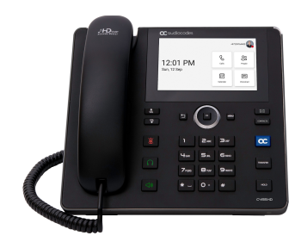
Audiocodes 455HD Desk Phone
If you are using a desk phone to manage your Teams calls, enjoy easy to use call management functions right at your fingertips.
Touch Screen
Navigation Control
Back Key
Menu
Voicemail
Volume Keys
Contacts
Mute Key
Home
Headset Key
Transfer
Hold
Alphanumeric Keypad
Microphone
Speakerphone Key

Slide 2
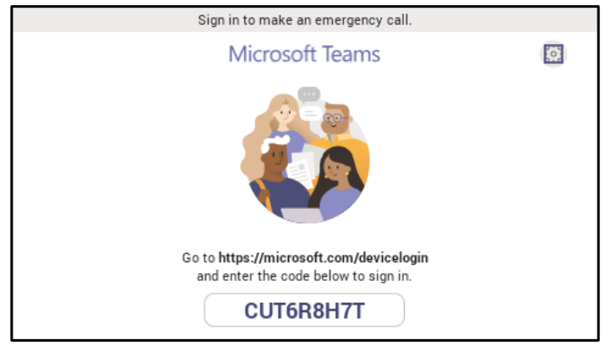
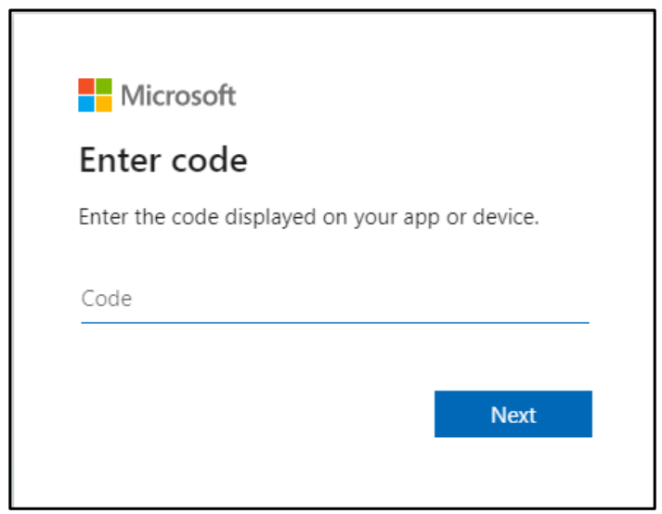
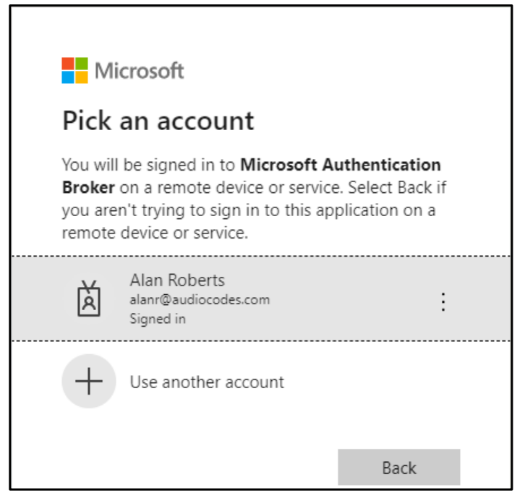
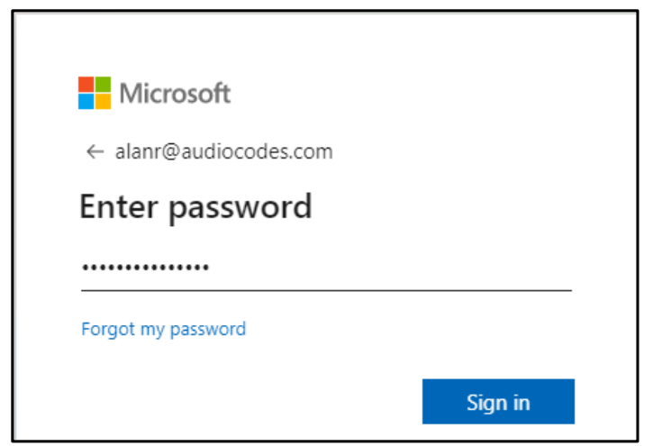
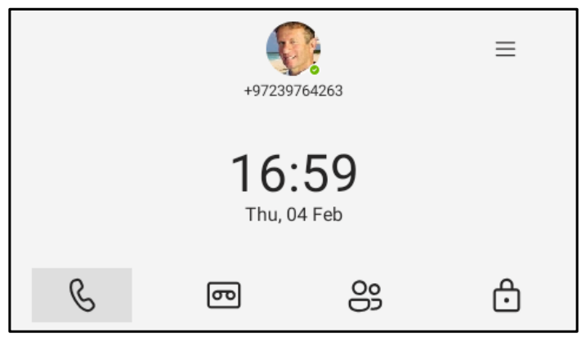
Audiocodes C435 Desk Phone – Signing in
Step 1: After connecting the phone to the network, it starts up and the following is displayed:
Step 2: Open your web browser and navigate to https://Microsoft.com/devicelogin
Step 3: Enter the code provided by the phone and click Next.
Step 4: In the “Pick an account” screen, double-click the account (or use + to use another.
Step 5: Enter your password (the same as the password for your computer) and then click Sign in.
Step 6: Navigate to and select Got it. The home screen should be displayed. You have successfully signed into the phone!

Slide 3

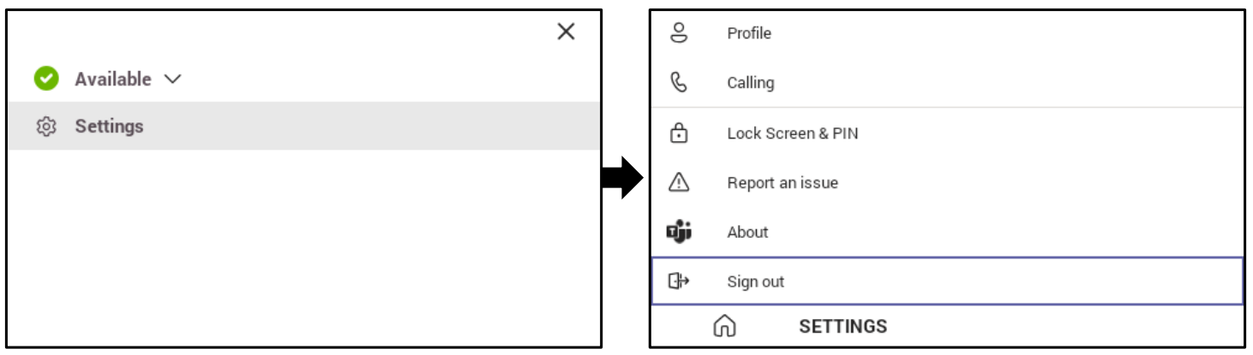
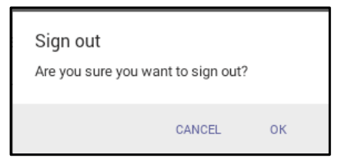
Audiocodes C435 Desk Phone – Signing out
Step 1: Navigate to and select . Navigate to and select Settings and then to the Sign out option.
Step 2: When prompted, navigate to and select OK, and you will be signed out of the phone.

Slide 4
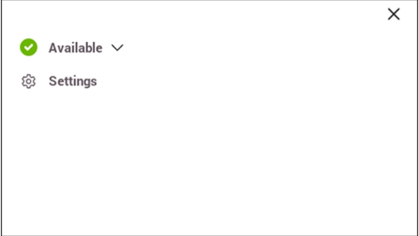
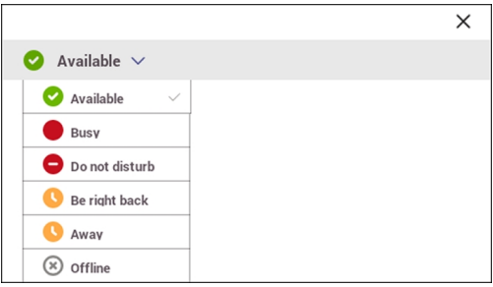
Audiocodes C435 Desk Phone – Setting Status
You can set a presence status such as 'Available' for others in the network to see.
Step 1: Navigate to and select .
Step 2: Select the status displayed (“Available” in the image above).
Step 3: From the drop-down, select the desired status to set and press the OK button.

Slide 5
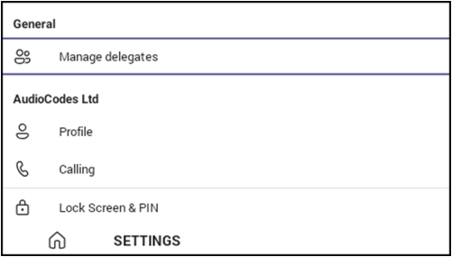
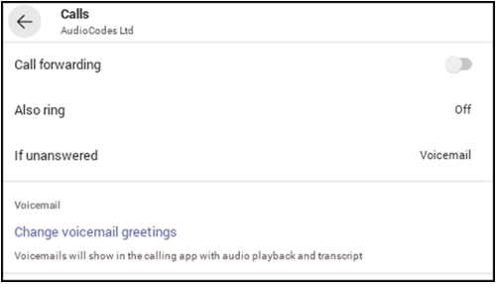
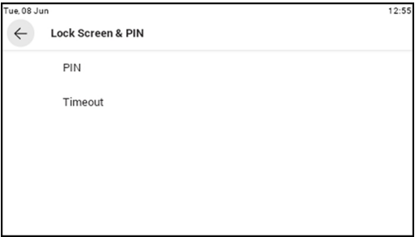
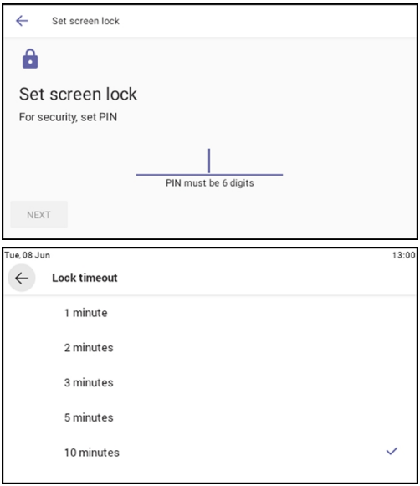
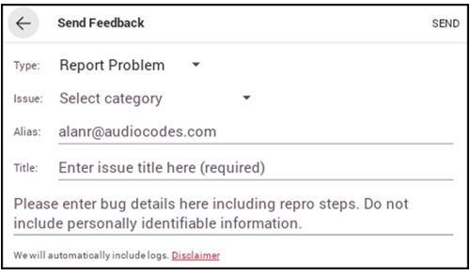
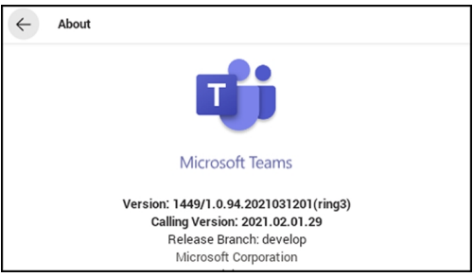
Audiocodes C435 Desk Phone – Settings
The following describes the Teams application's settings.
Step 1: Navigate to and select from the Home screen.
Step 2: Select Settings.
Options:
Profile – Opens the user’s email address and photo / avatar picture
Calling – Opens the Calls screen
  Call forwarding – Enables automatic redirection of incoming calls to another destination (voicemail, another employee, etc.)
  Forward to – Only displays if Call forwarding is enabled and defines the destination of the forwarded incoming calls
  Also Ring – Only displays if Call forwarding is disabled. Select from Off, Contact or number, or Call group
  If unanswered – Only displays if Call forwarding is disabled. Defines the destination where to send unanswered incoming calls. Select from Off, Voicemail, Contact or number, or Call group
  Caller ID – Hide your phone number when dialing people outside of Microsoft Teams (external numbers)
  Block calls
  Block calls with no caller ID – Enabling this will block calls that do not have a Caller ID associated
Lock Screen & Pin – Allows user to lock their phones as a security precaution. Configure a lock option before attempting to lock the phone.
  If a lock option isn’t configured, the lock action won’t work.
Report an Issue – Opens the Send Feedback screen
About – Opens the About screen
Sign out – Lets the user sign out of the phone application as one user and optionally sign in as another user

Slide 6
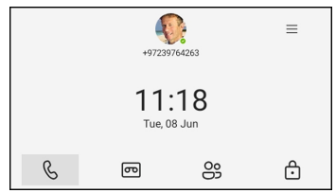
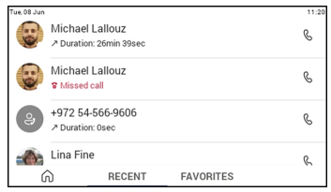
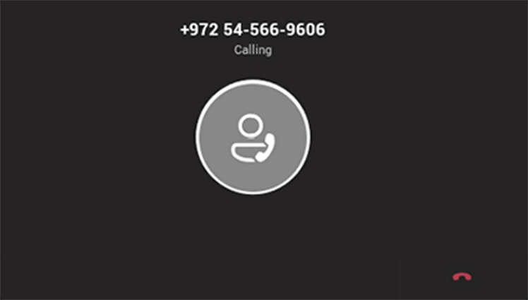
Audiocodes C435 Desk Phone – Make a Call
Calls can be made in multiple ways.
Option 1: Press the digit keys on the phone’s dial pad to enter the phone number.
Option 2:
From the home screen, press the Phone softkey to display the Recent screen, which shows recent calls.
Press the phone handset icon to call the contact from that call.
Home Screen (phone’s idle screen):
Recent Screen (shows call history):
After dialing a destination number, the phone displays the Calling screen while playing a ring-back tone.

Slide 7
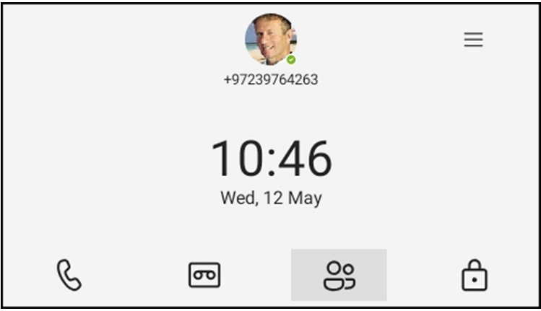
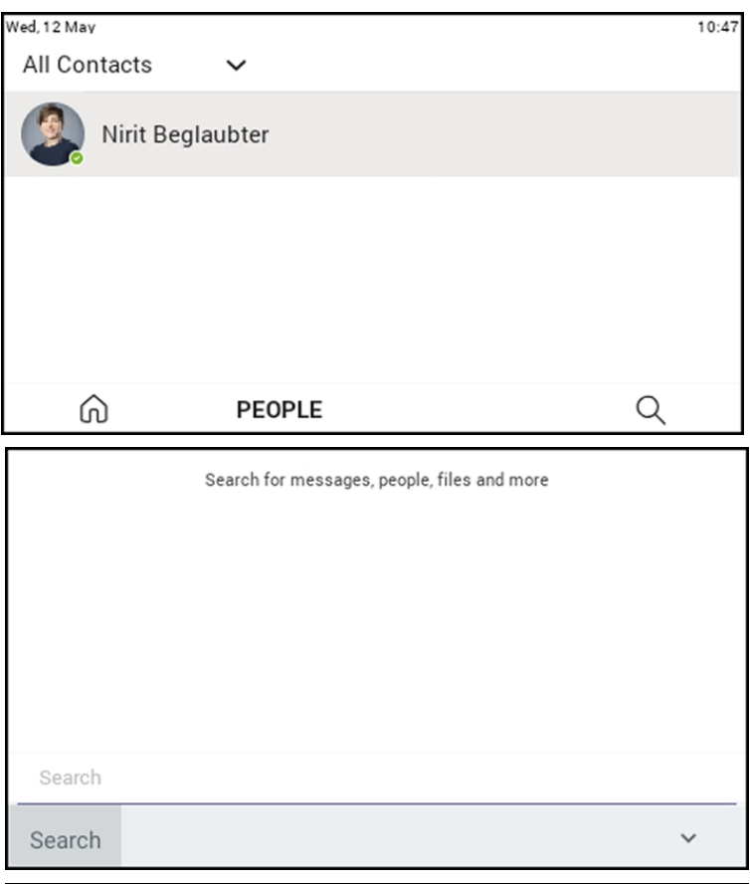
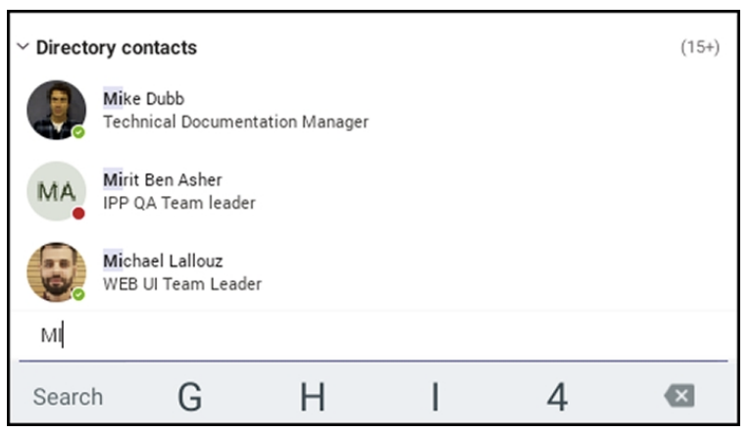
Audiocodes C435 Desk Phone – Make a Call
Option 3: Make a call using a speed dial from the People screen or from the ‘Search people’ feature in the People screen.
From the home screen, press the People softkey to display the user’s contact list screen.
The user may tap the name of a contact to dial or press the magnifying icon to search the directory.
Upon locating the desired contact during the search, tap the name to dial the call.
Home Screen (phone’s idle screen):
People Screen (shows user contacts):
Search Screen (use the digit keys to enter letters):
Search Results Screen (tap a name to dial):

Slide 8
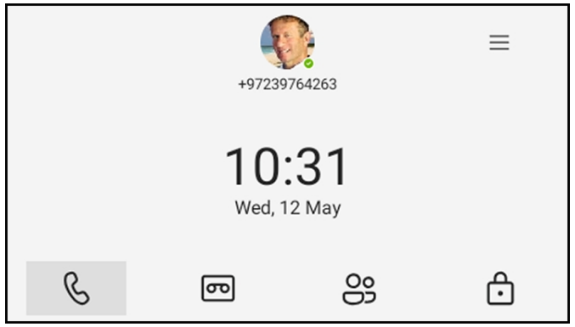
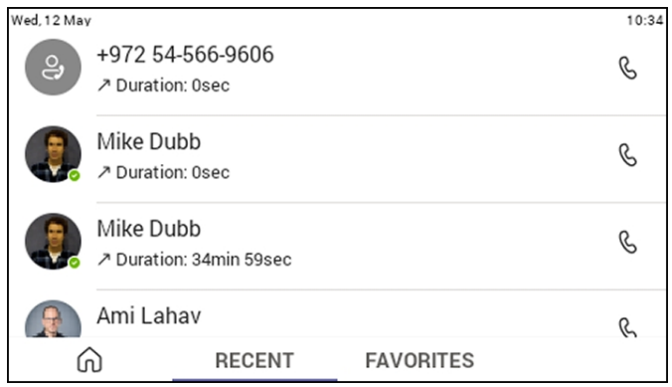
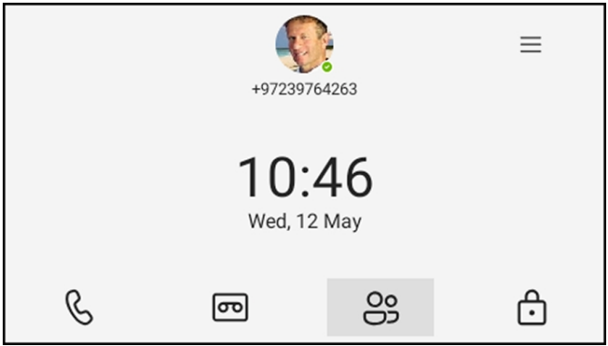
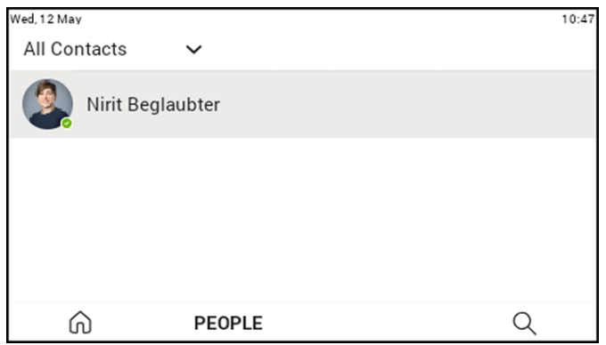
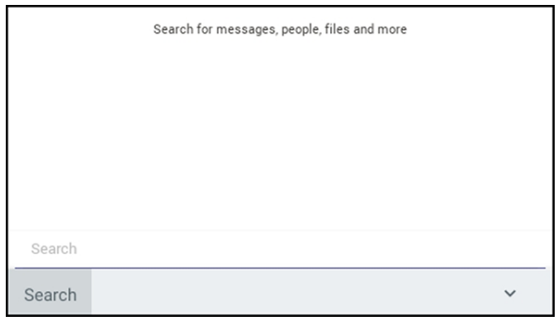
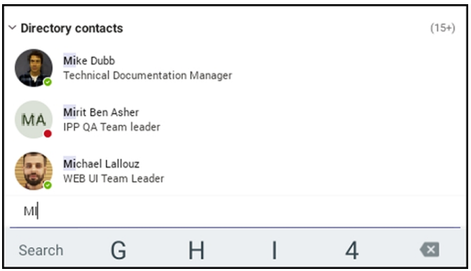
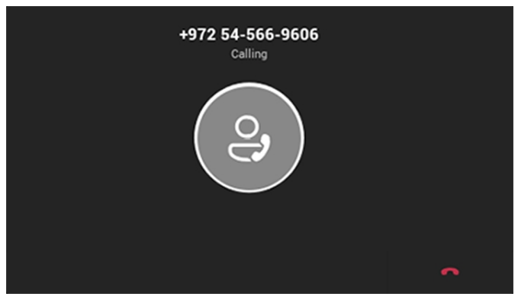
Audiocodes C435 Desk Phone – Call Operations
Making a Call:
Calls can be made in multiple ways:
Press the number keys on the phone’s dial pad to enter the number
In the home screen, press the softkey for Calls then in the Recent screen that opens, you can navigate to a recent call and press the OK button
From the home screen, select People and use a speed dial from there or search people and click to call when you locate the correct person
After dialing a destination number, the phone displays the Calling screen while playing a ring-back tone

Slide 9
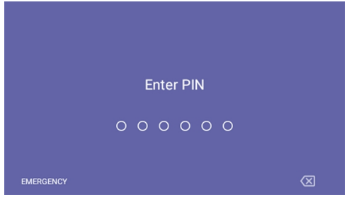
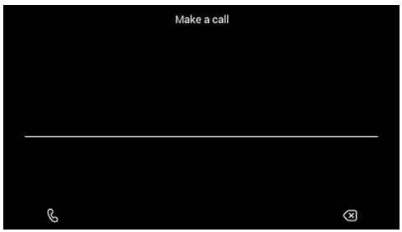
Audiocodes C435 Desk Phone – Call Operations
Make an Emergency Call:
This phone features an emergency call service. The idle lock screen (if enabled) displays and Emergency key.
Select the Emergency softkey shown above and then enter the emergency number.
Answer a Call:
This phone indicates an incoming call by ringing and displaying Caller X is calling you.
The LED located on the upper right corner of the phone flashes, alerting you to the incoming call.
To answer, do one of the following:
  Pick up the handset
  Activate the headset key on the phone (make sure the headset is connected to the phone)
  Activate the speaker key on the phone
  Select the Accept softkey (the speaker is then automatically activated)
End a Call:
To end a call, do one of the following:
  If using the handset, return it to the cradle
  If using the headset, press the Headset key again
  If using the speaker, press the Speaker key again
  Select the End softkey

Slide 10
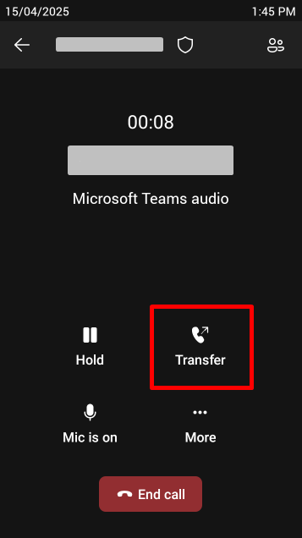
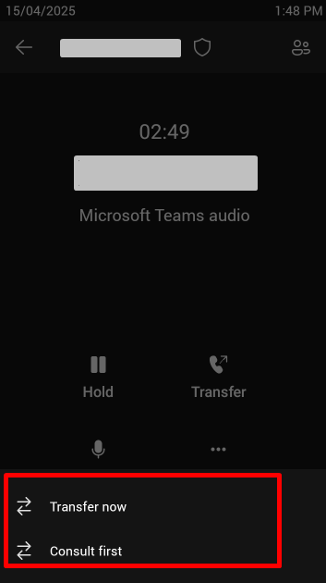
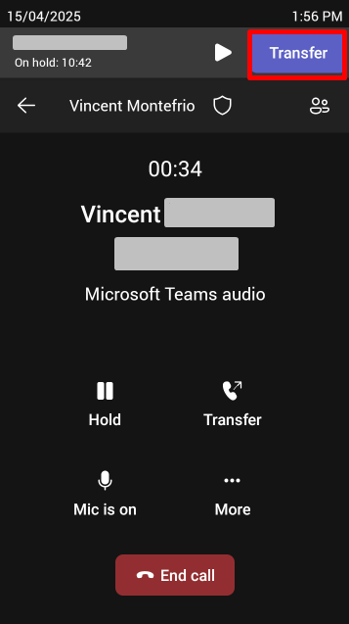
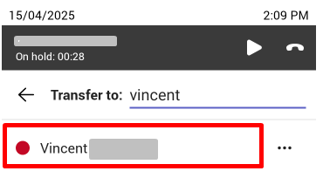
Audiocodes C435 Desk Phone – Transfer Call
When a call comes in, you have the option to transfer it right away or first check with the intended recipient to confirm if they wish to take the call before transferring.
Transfer a call:
During the call, tap the Transfer button on the desk phone or tap Transfer on the display
Choose to Transfer now or Consult first
  Transfer now – This option will transfer the call immediately to the next person upon locating and selecting their name
  Consult First – This option allows the user to speak to the call recipient before completing the transfer. This is helpful if the user wants to inform the recipient of the incoming call to ensure they are available to take it
    While you consult with the intended recipient about whether they want to take the incoming call, the caller will hear hold music and will not be a party to your discussion
Select the recipient of the transfer
  After choosing the transfer type, start typing the name or phone number of the recipient. Select their name or number from the list that appears
Complete the transfer
  If Transfer now was selected, the call will be immediately transferred once the recipient is selected
  If Consult first was selected, after speaking with the recipient, finalize the transfer by tapping the phone’s Transfer button again to complete the transfer
    If the recipient decides to take the call, click the phone icon on the top-right of the screen and then confirm the transfer; the call is then transferred smoothly to the intended recipient
Transfer now experience:
Consult first experience:

Slide 11
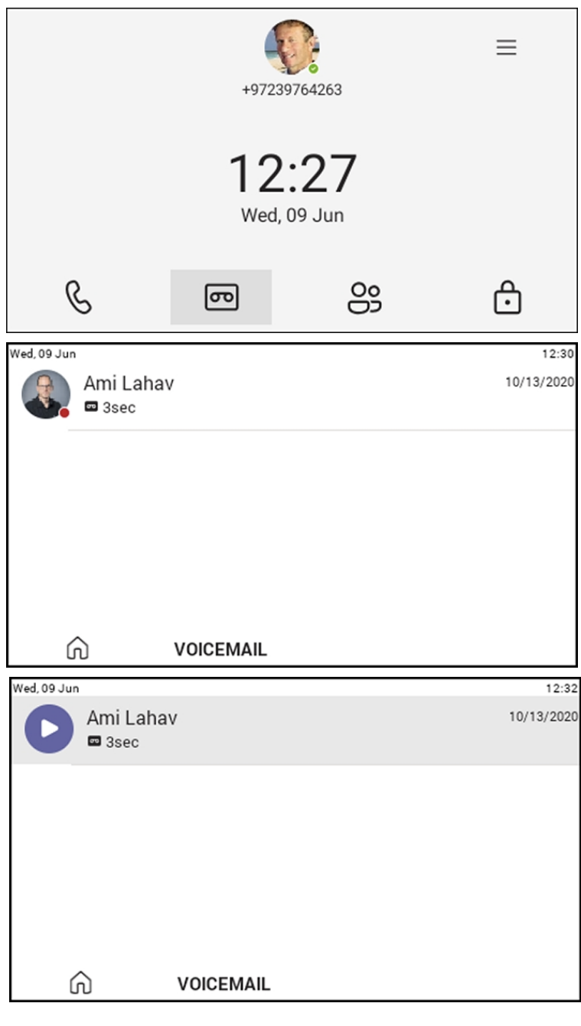
Audiocodes C435 Desk Phone – Voicemail
The following describes how to listen to and manage voicemails through the desk phone.
Step 1: From the phone's home screen, select the Voicemail tab.
Step 2: From the Voicemail home screen, select the voicemail icon and then select the message.

