Slide 1
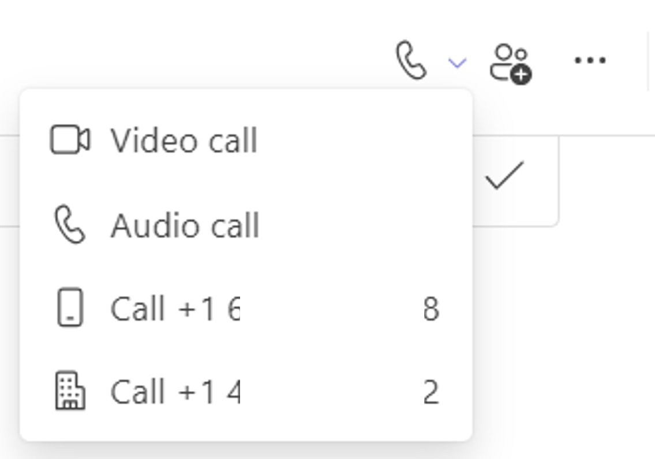
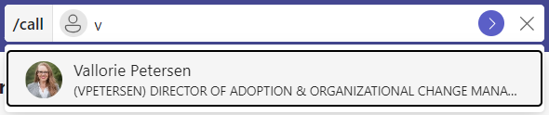
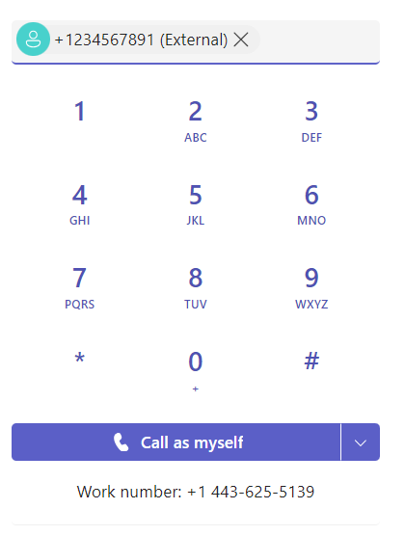
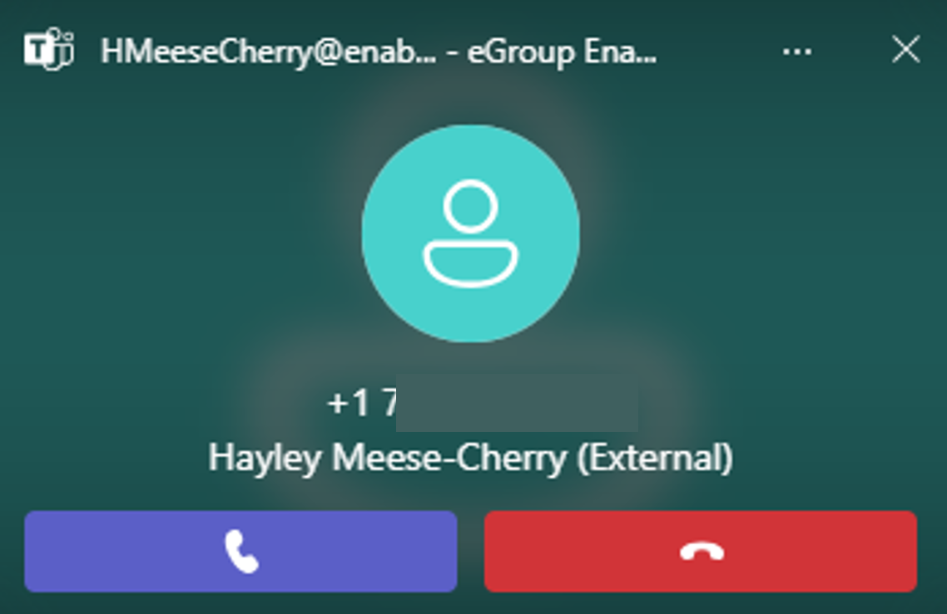
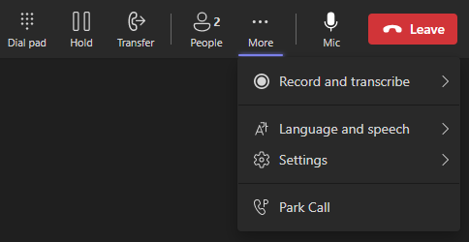
Initiate, Answer, End a Call
Video and audio icons allow you to initiate a call from People with one click.
Escalate any chat to a video or audio call.
Use the /call command from the search field to make a call no matter where you’re working in Teams.
The dial pad feature accepts a phone number that is copied and pasted to initiate a call. You may also click the numbers in the dial pad or type a number using the keyboard.
The Call button becomes active after a valid number has been entered or, if making an internal call, a name has been populated into the selection window.
Answer a call:
A toaster notification appears in the lower right corner of your desktop when a call is incoming. Click on the purple phone icon to answer the call. Pressing the red phone icon will decline the call and send to voicemail, depending on your call answering rules.
End a call:
From an active call, click Leave from the control bar across the top of the call window to end a call.

Slide 2
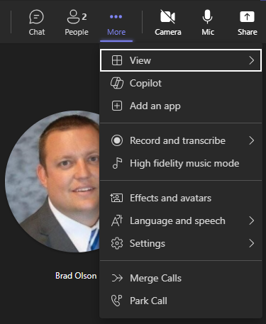
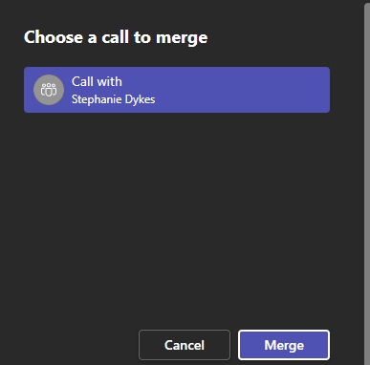
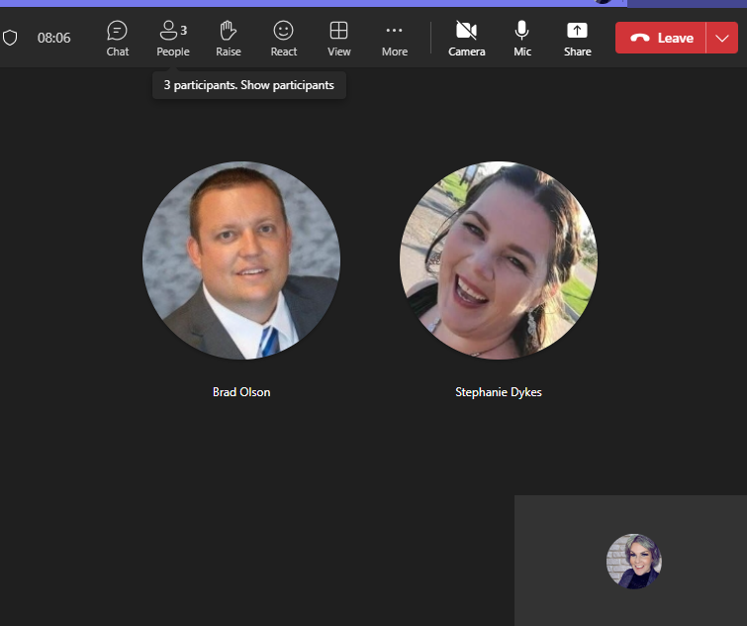
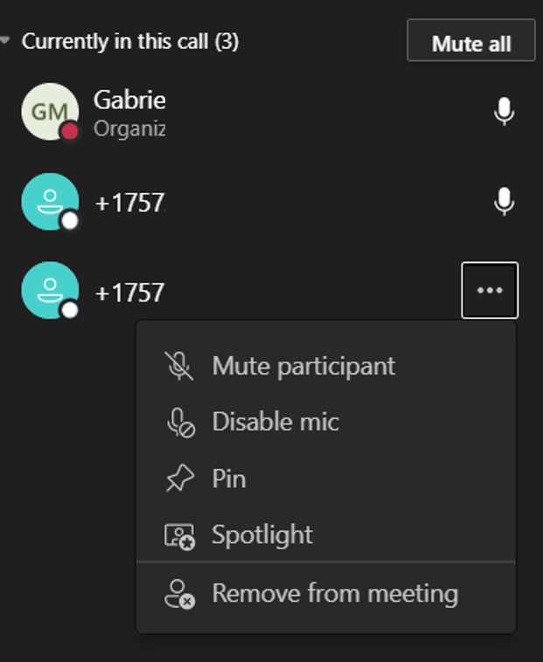
Call Management: Call Merge
When you receive a new call while on a call, or you make a second outgoing call, the Call merge feature allows you to merge the two calls into one.
From the active call, access the ellipsis and select Merge Calls.
Select the other call and click Merge.
When appropriate, you can Leave the call. The other call participants remain connected in the merged call.
Note: When merging two calls together and/or add a new caller to an existing call, the call is elevated to an audio-conference. To remove one of the callers during the call, access the People menu to remove the caller.

Slide 3
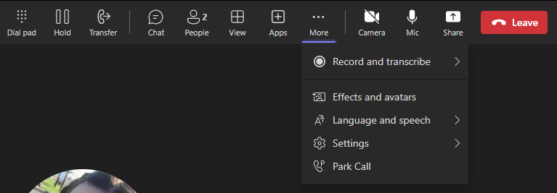

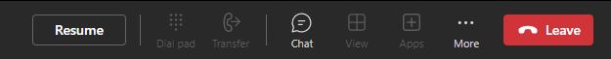
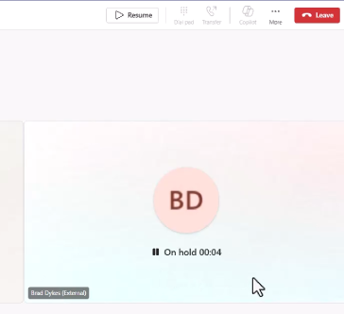
Call Management: Hold
Select Hold from the top control bar.
  Example of Internal Call:
  Example of an External call
A resume button will appear in the control bar when you have placed a call on hold. Tap Resume to retrieve a call.
  Example of an Internal call:
  Example of an External call:

Slide 4
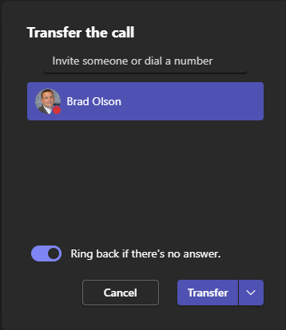
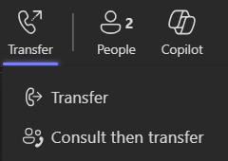

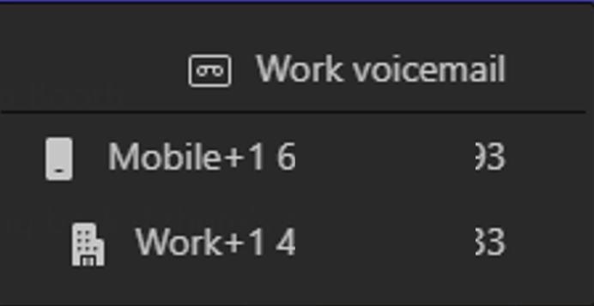
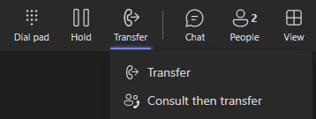
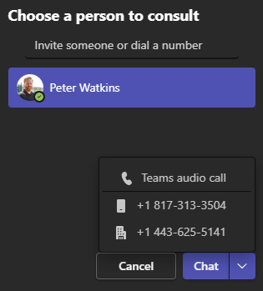
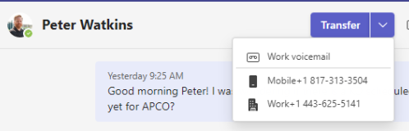
Call Management: Transfer
TRANSFER
Select Transfer from the top control bar, then select Transfer again.
Search for someone by name (if internal) or dial a number to transfer to an external recipient.
Note: Ring back if there’s no answer is only available when transferring the call Teams-to-Teams. This causes a call to ring back to you instead of going to voicemail if the next person doesn’t answer.
Transfer to a recipient’s voicemail or alternative phone number by clicking on the dropdown next to transfer.
CONSULT THEN TRANSFER
Start the process by clicking Transfer in the call window and selecting Consult then transfer.
  Consult then transfer = The user has a chat or a call with the receiving user before sending the caller to their line.
  The caller is automatically place on hold upon clicking Transfer.
Type the number or the name of the intended recipient.
  If internal, click their name when you see it.
Instead of transferring the call, you will select how you wish to consult with the receiving user.
When consulting via chat, you will see a Transfer button and a drop-down arrow to indicate the receiving user’s preference for the transfer to complete the call.
Click Chat to consult via chat.
Click the drop-down arrow to consult on another phone line.

Slide 5
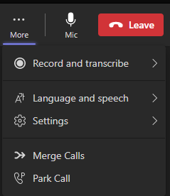
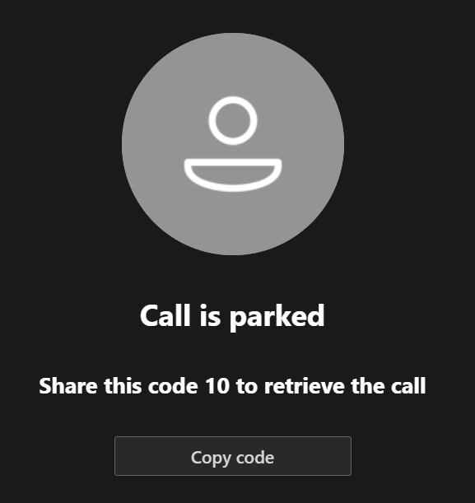
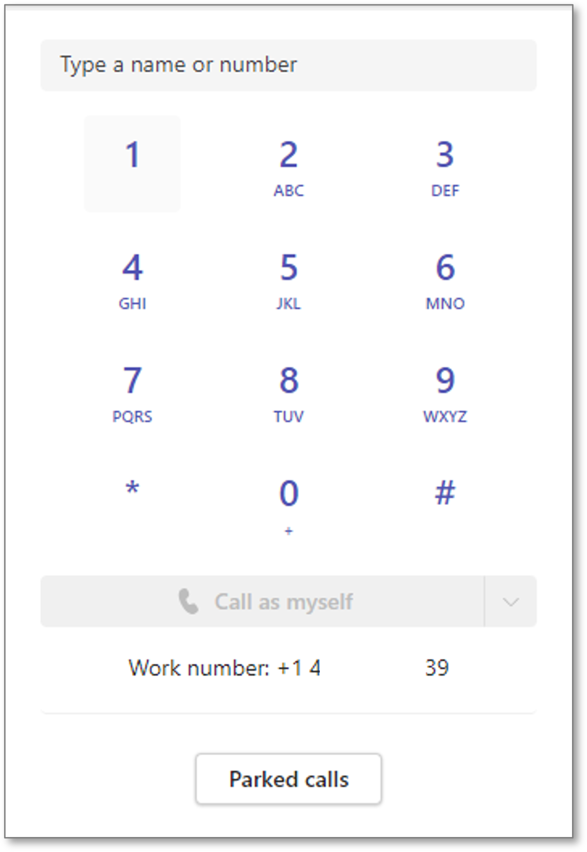
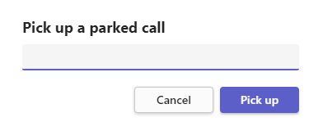
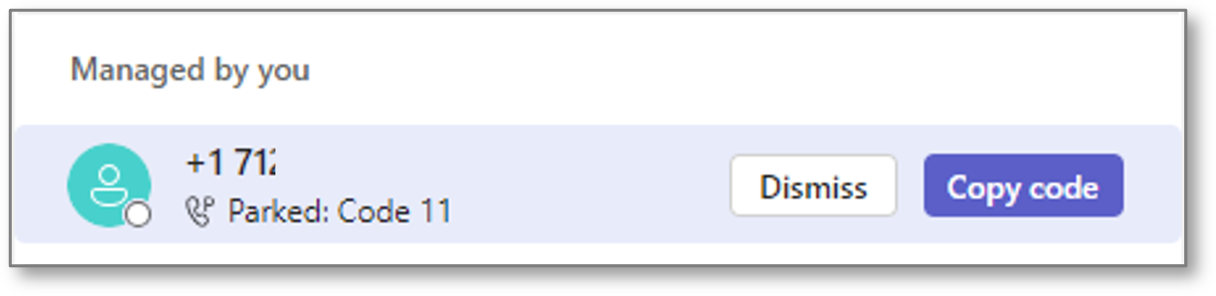
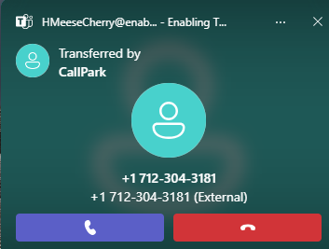
Call Management: Call Park – Teams Desktop
Parking a call puts the call on hold and provides a code to retrieve the call.
TO PARK A CALL
From an active call, select More…
Select Park Call to place the call on hold from one device and retrieve it from another device.
TO RETREIVE A PARKED CALL
In the Calls menu, click Parked calls under the dial pad.
Enter the code and click Pick up. The call window will automatically open, and the call is active.
CALL PARK NOTES
If you forgot the code or to access the parked call, find the call and the Copy code button in your call history.
If a parked call is not retrieved within several minutes, the number calling will ring back to the line that placed it on park.

Slide 6
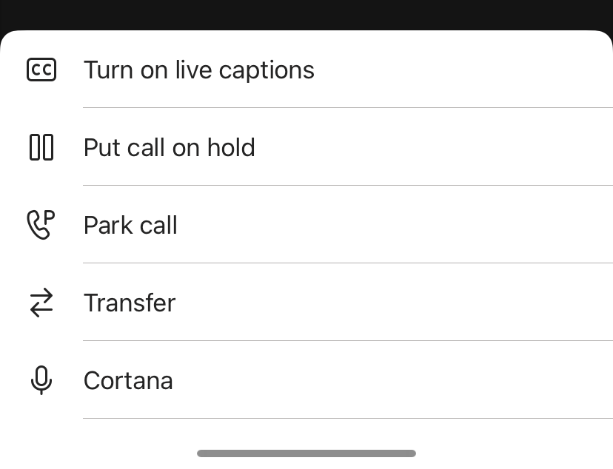
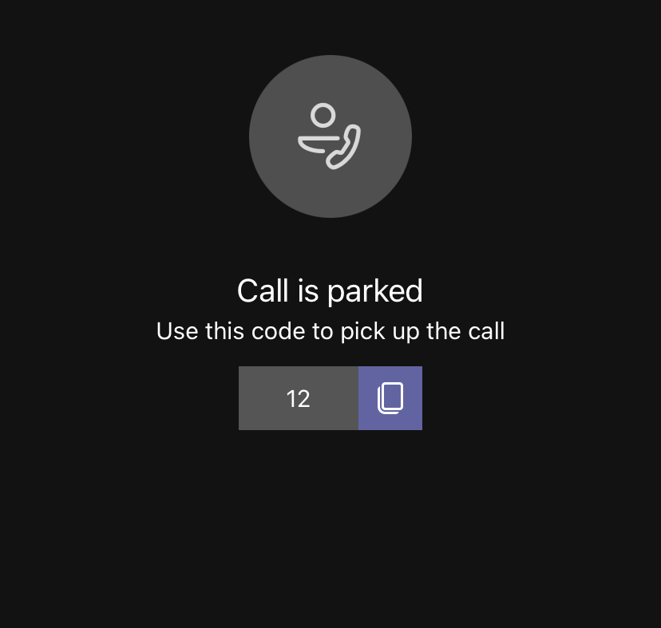
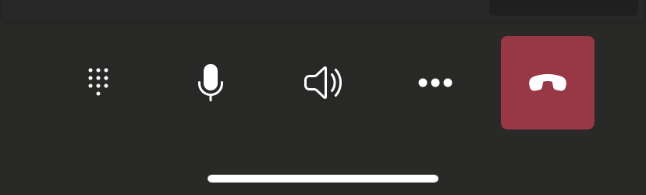
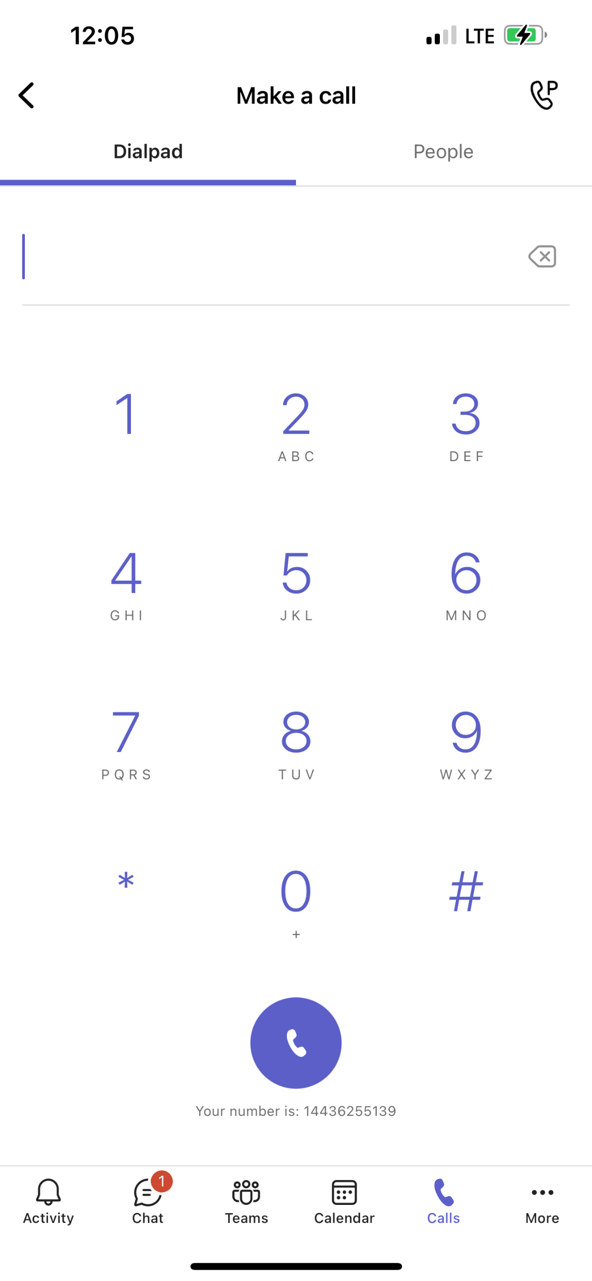
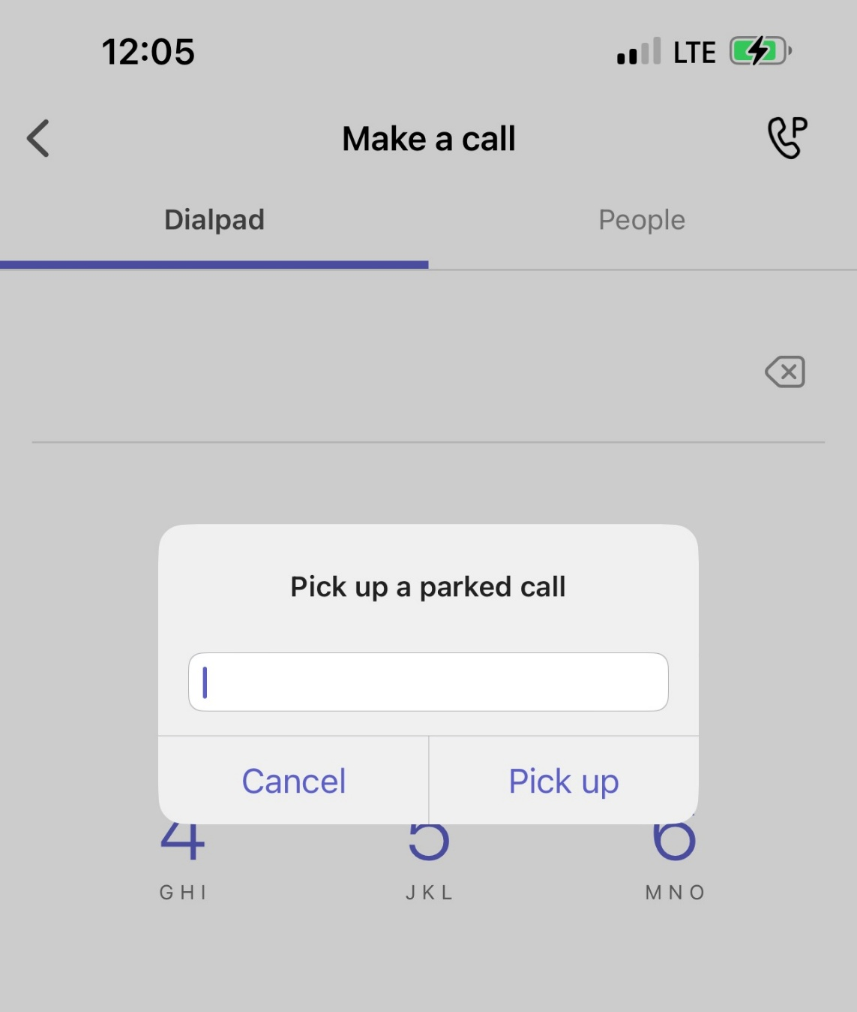
Call Management: Call Park – Teams Mobile App
Parking a call puts the call on hold and provides a code to retrieve the call.
TO PARK A CALL
From an active call, select … (three dots) button at the bottom of the screen.
From the pop-up menu, select Park call. You will receive a confirmation the call is parked and the park code.
TO RETREIVE A PARKED CALL
Within the Calls menu of the app, click the Phone+P icon in the top right corner.
Enter the parked call code when prompted and tap Pick up.
It will appear as if you are making a call, but the parked call will become active on your device.
CALL PARK NOTES
If you forgot the code or to access the parked call, find the call and the Copy code button in your call history.
If a parked call is not picked up within several minutes, the number calling will ring back to the line that placed it on park.

Slide 7


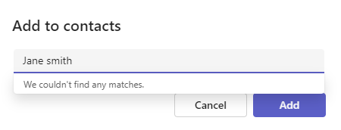
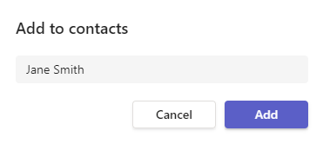
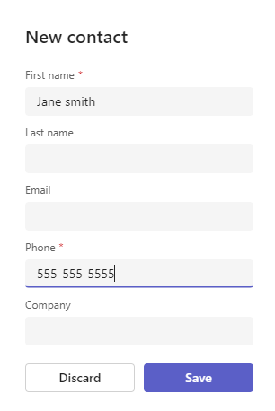
Manage Contacts
Contacts may be managed directly through Microsoft Teams or be imported and managed via Outlook.
To add a contact via Microsoft Teams, navigate to Calls and select View Contacts in the top-right corner or open the People app within Teams.
In the People app, click the Add contact icon.
Teams will attempt to find that name in the directory. If the contact is external, you will receive a message that says We didn’t find any matches.
Simply, bypass this by clicking back into the dialog box and clicking Add.
Continue inputting contact details and click Add when complete.
Note: Contacts added via Outlook must be managed from Outlook. However, contacts added via Teams can be edited and/or deleted from Teams.

Slide 8

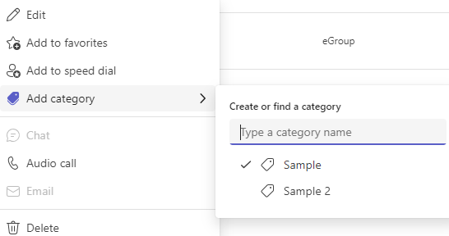
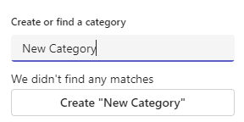
Manage Contacts: Create People Categories
Within the People app, you may create Categories to assign contacts.
Quickly identify everyone on a team or in a department.
Make a list of everyone involved in a project.
Create a new category:
Click the three dots next to any added contact’s name and hover over Add category.
Enter the name of the new category and click Create “new category”
Assign a Contact to a Category:
Click the three dots next to a contact’s name and hover over Add category.
Select the existing category’s name. You’ll see a checkmark for each category they belong to.
Note: Contacts added via Outlook must be managed from Outlook. However, contacts added via Teams can be edited and/or deleted from Teams.

Slide 9
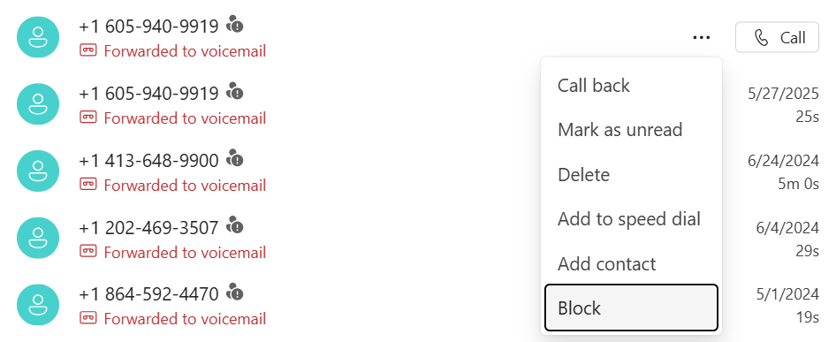
Block Unwanted Calls
In your Call History click the more options menu next to the unwanted call/number and select Block.
Note: You can only block External callers.
The number/caller will be added to your blocked list in Settings.

Slide 10
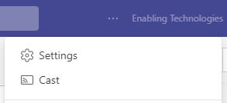
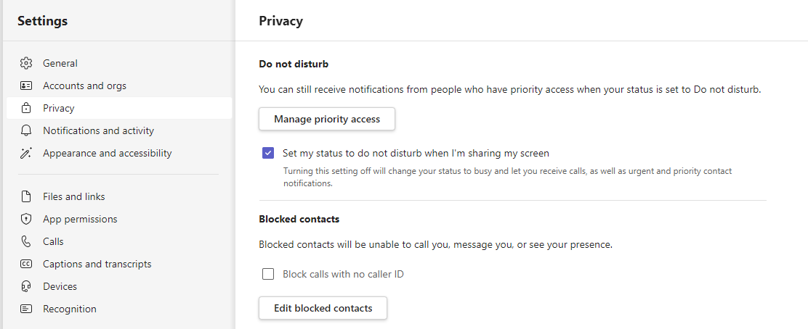
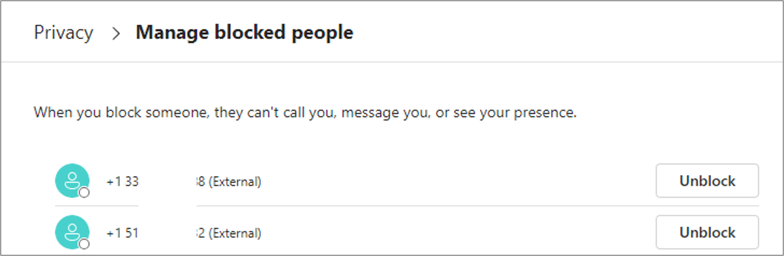
Manage Blocked Numbers
In the top, right corner of your Teams application, click the more options menu and then Settings.
In your settings menu, select Privacy.
To review your blocked contacts, click Edit Blocked Contacts.
To unblock a call/number, simply click Unblock.

Slide 11
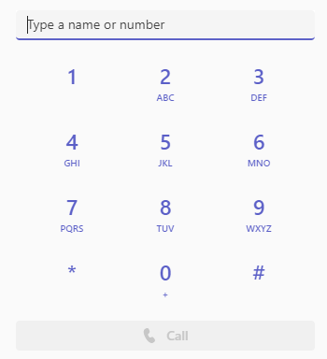
Dialpad
Use the dial pad located in the Calls app to initiate an outbound call. Acceptable entries include:
First and last name for anyone internal to your organization.
Ten-digit phone number, a prefix is never required.
  Phone numbers can be input by keyboard, mouse-clicks, or numbers copied and pasted to the entry field.
  Websites that are enabled with click-to-dial will initiate a call via Microsoft Teams.
A dial pad is also available from an active call. This dial pad is used to respond to automated systems that require key inputs.
Internal Calls (Team to Teams)
External Calls
Note: A dial pad is not be available in a multi-party call.

Slide 12
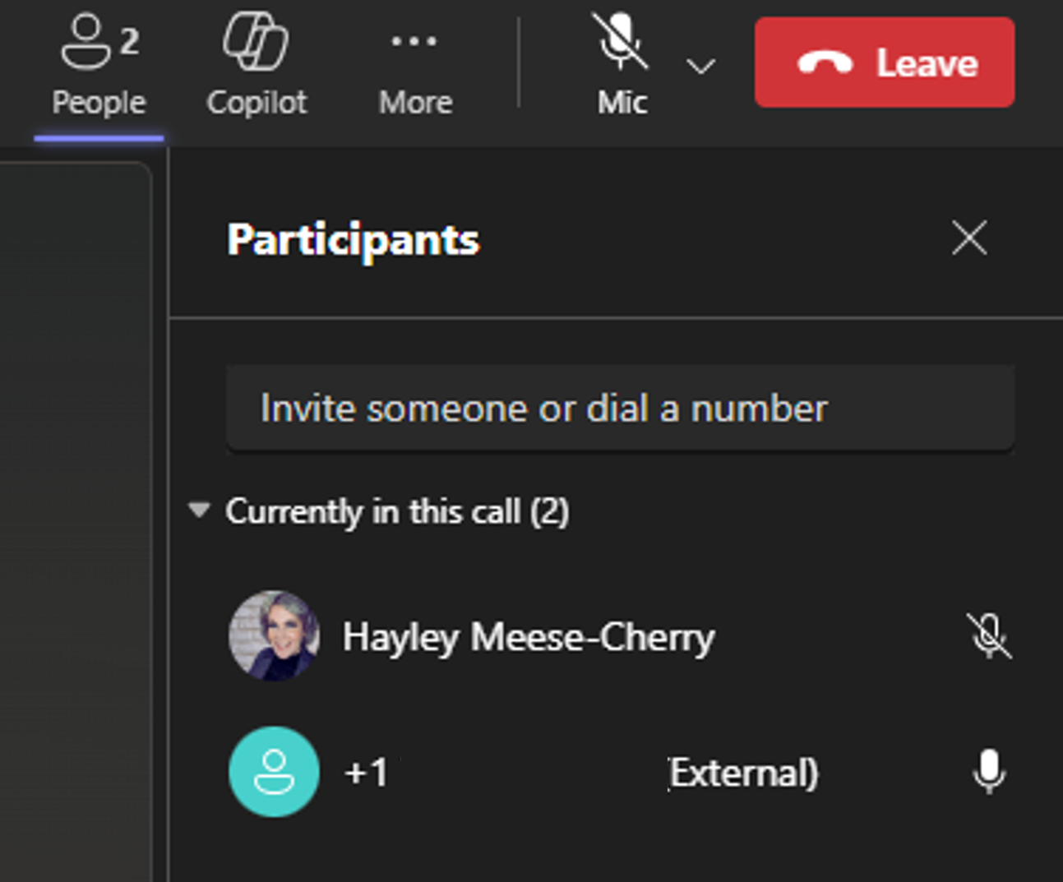
Call Management: Initiate a Multi-Party Call
Click the People icon to add another person to an active call and initiate a multi-party call.
Type (then click on) the name or ten-digit phone number in the Invite someone or dial a number field. This initiates a call that, when accepted, adds the caller to the active call.
Note: Calls are transitioned to a meeting when another party is added to an active call. A dial pad will not be available during a multi-party call.

Slide 13
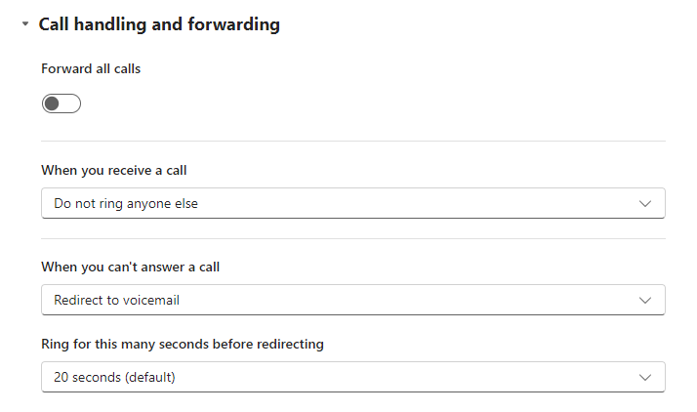
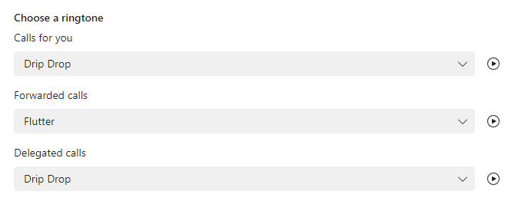
Call Management: Call Answering Rules
Call answering rules are established to determine how to handle incoming calls. Access in the Calls menu inside Team settings.
Forward all calls: To forward your calls, toggle the Forward all calls switch and select from the drop down where they are forwarded.
When you receive a call: You may designate where a call should ring when it’s coming in.
When you can’t answer a call: You may designate what should happen when you do not answer a call.
Ring for this many seconds before redirecting: You may designate how long your calls should ring before redirecting to your designated preference. Each ring = 5 seconds.
Choose a ringtone: You may select a unique ring tone for calls for you, forwarded calls, and delegated calls.

Slide 14
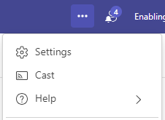
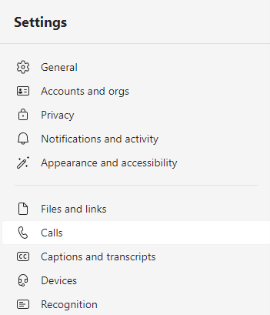
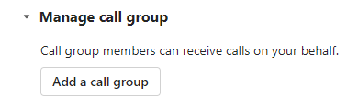
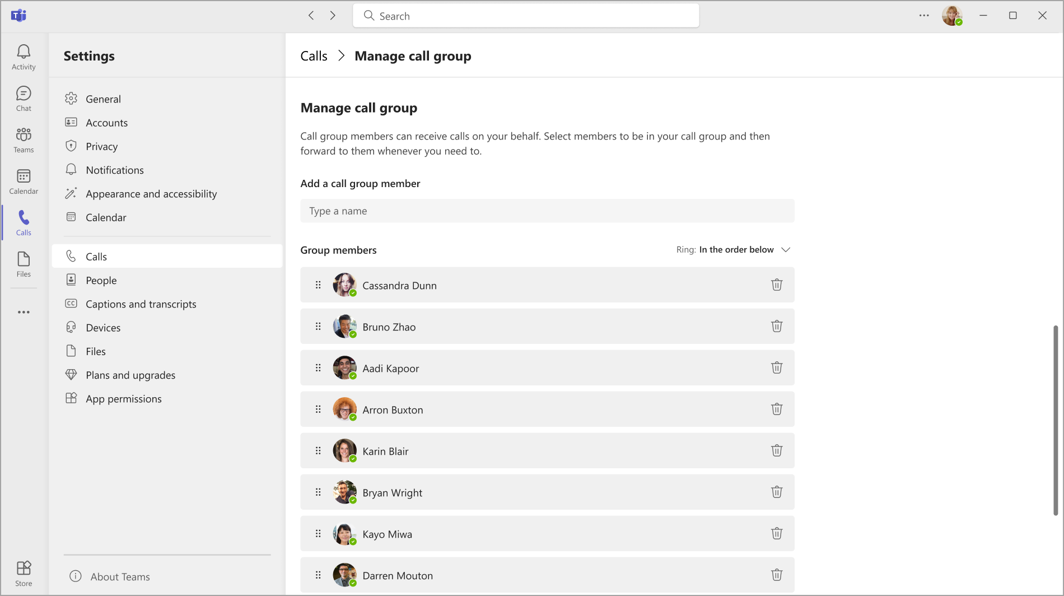
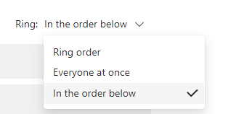
Call Management: Call Groups
Call Groups let users share their incoming calls with colleagues so they can answer calls that occur when the user is unavailable.
Once created, users may use forwarding instructions to have calls forwarded to the call group or have incoming calls ring the call group at the same time as their own line.
Click on Settings and more, then Settings.
Click the Calls menu, scroll down to the Manage call group section, and click the Add a call group button.
Begin typing the names of those to be in the call group and select as the names appear.
Designate the Ring order:
  Call groups of 5 or less people: May designate as Everyone at once or In the order below.
  Call groups of 6-25 members: May only be Everyone at once.
Group call pickup is less disruptive than other forms of call forwarding. Recipients can choose how to be notified of an incoming call in their settings and decide whether to answer it.

Slide 15
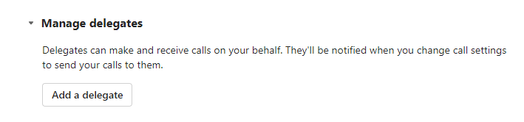
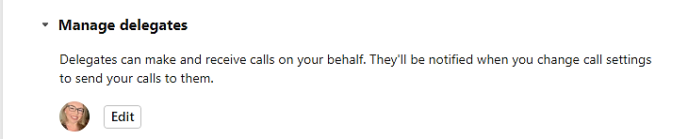
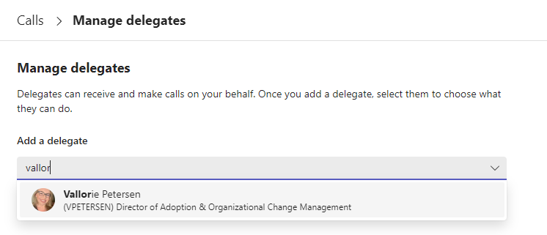


Delegate Settings: Assign a Delegate
Assign delegate permissions to another person to enable them to make and receive calls on your behalf. Permissions can also be assigned to allow a delegate to change your call and delegate settings.
Click Settings and more, then Settings.
Click Calls and scroll to the Manage delegates section.
When adding your first delegate, click Add a delegate.
When adding more delegates, click Edit.
Begin typing the name of your delegate and click their name when it displays.
Select the appropriate permissions.
  The recipient will be notified via chat that they have been added as a delegate:

Slide 16


Delegate Settings: Delegate Duties
When someone else has added you as a delegate, depending on the granted permissions, you may update their call settings as needed.
To access their call settings, click Settings and more, then Settings.
Click Calls. Once on the Calls menu, select Personal with your Teams icon, plus the name and Teams icon of anyone you are a delegate.
Click on the delegator you wish to manage and update their settings as appropriate and as you have access.

Slide 17





Location Services: E911 Location Setting (pt. 1)
To support secure, remote work Microsoft has a location feature in Teams.
Adding or confirming your location in Teams is designed to get the fastest emergency response when you dial 911 while working remotely.
On the bottom left of the Calls menu, below your dial pad, locate and select the option referring to location. You will see one of the following three options:
An address
Location not detected
No item referring to location at all.
If you do not see anything referring to location, please contact IT.
Click the dropdown next to the location option (showing an address or “location not detected”) and select edit or add to manually confirm address (do this even if address is correct).
Experience when an address is listed.
Experience when “location not detected”.

Slide 18





Location Services: E911 Location Setting (pt. 2)
To support secure, remote work Microsoft has a location feature in Teams.
Adding or confirming your location in Teams is designed to get the fastest emergency response when you dial 911 while working remotely.
Click the Search for a location field and type your physical address.
  When your address populates, select it and Confirm.
Add floor and/or unit numbers if it applies to your address.
If your address does not populate, click Enter address manually.
  Once all information is entered, click Add.
Add a floor and/or unit number if it applies to your address.

Slide 19


Voicemail Configuration
Configure your voicemail settings in Settings and more → Settings → Calls.
Record a custom greeting: Allows you to record your own voice to play when callers reach your voicemail.
Choose a language for your default greeting: If you do not create any voicemail settings, an automated message will play in the language you select.
Choose what happens when the call is redirected to voicemail: Designate the caller’s experience when reaching your voicemail.
Set up text-to-speech customized greeting option: Indicate what the automated message should read instead of the standard message.
Manage out-of-office email: Indicate what the automated message should read instead of the standard message when you are out of the office as well as when the out-of-office text-to-speech should be read instead of your standard voicemail greeting.

Slide 20





Voicemail Management
Voicemails received are stored in the Calls app in Teams.
From the History section, select Voicemail to see a list of your message.
Click a message to populate more information in the Details pane, including information about and ways to contact the sender, a transcript, and options to play, speed up, or pause the playback.
When hovering over the voicemail line under History, from the More options menu, you may also return the call, initiate a chat (if internal caller), manage the message, or add the caller to your contacts.
A copy of each voicemail is also sent to Outlook. Open the Outlook message to read or listen to your voicemails.

Slide 21



Call Recording and Transcription
Record and transcribe one-to-one internal and external calls.
Click the More… button.
Hover over Record and transcribe.
Select Start recording to record content, video, and audio (transcription will automatically begin, unless disabled by admin), or Start transcription.
When the call includes an external caller, an automated audio message plays, “This call is being recorded.”
When the recording stops, another message plays notifying that the call is no longer being recorded.
TO REVIEW A CALL RECORDING OR TRANSCRIPTION
Once the call has ended, the recording and transcript are available from History in the Calls app in Teams.
The Recording and Transcription icons display in the call record indicating the call was recorded and/or transcribed.
Select a recorded call from History to view the Details pane containing the call recording and transcript.

Slide 22








Shared Lines & Call Queues
Microsoft Teams supports functionality for shared lines, call queues, and auto attendant lines. Configuration of this function is owned by IT support staff.
To help differentiate between calls to you directly or calls coming from a shared line or call queue, Teams will display a note on the pop-up banner indicating the source of the call.
This allows you to answer the call using the appropriate greeting.
In your call history, you will see activity for calls associated with your personal number as well as those associated with any call queue or shared line you support.
The line below the person’s name or number indicates the shared line the call came from.
If you see no shared line name, that call was associated with our direct number.
Logging In & Out
When you are a member of a call queue or shared line, you may need to sign in and out of that phone line, based on your schedule.
Option 1:
Click the Settings and more menu at the top of Teams, then click Settings.
Select Calls, then click into the shared line name at the top of the screen and toggle the switch on or off to receive calls.
If your line is not using a voice-enabled channel, this is your only method to sign in and out of the line.
Option 2:
If your shared line is using a voice-enabled channel, you may also go to the Calls tab within the channel for that line and use the toggle switch located under the dial pad.
  Toggling in and out of the queue in Settings (Option 1) will also toggle you within the voice-enabled channel, and vice versa.

Slide 23
Logging In & Out of Shared Lines & Call Queues
When you are a member of a call queue or shared line, you may need to sign in and out of that phone line, based on your schedule.
Option 1:
Click the Settings and more menu at the top of Teams, then click Settings.
Select Calls, then click the shared line name at the top of the screen and toggle the switch on or off to receive calls.
When your line is not using a voice-enabled channel, this is your only method to sign in and out of the line.
Option 2:
When your shared line is using a voice-enabled channel, you may also go to the Calls tab within the channel for that line and use the toggle switch located under the dial pad.
  Toggling in and out of the queue in Settings (Option 1) will also toggle you within the voice-enabled channel, and vice versa.

Slide 24

Voice Enabled Channel
A voice enabled channel connects a Teams channel with a specific call queue, shared line, or auto attendant line.
To access the voice-enabled channel, locate the team associated with the queue, then the voice-enabled channel within that team.
Click to the Calls tab to find call history, a dial pad, a toggle in and out switch, and a listing of agents associated with the queue.
Within a voice-enabled channel, you can:
Sign in and out of the shared line.
View call history of the calls you serviced from the shared line.
View and listen to voicemail left for the shared line.
View other members of the shared line and their current status.
Place outgoing calls as yourself or as the shared line number if required.

Slide 25



Voice Enabled Channel – Adding a Member
As a Team Owner of a Voice Enabled Channel, you can add members to your Team. Adding members to the Voice Enabled Channel automatically adds the user to the call queue as well.
Click on the ellipsis to the right of the Team you’d like to add a member to.
Select Add member.
Start typing the name of the individual you would like to add, select them and click Add.
When complete, click Close.
Next to the person’s name, click member, and choose if you would like that person to be a member or owner.

Slide 26



Shared Voicemail in Outlook
When a main line or call queue, you are a member has an associated voicemail, you are automatically added to a new group in Outlook.
If the call queue/shared line you support does not use a voice-enabled channel in Teams, you will only access the voicemail via the group mailbox in Outlook, and all members of the call queue will have access.
In the Groups section of Outlook, click the group name that matches the name of the call queue.
Voicemail-related emails will contain a printed transcript and an MP3 attachment of the voicemail that you can click to play.
Best Practice: For shared voicemail, we recommend building a process to determine who is responsible for reviewing and/or managing voicemail. If the message is for a specific person, the email can be forwarded to their email address, which gives them the audio recording.

Slide 27


Shared Voicemail in Teams
If the call queue you support uses a voice-enabled channel and has an associated voicemail, all queue members can review and manage voicemail via the group mailbox in Outlook and directly within the voice-enabled channel in Teams.
Go to the voice-enabled channel in Teams and locate the voicemail in the History section or by clicking on Voicemail to filter only that activity.
You will see who called, the opening transcription of the call, and the time of the call.
To listen, click the voicemail to open the Details pane on the right.
Here, you can:
  View details about the caller and their contact options
  Send a message via Teams
  Read the transcript
  Play or speed up the message
Best Practice: If you work with others to manage a shared voicemail, it is recommended to create a business process to indicate when a team member has reviewed and responded to a voicemail. Marking the message as read/unread will not be visible to others accessing the shared voicemail.
We recommend assigning and scheduling shared voicemail response duty, to eliminate multiple people responding to the same voicemail.

